Slide 1

IGI Business Overview

Slide 2
Cautionary Note Regarding Forward-Looking Statements
This information contains forward-looking statements that are based upon current expectations or beliefs, as well as a number of assumptions about future events. Although we believe that the expectations reflected in the forward-looking statements and the assumptions upon which they are based are reasonable, we can give no assurance or guarantee that such expectations and assumptions will prove to have been correct. Forward-looking statements are generally identifiable by the use of words like "may," "will," "should," "could," "expect," "anticipate," "estimate," "believe," "intend," or "project" or the negative of these words or other variations on these words or comparable terminology. The reader is cautioned not to put undue reliance on these forward-looking statements, as these statements are subject to numerous factors and uncertainties, including but not limited to: COVID, the ability of our products and services to detect and prevent cybersecurity threats, our ability to maintain our listing on the OTCQB Market, our ability to maintain and expand our business partnerships, adverse economic conditions, competition, federal, state and local government regulation, international governmental regulation, inadequate capital, inability to carry out research, development and commercialization plans, loss or retirement of key executives and other specific risks, including those discussed under the heading “Risk Factors” in our Annual Reports and Quarterly Reports filed with the Securities and Exchange Commission. To the extent that statements in this document are not strictly historical, including statements as to revenue projections, business strategy, outlook, objectives, future milestones, plans, intentions, goals, future financial conditions, events conditioned on stockholder or other approval, or otherwise as to future events, such statements are forward-looking, and are made pursuant to the safe harbor provisions of the Private Securities Litigation Reform Act of 1995. The forward-looking statements contained in this document are subject to certain risks and uncertainties that could cause actual results to differ materially from the statements made. Readers are advised to review our filings with the Securities and Exchange Commission that can be accessed over the Internet at the SEC's website located at http://www.sec.gov, as well as IMCI's website located at http://www.igicybersecurity.com.

Slide 3
About IGI
Cybersecurity company uniquely positioned with recurring revenue in Professional Services and SaaS platforms
Public holding company structure (OTCQB:IMCI)
IGI Cybersecurity
IGI CyberLabs
Highly developed channel structure in place
SMB to mid-size enterprise customers across North America
Focused on increasing shareholder value and profitability
Strategic plan for mid-market roll-up of cybersecurity companies
Notes:
Created wholly owned business (CL) to focus on saas software that is much higher market value than services
; such as Nodeware®
Profitable
Highly focused management team driven by

Slide 4

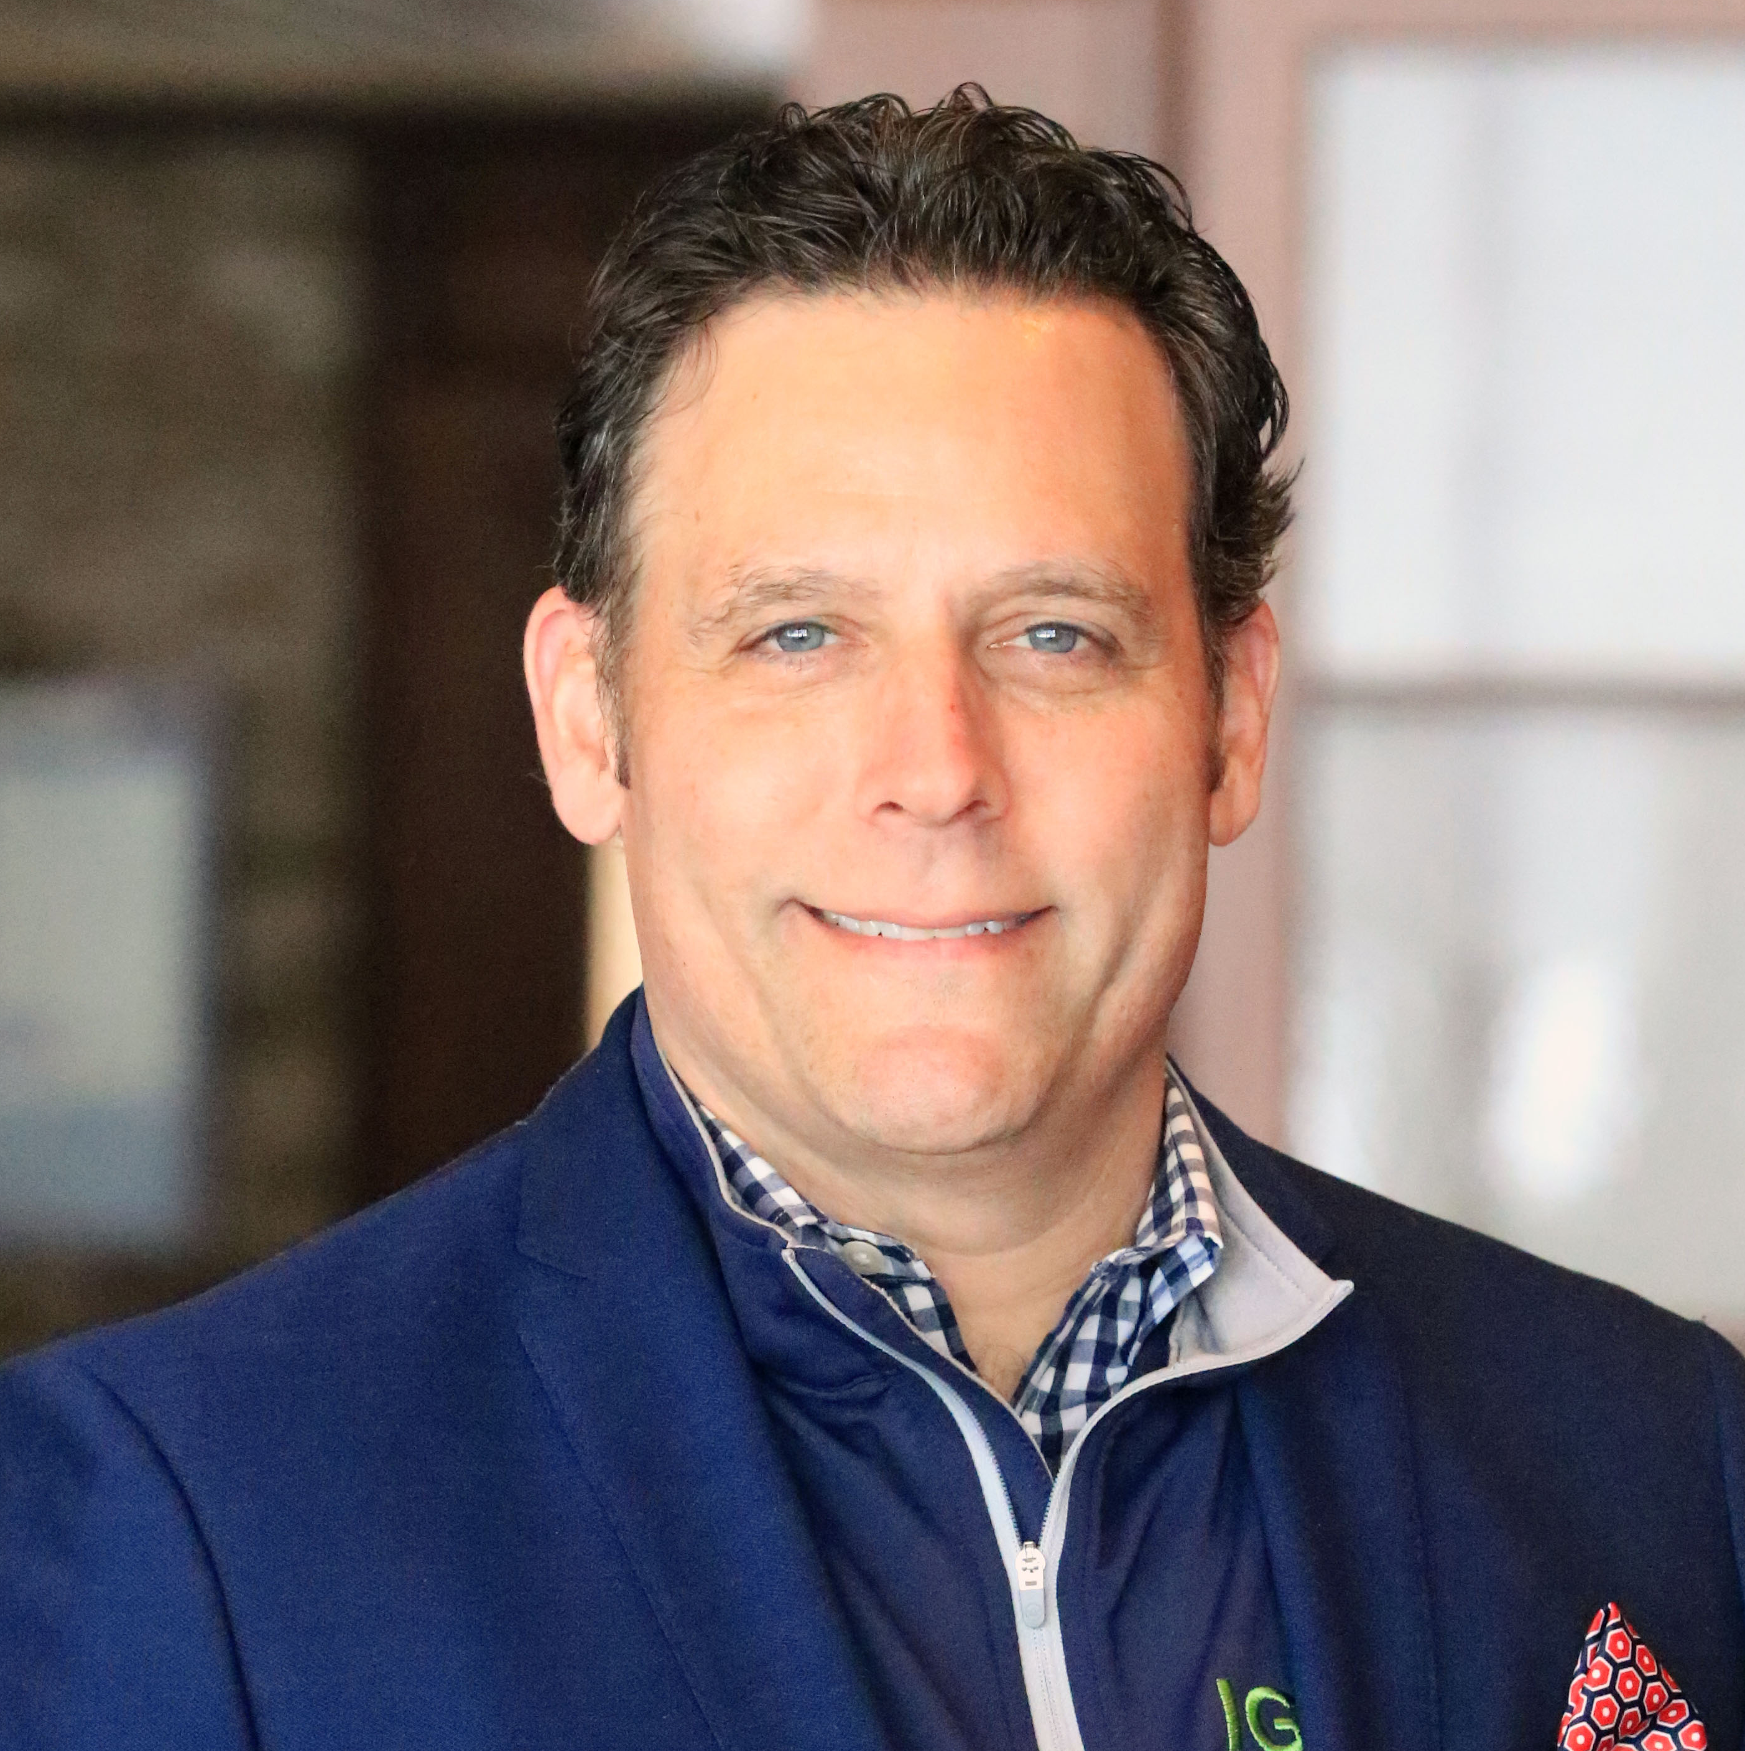

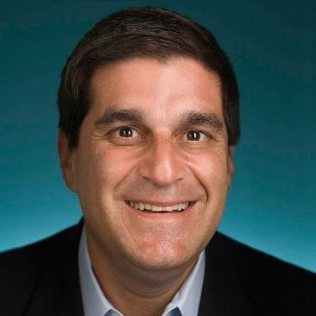
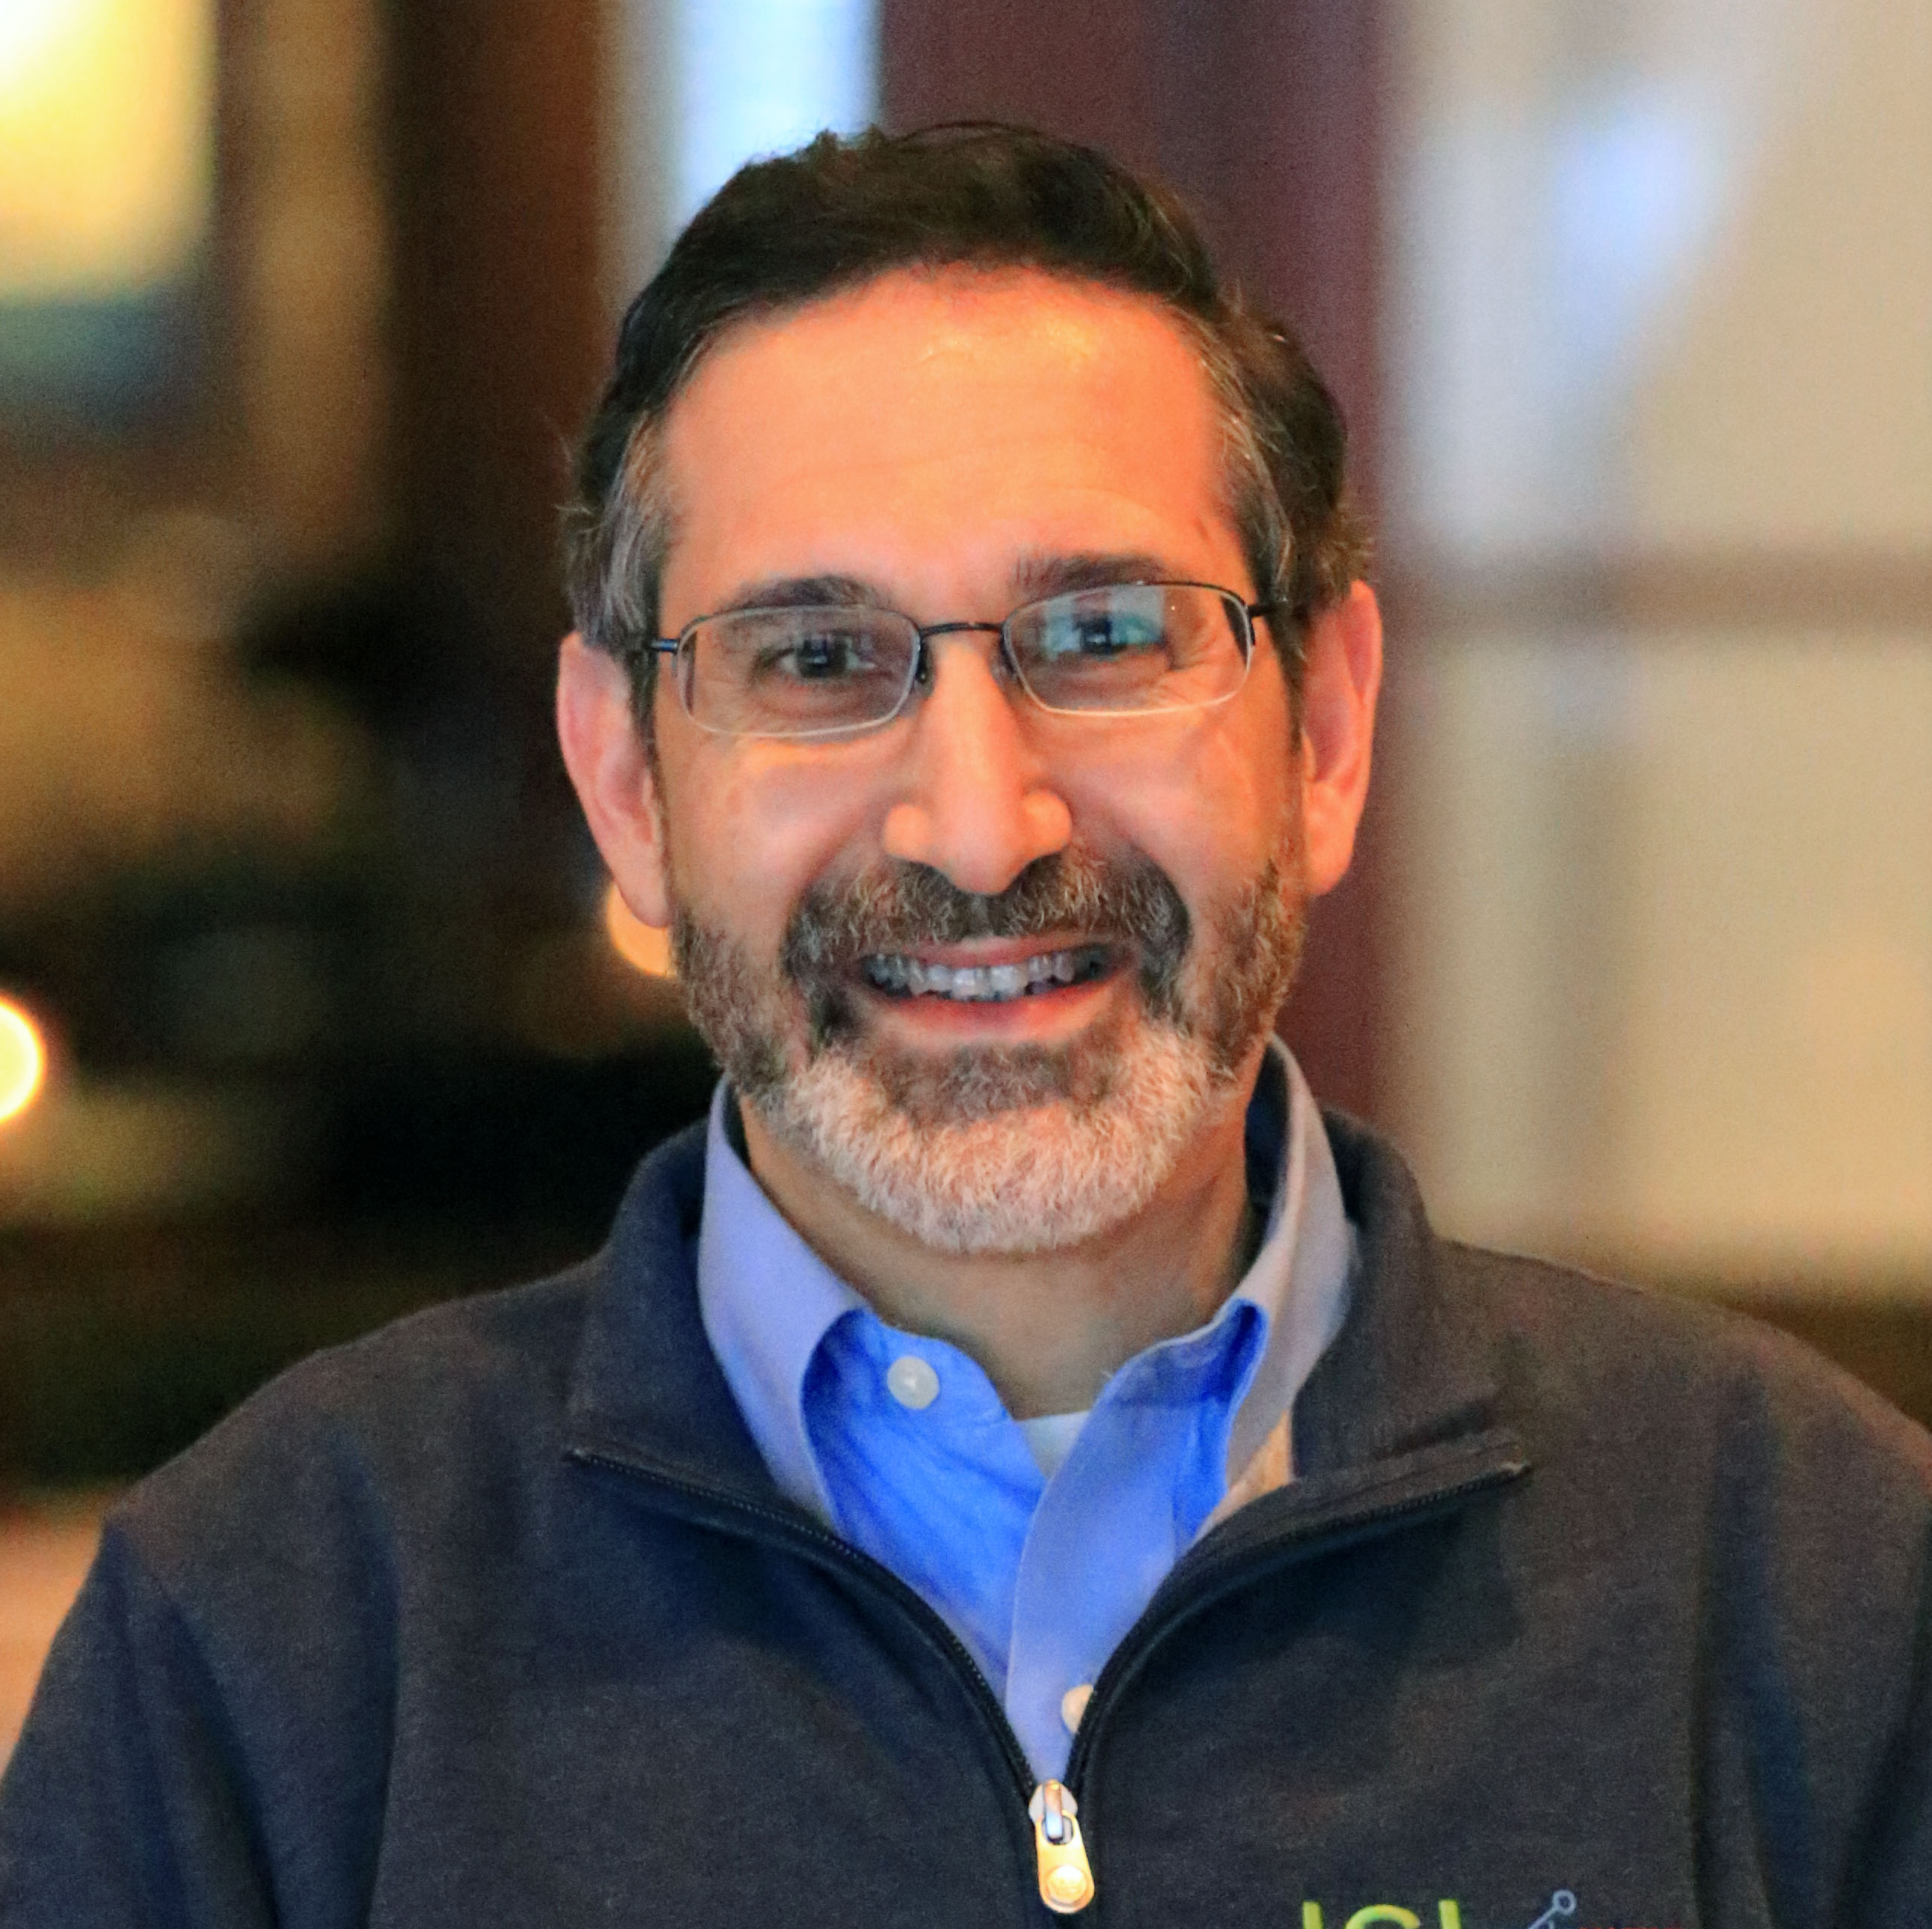
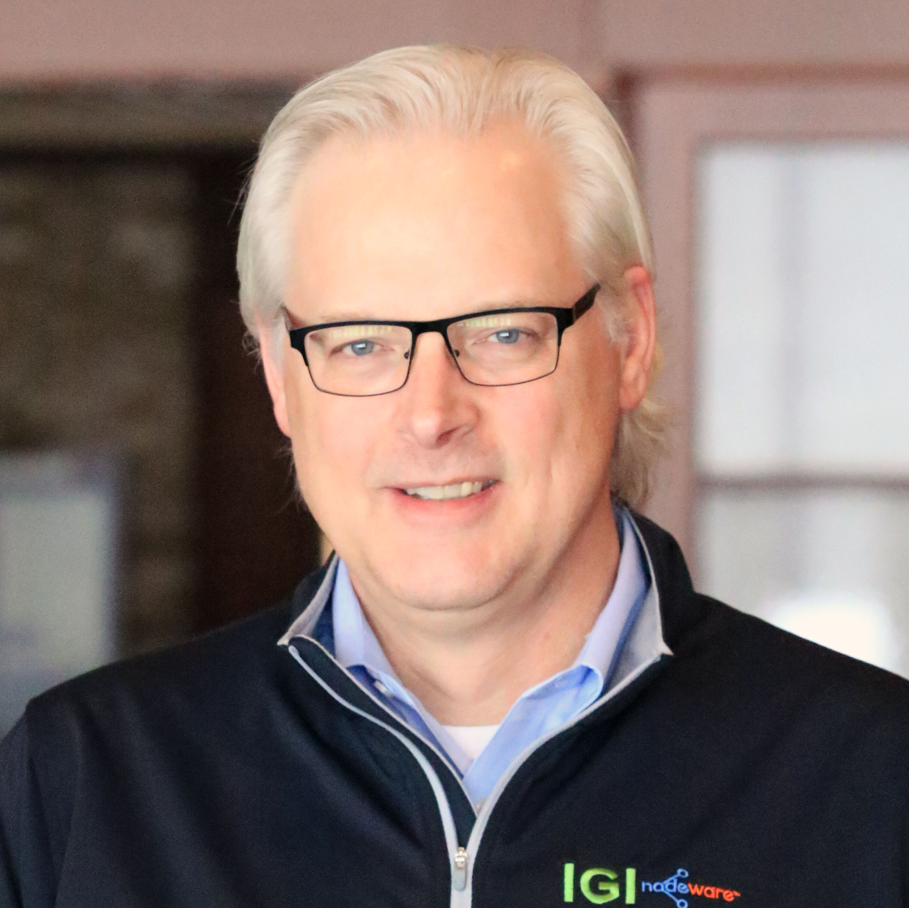
IGI Leadership Team
James Villa, CEO, Board Member
Jim serves as Chief Executive Officer and is on the Board of Directors of IGI. Jim has over 30 years of professional experience investing, raising capital, and consulting with a variety of public and privately held organizations.
Andrew Hoyen, President/COO, Board Member
Andrew serves as President & COO and is on the Board of Directors of IGI. He brings over 25 years of experience from a variety of executive roles at Fortune 100 companies like Eastman Kodak, Carestream, and Toyota.
Rich Glickman, VP, Finance & CAO
Rich’s background in finance and accounting spans over 30 years at various private and publicly held companies. His primary responsibilities include accounting, financial reporting, financial analyses, and various special projects.
Stuart Cohen, President, IGI CyberLabs
Stuart brings 35 years of industry experience in high tech, open source, and cybersecurity collaboration. As the Founder of The Cybersecurity Collaborative and a former VP at the CyberRisk Alliance & IBM, Stuart brings a wealth of knowledge to IGI’s cybersecurity software and SaaS focused subsidiary.
Rich Popper, VP, Business Development
Rich brings over 30 years of experience in technology in executive roles that encompass business & channel development, operations, M&A and software product management.
Chad Walter, VP, Sales & Marketing
Chad brings over 25 years of leadership in cybersecurity sales, marketing, and business development to his role at IGI. His vast knowledge of all the areas related to technology and cybersecurity provide the leadership necessary to drive outcomes.
Notes:
Need to add new photos in here for people

Slide 5
Market and Competitive Landscape
Cybersecurity is a vastly expanding industry that has grown from a $3.5B market in 2004 to what is forecasted to be a $170B market by 2022
Increased tech; shift to the cloud; and work from anywhere have increased the attack surface significantly​
Continued shifts to remote work and the cloud are playing an outsized role.​
  McKinsey found that the pandemic accelerated the pace of digital transformation by seven years​
  Gartner predicts 70% of all enterprise workloads will be deployed in the cloud by 2023, up from 40% in 2020​
  Worldwide public cloud services are predicted to grow from $387.7 billion in 2021 to $805.5 billion in 2025, according to Gartner​
Per Gartner, 61% of CIOs surveyed plan to increase security spending in 2021.​
  Fueled by increasing compliance to regulations at the state, national, and international levels​
Over 60% of all breaches are in the SME market​
Gartner predicts that 75% of all spending for security software and hardware will be spent on security outsourcing services. ​
Vulnerability management SaaS competition​
  Expensive, hard to use and many are not 24x7 solutions​
  Fragmented competitive supplier base​
  National firms tend to offer only off the shelf solutions
Notes:
I would pull slides from some of the decks we got from BTB or Pratum for market perspective and stats

Slide 6
IGI CyberLabs
Develop and market cybersecurity solutions that address customers’ needs and fill technology gaps
Innovators
  Our people take bold ideas and then build them, so organizations can save time and money, and ultimately be better protected
Product Development and Deployment
  Continuously evaluating the market for gaps or enhanced solutions to develop
Aggregators
  Continuously developing solutions that fit into the cybersecurity technology stack

Slide 7
IGI CyberLabs
Why CyberLabs?
Why Nodeware®?
Wholly-owned subsidiary of IGI
Uniquely positioned with patented SaaS platform
  Additional IP portfolio being developed
Channel relationships - Telarus, SYNNEX, Staples, Perspecta
In house & domestic development teams
Key team members have significant M&A experience
Patented Nodeware SaaS platform is just the beginning of the cyber software solutions our people are working on for the benefit of the masses
Sell Nodeware as stand-alone, part of cyber services engagement, or integrate with third party security platforms for broader reach
Nodeware was developed by cybersecurity practitioners and combines new device recognition with vulnerability scanning
It enables businesses to easily monitor their network, identify security gaps, and access detailed reports in order to achieve security compliance and protect their networks

Slide 8
SMB’s: Under Attack & Underserved
IBM: Cost of data breaches hit 17-year high
  Data breaches cost companies an estimated $4.24 million per incident on average — a 17-year high, according to a Wednesday report from IBM
  Cybercrime costs small and medium businesses on average $2.2 million a year
There was a 424% increase in new small business cyber breaches in 2020
  43% of cyber attacks target small businesses
  60% of small businesses that are victims of a cyber attack go out of business within six months
14% of small businesses rate their ability to mitigate cyber risks and attacks as highly effective

Slide 9








Nodeware® SaaS Vulnerability Management
Scan during normal business hours with no impact to the network
New device recognition and alerts
Patented & developed by cybersecurity practitioners
Quick and easy software installation with integration options
Simple and easy to use for MSPs or IT Admins; no security certification required
Provides MRR and easy to bundle with services
Scalable across multiple networks and customers
Ability for MSPs to manage multiple customer environments in single pane of glass

Slide 10
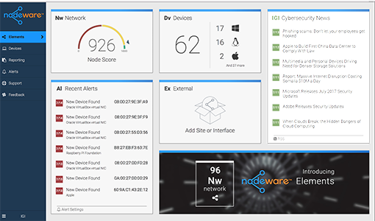


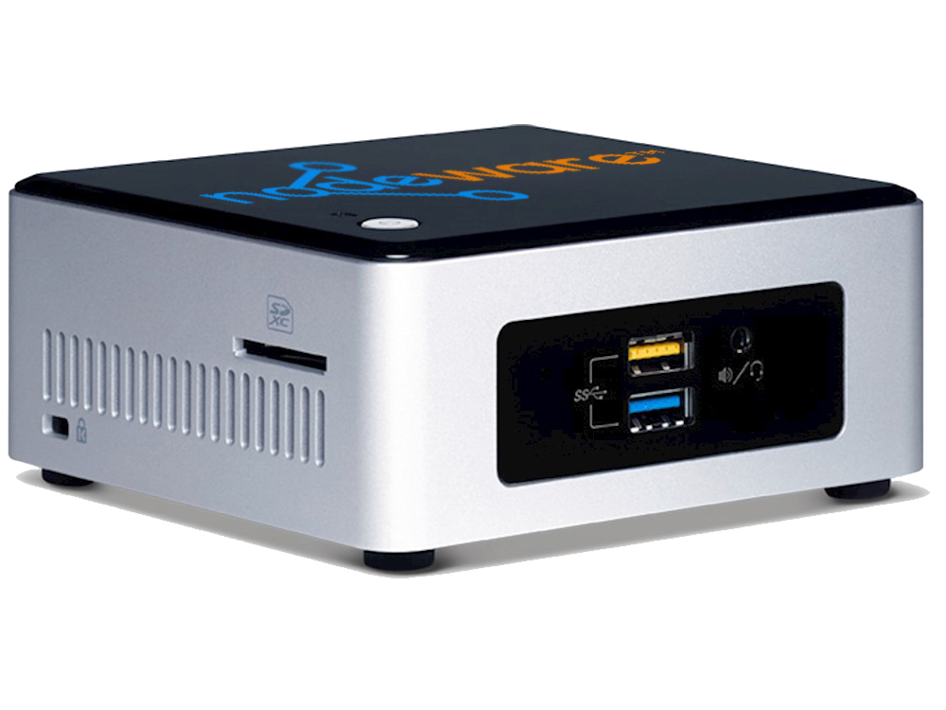
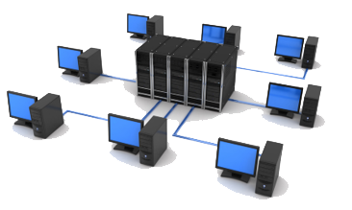
Nodeware Architecture
Nodeware Virtual or Hardware Sensor
  Identify
  Every connected device
  Continuous
  Including IoT devices
  Notify
  Nodeware dashboard or API
  Alerts
  Remediation steps
  Monitor
  24/7 visibility
  No network impact
  Internal and external scanning

Slide 11
Why IGI
Growing, public cybersecurity company (OTCQB:IMCI), positioned for continued success in the rapidly growing cyber industry
Strategic plan for roll-up of niche cybersecurity companies
  Mid-market consolidation strategy can drive rapid top line growth and shareholder value
Growing, recurring cybersecurity services revenue
20 years of cybersecurity background and pedigree
Uniquely positioned with expert service delivery team and its own patented and patent-pending SaaS platform
Channel relationships - Telarus, SYNNEX, Staples, Perspecta
In house & domestic development teams
Key team members have significant M&A experience
IGI leadership and management teams anticipate overseeing successful transitions

Slide 12
