Slide 1
CADfix 10 Service Pack 2
January 2016

Slide 2
CADfix 10/SP2 Summary
Import/Export
CAD version updates
Inventor 2016
New Creo export of .prt files
New PLMXML import
Import/Export of density
Import/Export of mixed units assemblies
New non-watertight option for STL/3DS
Wizard
Improved smart healing
Repair splits complex torus faces
Assemblies
Mixed units support added
Morph
More robust mesh->Brep matching stage
3D Printing
Improved and more robust slicing
Facets
Faster more robust facet generation
Join/Split/Offset/Weld
Much improved Weld tool
Build
Lofted surface creation now accepts guide rail curves
Improved creation of swept bodies
GUI
New hidden part display mode
New “similar bodies” selection
Miscellaneous improvements
CADfixForSOLAR
Numerous improvements
Misc.
Cross platform .fbm support
Extended CFI api
Bugfixes.

Slide 3
Import/Export
CAD version updates
Inventor 2016
Export of native Creo .prt files
Single parts can now be exported to native .prt files
PLMXML support
New import of PLMXML assemblies
Import/Export of density
Import from CATIA V5 and Creo
Export to JT and PLMXML
STL Export
New option to relax watertight export checks
Import of mixed unit assemblies
Mixed units preserved and exported (to STEP only)

Slide 4
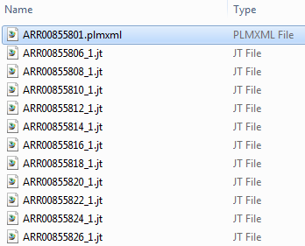
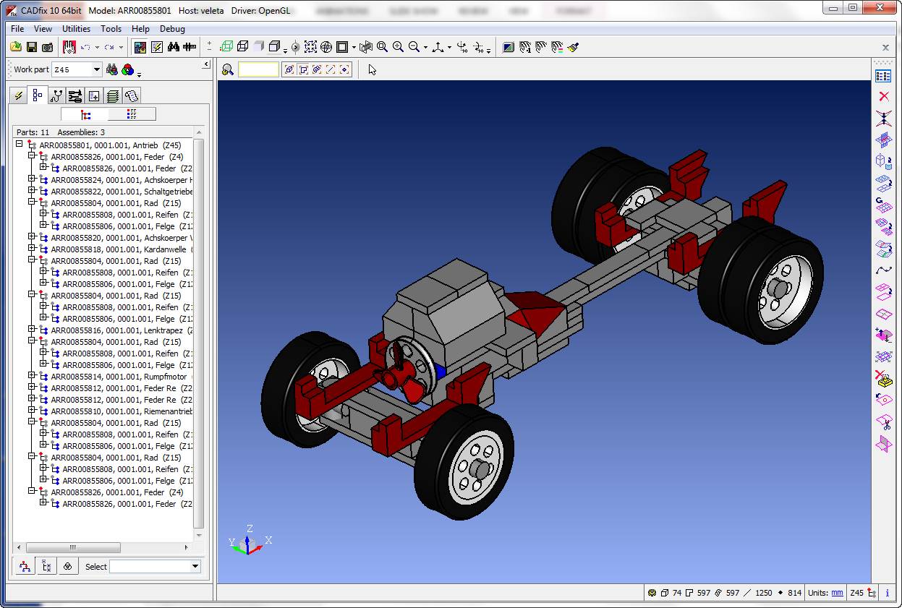
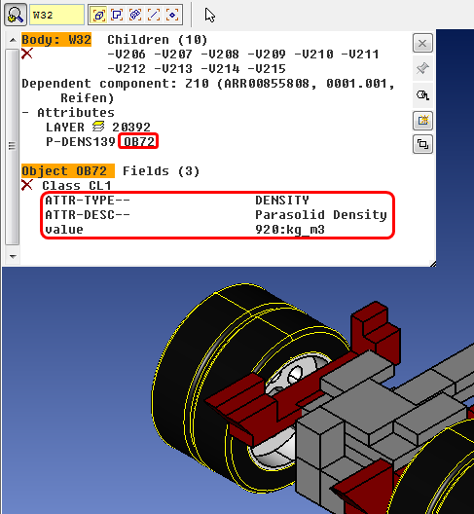
PLMXML Import
Import of PLMXML assembly
Colour, layer & label
Material properties

Slide 5
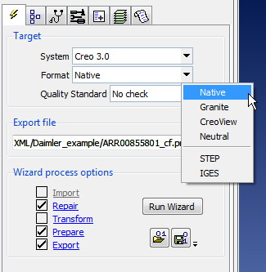
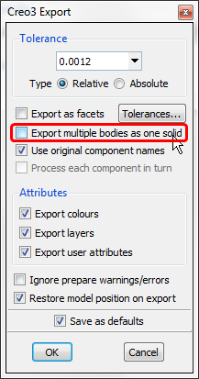
Creo 3.0 Export
New export to native Creo 3.0 .prt file
Some restrictions:
Only parts (.prt) supported in this release, assembly export planned for future.
Asssembly or multi-solid models exported as sub-folder of multiple .prt files, one per solid
Earlier versions of Creo not supported, only 3.0
New option to export all solids as a single part

Slide 6
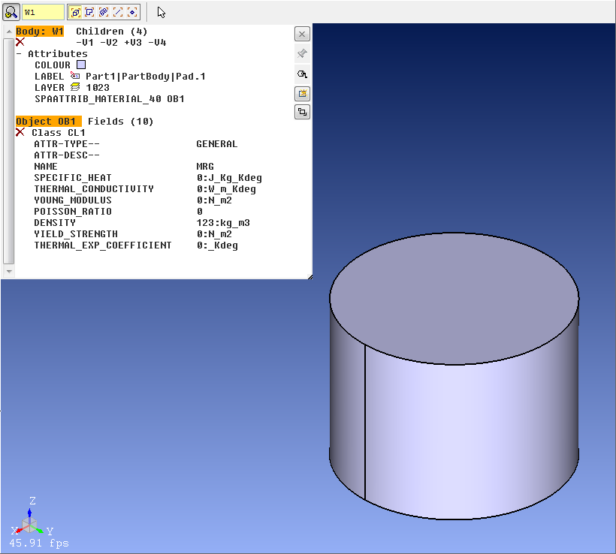
Material Property Import
Material property import from:
CATIA V5
NX
Creo
JT/PLMXML
View properties via probe tool
Double-click attribute
Available properties varies with system

Slide 7
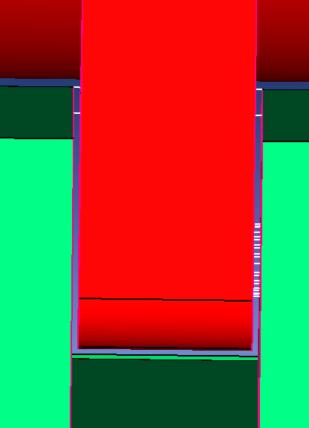
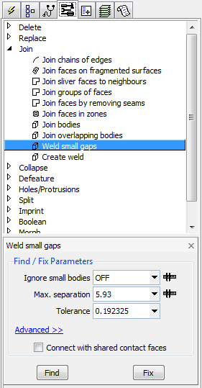
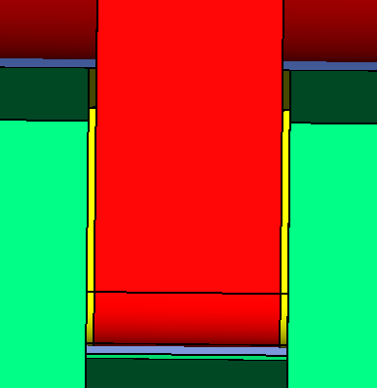
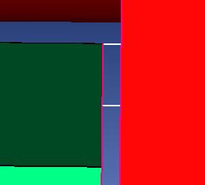
Improved Welding tool
New “Weld small gaps” tool
Can now “Find” gaps to weld before “Fix”
Potential weld geometry highlighted in white
Resulting weld bodies in yellow

Slide 8
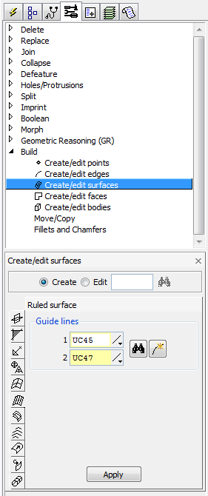
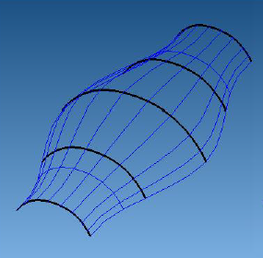
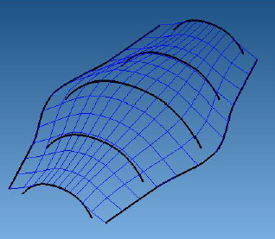
Build Tools
Lofted surface creation with guide rails
1 or 2 guide rail curves can now control lofted surface creation
No guide rails
With guide rails

Slide 9
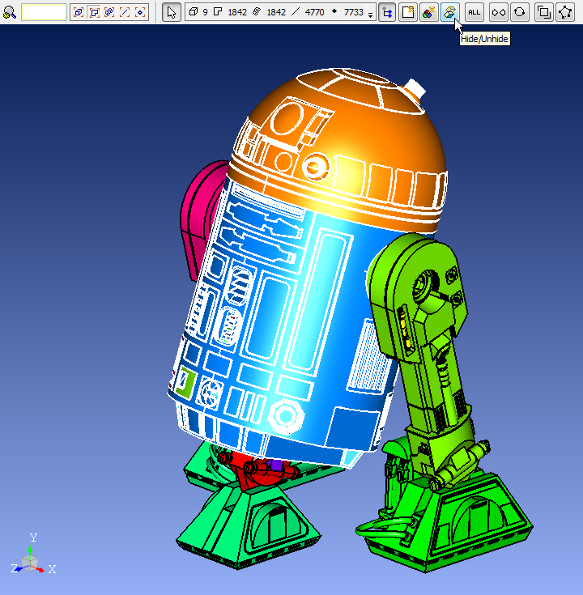
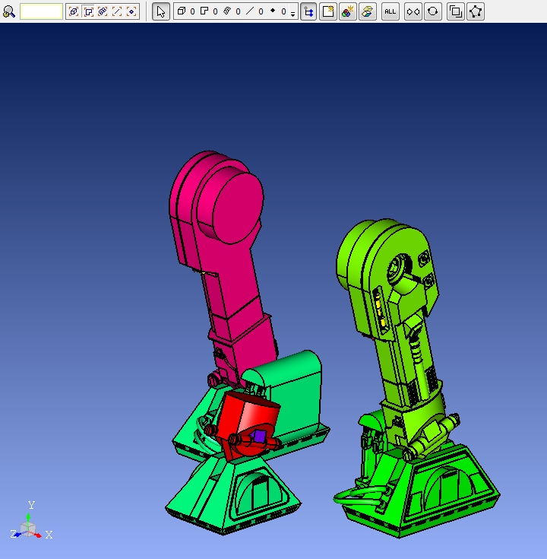
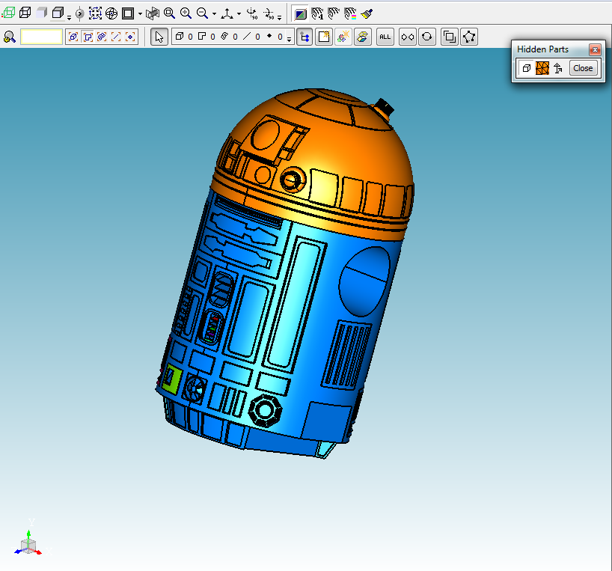
New Hidden Part Display Mode
Display mode shows hidden parts
Background colour indicates hidden mode
Switch between normal and hidden modes with
Un-hide selected entities with <ctrl-h> or
Entity counter shows hidden parts
Hide selected entities
Entities hidden
Switch to hidden view mode

Slide 10
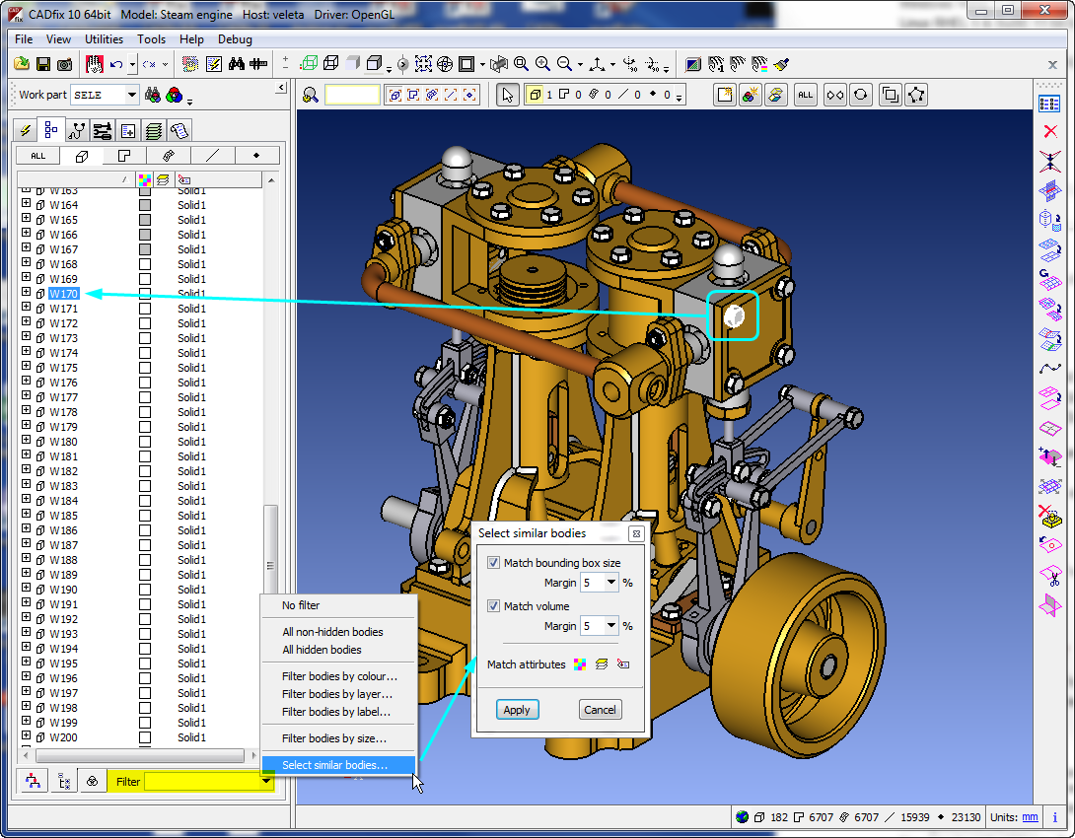
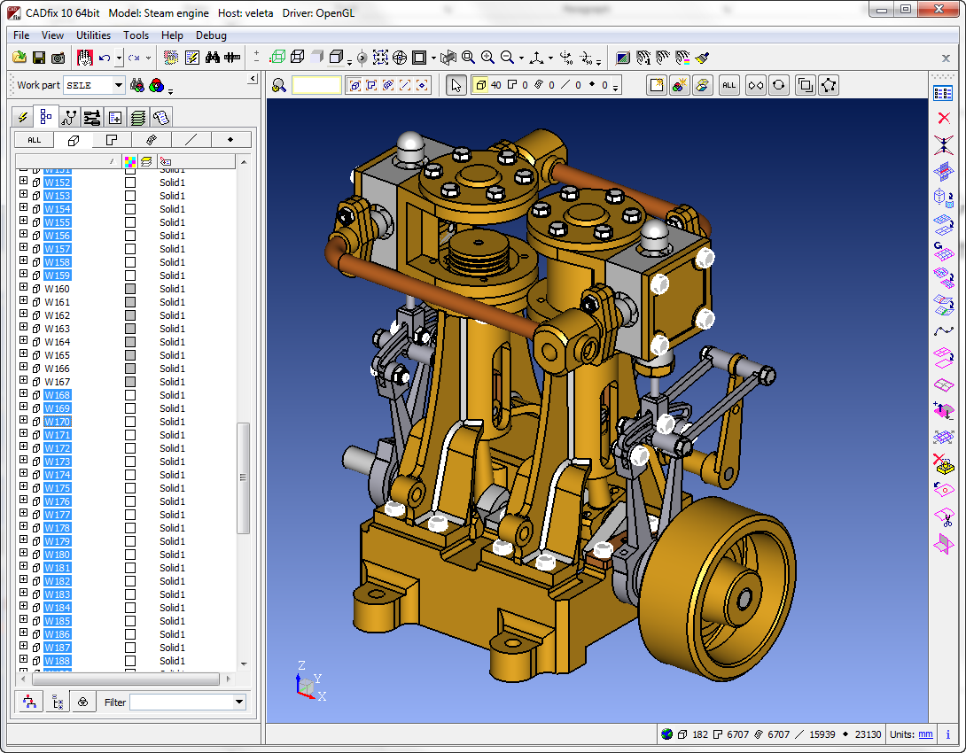
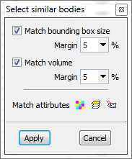
Select “Similar” Bodies
New option in model tree – body view
Pick one body, then auto-select similar bodies
Useful in gross simplification of large multi-solid models

