Slide 1
Compliance lessons from nbc’s the office July 21, 2020
HIPAA
& PR PITFALLS
August 11, 2020
Margaret Scavotto, JD, CHC, President MPA
Margaret Scavotto, JD, CHC, President

Slide 2
POLL
Where are you working today?

Slide 3
POLL
Where does compliance stand NOW
with COVID-19?

Slide 4
POLL
Has your communication with the media increased during the pandemic?

Slide 5
The OCR weighs in
FAQ:
Can health care providers invite or arrange for members of the media, including film crews, to enter treatment areas of their facilities without prior written authorization?
https://www.hhs.gov/hipaa/for-professionals/faq/2023/film-and-media/index.html

Slide 6
The OCR weighs in
OCR Issues Guidance on Covered Health Care Providers and Restrictions on Media Access to Protected Health Information about Individuals in Their Facilities
Get a HIPAA authorization BEFORE granting media access
CANNOT require a patient to sign a media authorization as a condition of receiving treatment
Masking/blurring voices/faces NOT ENOUGH
Implement safeguards to protect PHI
https://www.hhs.gov/hipaa/for-professionals/special-topics/hipaa-covid19/index.html

Slide 7
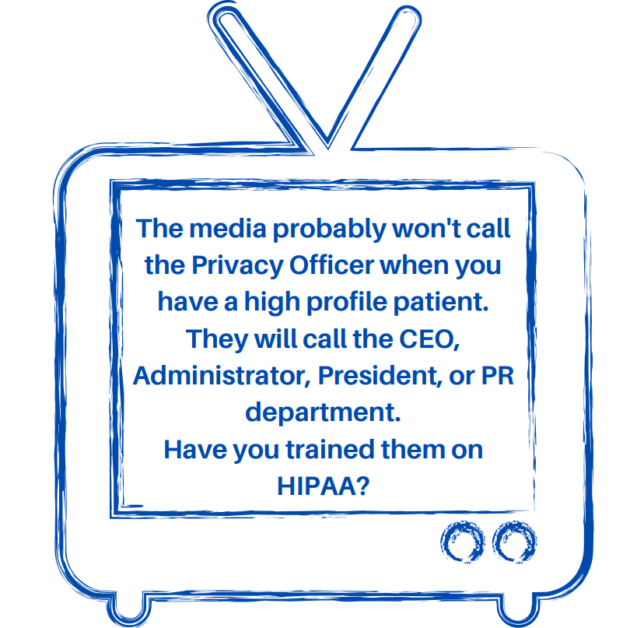

Slide 8
Example 1:
An arrest and a press release

Slide 9
An arrest and a press release
A patient presented a fake ID at a health system OB/GYN clinic in Texas. The clinic called the police – which complied with the Privacy Rule’s provisions for reporting a crime on the premises. Then the health system issued a press release about the arrest. The press release title included the patient’s name.
https://www.hhs.gov/about/news/2017/05/10/texas-health-system-settles-potential-hipaa-disclosure-violations.html
POLL: Is there a HIPAA violation here?

Slide 10
Compliance lessons from nbc’s the office July 21, 2020
Example 2:
A media interview and a group email
Margaret Scavotto, JD, CHC, President

Slide 11
A media interview and a group email
Medical center senior leaders “met with media to discuss medical services provided to a patient” and “impermissibly shared details about the patient’s medical condition, diagnosis and treatment in an email to the entire workforce.” The medical center “failed to safeguard the patient’s [PHI] from impermissible disclosure by intentionally disclosing PHI to multiple media outlets on at least three separate occasions, without a valid written authorization.”
https://www.hhs.gov/hipaa/for-professionals/compliance-enforcement/agreements/srmc/press-release/index.html

Slide 12
Compliance lessons from nbc’s the office July 21, 2020
Example Three:
A TV crew and a garbage truck
Margaret Scavotto, JD, CHC, President

Slide 13
A TV crew and a garbage truck
A NY hospital allowed the ABC TV show NY Med to film two of its patients in the emergency room, without obtaining their authorization. One of the filmed patients was dying; the other was in distress. Filming continued after a medical professional objected.
One of the patients filmed was a gentleman who was taken to the hospital after he was hit by a garbage truck. When NY Med aired, his voice was muffled and his face was blurred – but he was still recognized by his widow.
The hospital paid $2.2 million
https://www.hhs.gov/hipaa/for-professionals/compliance-enforcement/agreements/new-york-presbyterian-hospital/index.html

Slide 14
It happened again, in Boston

Slide 15
A TV crew and 3 hospitals
3 Boston hospitals allowed an ABC film crew to film “Save My Life: Boston Trauma” on hospital property, without obtaining prior HIPAA authorizations.
Collectively, the hospitals paid $990,000
https://www.hhs.gov/about/news/2018/09/20/unauthorized-disclosure-patients-protected-health-information-during-abc-filming.html

Slide 16
Compliance lessons from nbc’s the office July 21, 2020
Example Four:
An Ebola survivor and a GoPro
Margaret Scavotto, JD, CHC, President

Slide 17
An Ebola survivor and a GoPro
A nurse contracted Ebola while treating a patient. While she was being treated, a doctor visited her hospital room with a GoPro camera under his hazmat suit and asked her how she was feeling. The hospital’s PR department published the video on its YouTube site and released it to the press as part of a PR campaign.
POLL: Is there a HIPAA violation here?
https://www.propublica.org/article/ebola-infected-nurse-contends-dallas-hospital-violated-her-privacy
Notes:
An Ebola survivor
Nina Pham, a former nurse at Texas Health Presbyterian Hospital (Dallas), contracted the Ebola virus while treating a patient. While Pham was being treated at Texas Health Presbyterian, a doctor visited her hospital room with a GoPro camera under his hazmat suit, and asked her questions about how she was feeling. The hospital’s PR department published the video on its YouTube site and released it to the press as part of its #PresbyProud campaign. Pham sued the hospital, and claims the hospital released the videos to overcome the bad press received by the hospital when Pham and another nurse contracted Ebola on the job: “Never once did THR get Nina’s permission to be used as a PR pawn like this.”
The hospital asserted that it “was sensitive to Nina’s privacy, and we adhered to HIPAA rules in determining what information to share publicly. We had Nina’s consent to share the information about her that was released.”
In her complaint, Pham disagrees. The lawsuit contains notes from Pham’s medical records on Oct. 14 from her pulmonologist that the doctor “discussed with her and reviewed in detail the consent form for release of information and she agrees to consent of information release.” But, Pham points out, the same doctor noted at the time that they discussed “end-of-life issues” with Pham and discussed Pham’s treatment plan.
Pham’s lawsuit settled, and the settlement terms were not made public – so we don’t know exactly what happened on October 14. We do know that HIPAA consent to media use can be complicated

Slide 18
Compliance lessons from nbc’s the office July 21, 2020
Lesson Six:
Social media: the cheapest and most risky PR
Margaret Scavotto, JD, CHC, President

Slide 19
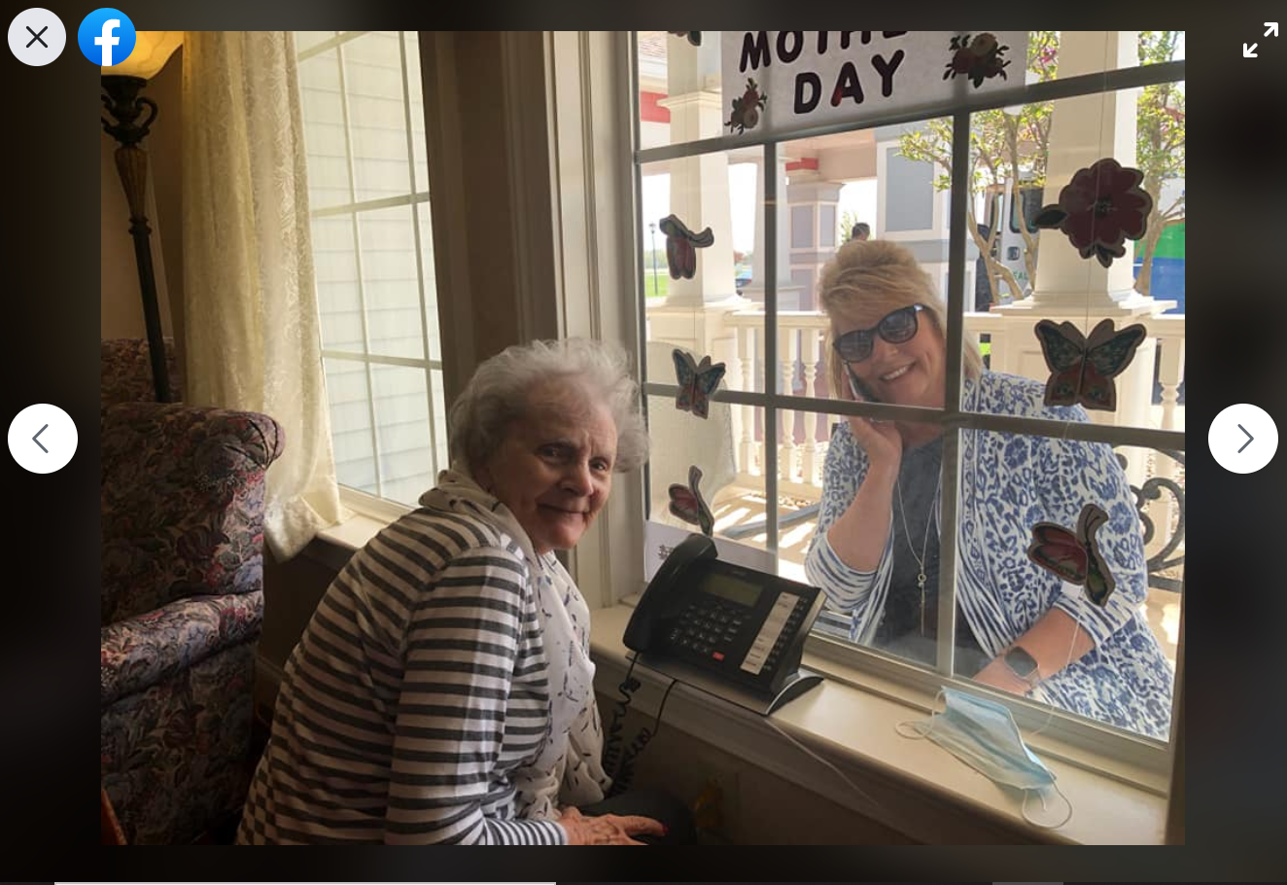
Sharing COVID connection stories

Slide 20
Stay on the right side of the news
Who attends HIPAA training? What about the CEO? The Board? Doctors? Who is most likely to speak with the media? These people need HIPAA training just like your nurses do.
It can be tempting to leave execs out of training because we know they’re busy, but be careful when it comes to compliance, including HIPAA. They might not come to your 7:00 a.m. in-service, but find a way to get them the info they need.
Keep in mind that HIPAA education for leadership might need to be done a little differently than HIPAA education for patient care staff. Tailor education content, including hypotheticals wherever possible, to the specific HIPAA situations your audience might encounter.

Slide 21
Stay on the right side of the news
Media inquiries about patients
If someone asks for a patient by name, STICK TO YOUR DIRECTORY
All other disclosures require a HIPAA authorization FIRST

Slide 22
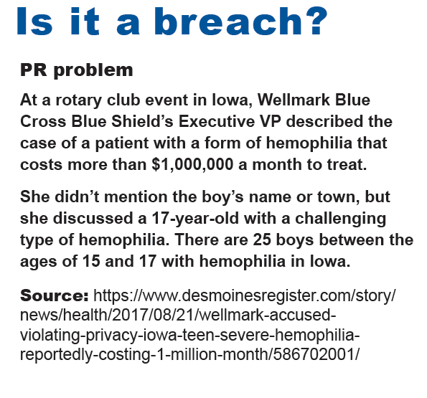

Slide 23
MPA CAN HELP
MPA can train your staff on HIPAA virtually.
You keep the recording.
We won’t tell your staff that HIPAA was enacted in 1996, but we will use real word examples that will help them do their jobs.

Slide 24
MPA CAN HELP
MPA can review your compliance program
We look at policies, training, audits, governance and culture

Slide 25
Questions?
Margaret Scavotto, JD, CHC
President
314-394-2222 ext. 124
mcs@healthcareperformance.com
Blog: www.healthcareperformance.com/blog
Store: www.healthcareperformance.com/store
(c) 2020 Management Performance Associates
This presentation does not constitute legal advice

