Slide 2

Gasketed plate-and-frame heat exchangers
Datacenters cooling solutions
Design considerations

Slide 3
Topics
Introduction to gasketed plate-and-frame heat exchangers
Logarithmic Mean Temperature Difference (LMTD)
Pressure drop
Shear stress, maintenance
AHRI certification
Best practices to write a good heat exchanger spec
Connectivity
Liquid cooling

Slide 4
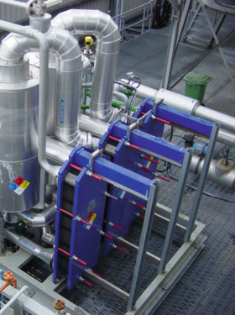
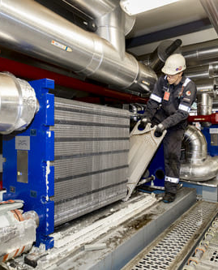

Key parameters
How do they effect?
Performance
Service
Consequences of decisions
Notes:
Performance:
How long is it going to run
How efficient will it be
Service:
How often will it need to be serviced
How easy will it be to service it
Consequences:
Design is a balance. A desirable trait may bring issues somewhere else. It would be good to know the trade offs. It’s the good fast cheap triangle. Pick two. If its fast and cheap it isn’t going to be good.

Slide 5
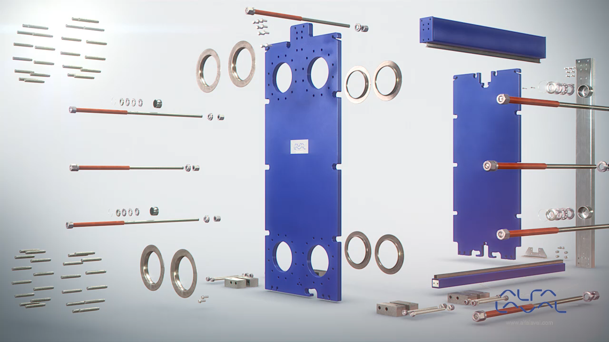
Gasketed plate-and-frame heat exchangers

Slide 6
Gasketed plate-and-frame heat exchangers

Slide 7
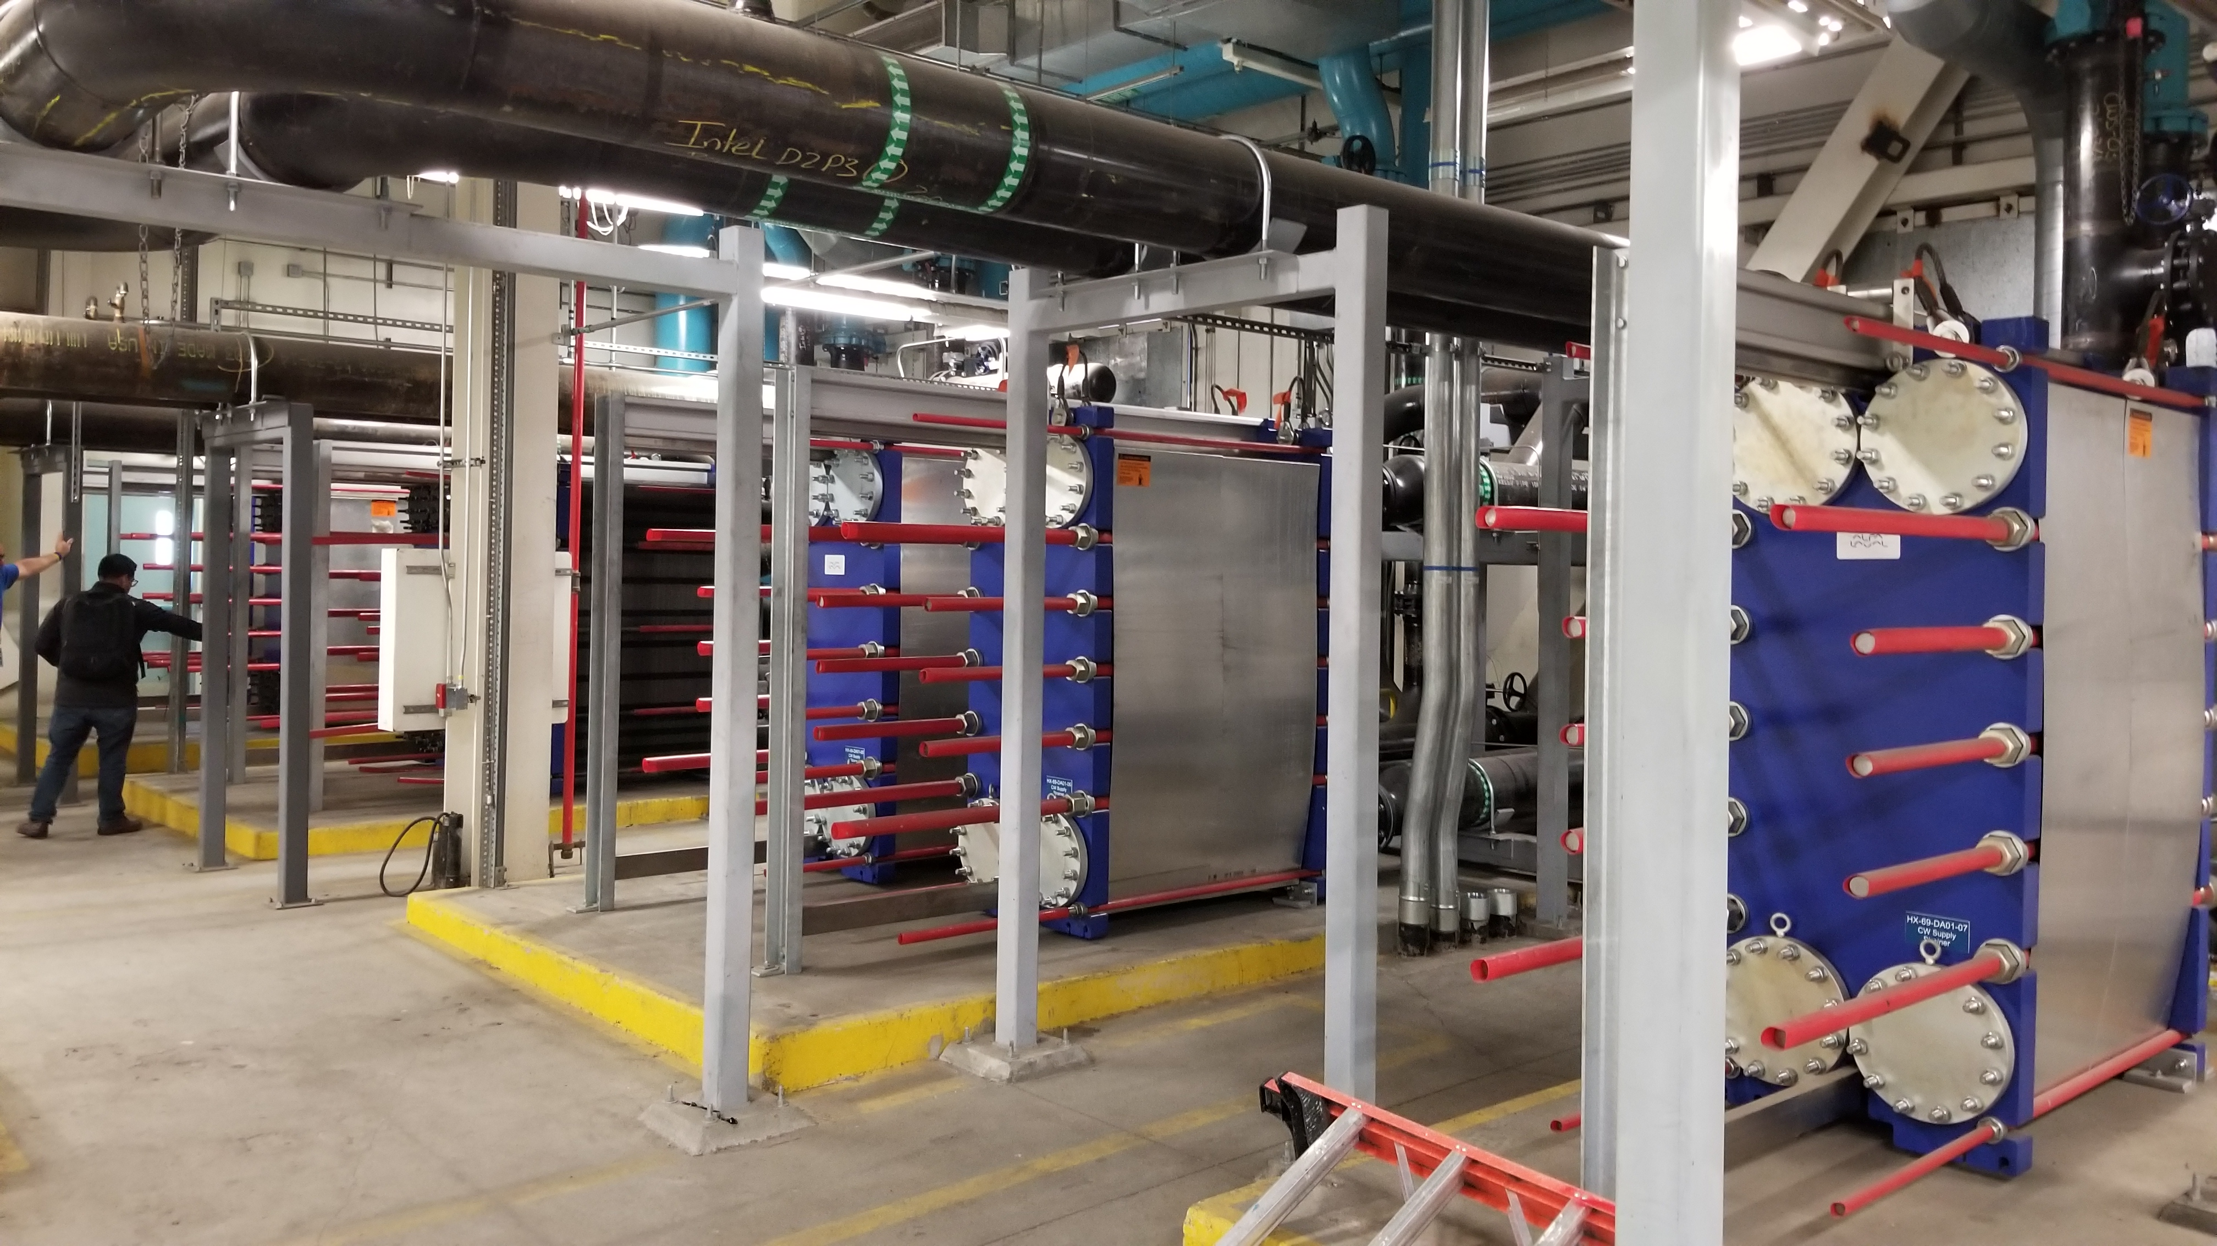
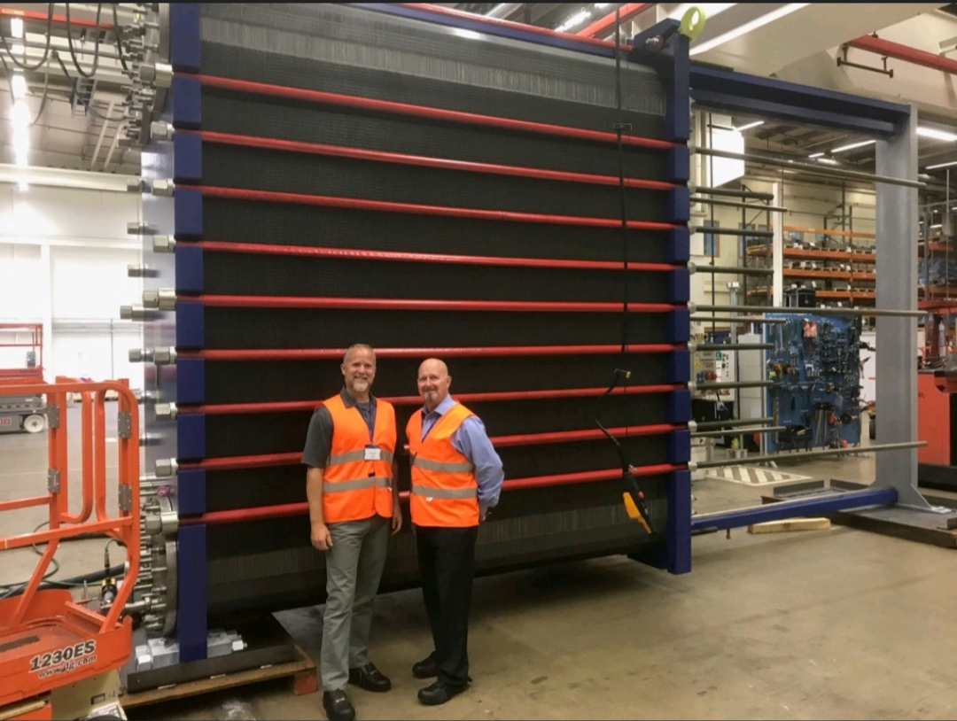
Gasketed plate-and-frame heat exchangers

Slide 8
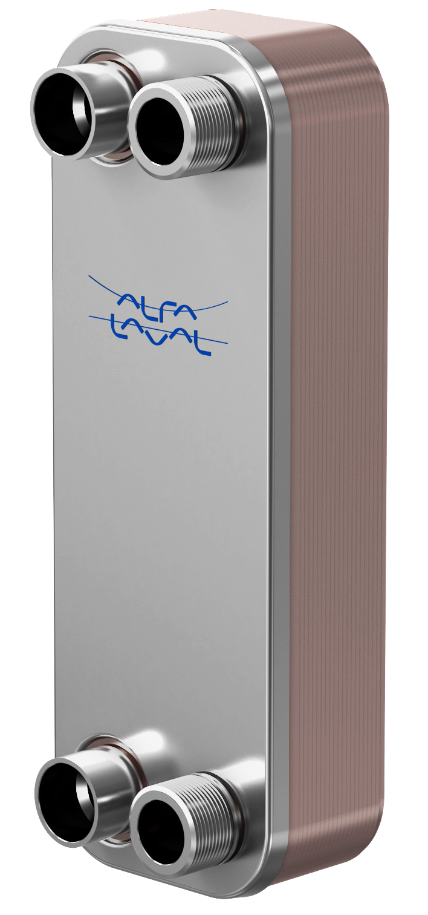
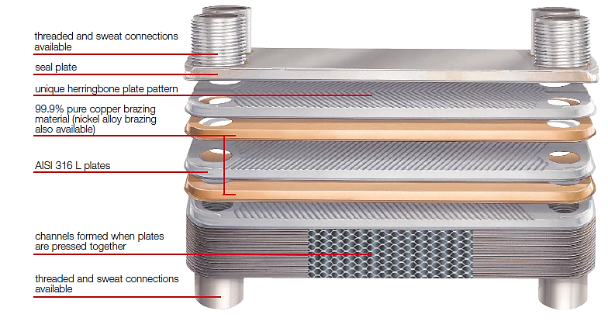
Brazed plate heat exchangers

Slide 9
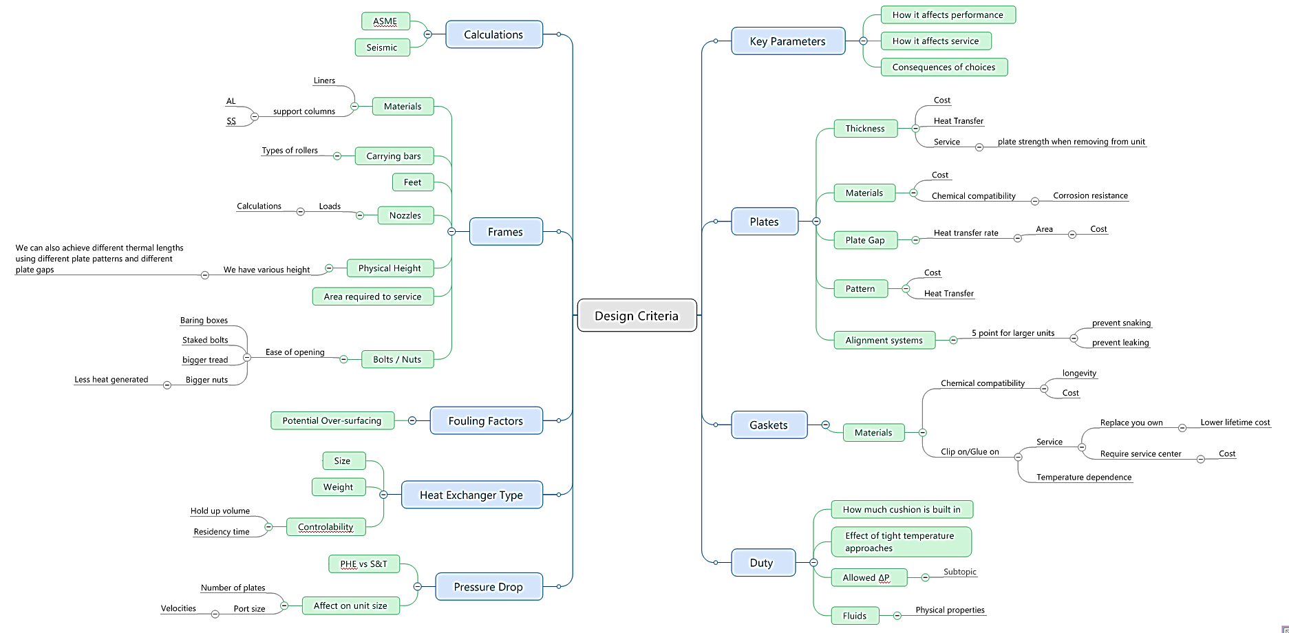
What are the key parameters?
Notes:
Started to map the parameters to decide which are key. There are many of them. I stopped before I made a giant spider web.

Slide 10
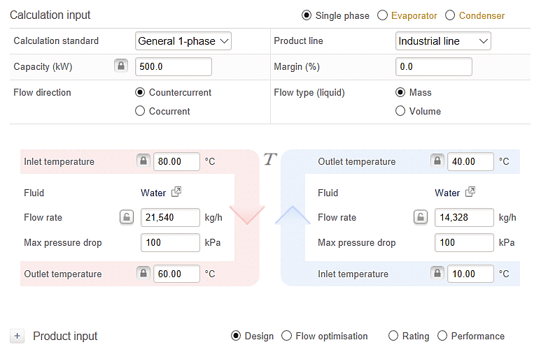
The duty
Required information
Flow rates
Temperatures
Allowed pressure drops
Fluid properties
Design pressures
Design temperatures
Particle sizes
Is the fluid fouling
Total heat transferred
Notes:
What needs to be done. What needs to be specified for a proper design.
Heat or cool: Makes a difference in the type of channel you use
Flow: There will be a process in place
Allowed pressure drops. Much to discuss here
Fluid props: one of the more overlooked aspects
Specified Design pressures/temperatures.
Consequence of particle size
Is the fluid fouling, or non Newtonian
What you need the equipment to do
I know what you are thinking, thanks captain obvious, but lets look at these points.

Slide 11

Flow rates
Sizing the model depends on the port size
There are maximum flow rates for port sizes
  ΔP (price for efficiency, don’t waste it in the port)
  Noise
  Erosion
Sizing the model depends on the port size
  The size of the unit has to be optimized for one of the flows so the other side may suffer
  Less shear stress
    Less turbulence
      Lower heat transfer
      More fouling
        Bigger more costly unit
Plate heat exchangers work best with similar flow rates on each side
Notes:
Models are not analog in that the size of plate they come with is a fixed entity. So flow rates come with restrictions on pressure drops, thermal length.
There are restrictions on the amount of pressure drop you want to use in the port. Pressure drop is valuable and you don’t want to use it in something that does not transfer heat.
High flow rates cause undesirable noise. Speed of sound
Of course even water is erosive so that has to be taken into account. Even more so if there are particles
Something not normally talked about is dissimilar flow rate
The blue text are the take a ways from the presentation. Something to keep in the back of your mind while specifying this type of equipment.

Slide 12
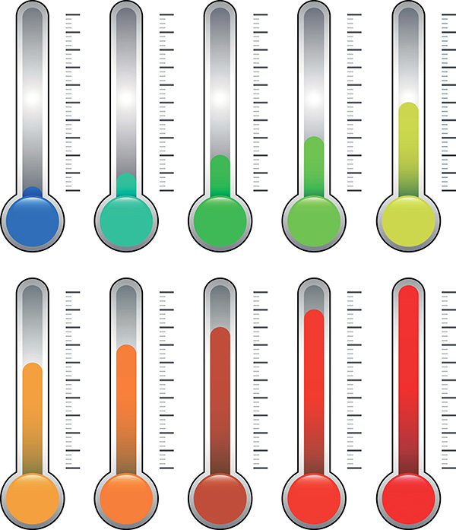
Temperatures
Affects the gasket selection
  Very high or very low temperatures may mean more expensive gaskets
  Specifying excessively high or low design conditions also affects the gasket type used
Temperature approach
  LMTD
  Theta θ
Notes:
Temperature approach is a critical factor. For that we need to talk about LMTD and the concept of theta.

Slide 13
Logarithmic Mean Temperature Difference – LMTD
Notes:
Temperature approach is a critical factor. For that we need to talk about LMTD and the concept of theta.

Slide 14

LMTD
Counter-current flow
T_{1 in}
LMTD $=\frac{Δ1−Δ2}{\ln\left(\frac{Δ1}{Δ2}\right)}$
Δ1
T_{2 out}
T_{1 out}
Δ2
T_{2 in}
The closer the approach temperature ∆1, ∆2 … the smaller the LMTD.
Theta describes how difficult a duty is, the higher the theta the more difficult the duty.
Notes:
This is the formula and this is a visualization.
LMTD is the relationship between the inlet and outlet temps.
Theta is the relationship between the change in temperature and the LMTD.
LMTD is the driving force. Theta is the measure of how difficult it is to complete the duty.
We talk a lot in terms of theta and eventually try to match the theta of the duty to the theta of the unit.
500 is conversion from lbs/hr to gpm= 8.34 lbs/gal (60 min/hr).

Slide 15
Thermal design parameters
Q is fixed by the amount of heat that is to be transferred
U is a function of the fluid and heat exchanger selected (somewhat fixed)
A is what we want to minimize
Therefore a larger LMTD gives us a smaller exchanger
Q = U A (LMTD)
Where:
    Q = Heat transferred (Btu/hr)
    U = Overall heat transfer coefficient (Btu/hr, ft², °F)
    A = Heat transfer surface area (ft²)
    LMTD = Log Mean Temperature Difference (°F)

Slide 16
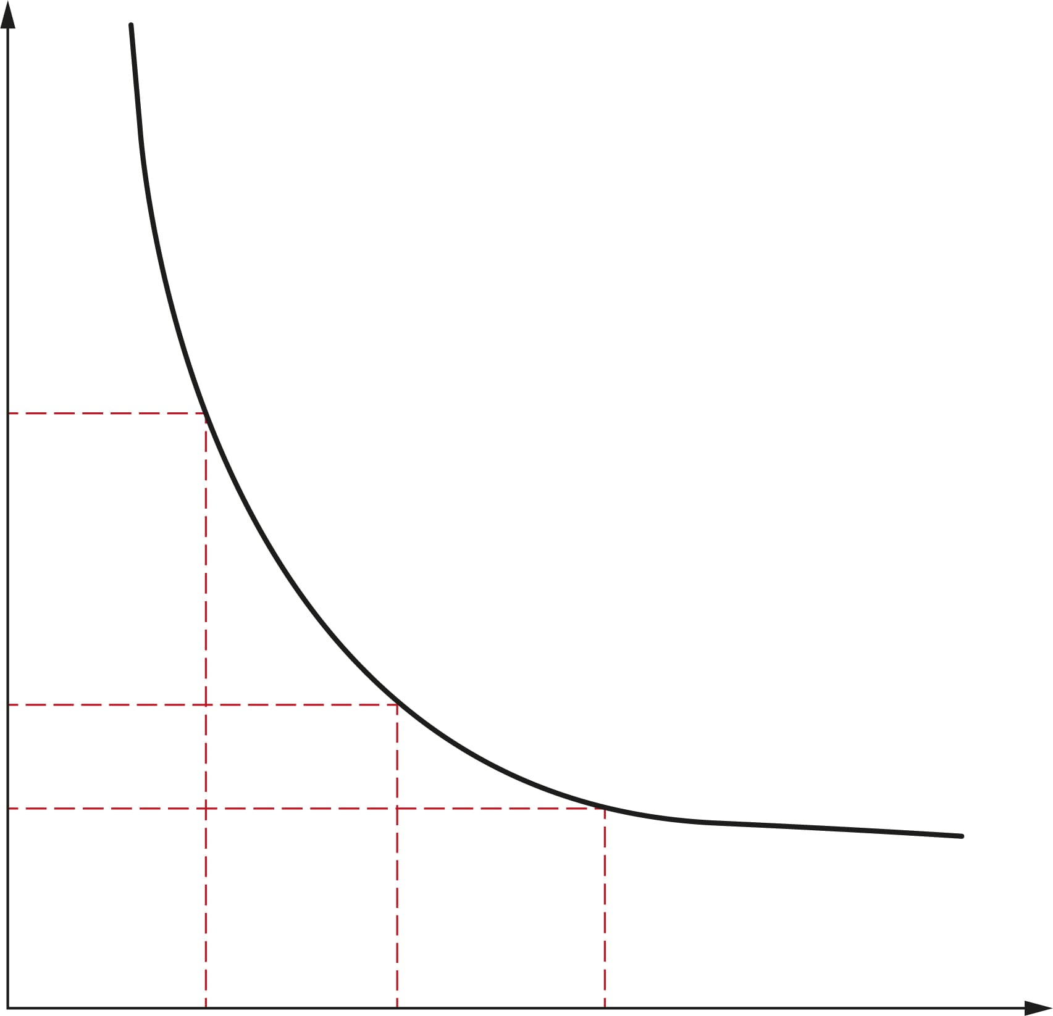
Approach temperature (LMTD) vs. Surface area and cost
Area (ft²)
-40%
-10%
LMTD
2.0°F
2.5°F
3.0°F
Notes:
We can learn from most of the books describe that the higher the heat recovery (I.e. very high NTU), the heat transfer area will be much bigger and not in direct proportion. That is the money you have to pay for the heat recovery. It is also explain that the closer the temperature approach, the harder for the heat transfer because simply the driving force is not big for very efficient heat transfer.

Slide 17
Small changes in temperature can have a huge impact on price
Specified
Offer version 1
Offer version 2
56°F
56°F
56°F
42°F
42.5°F
43°F
54°F
53.5°F
54°F
40°F
40°F
40°F
LMTD: 2°F
Heat transfer area: 6415 ft²
Heat load: 12,000 kbtu/hr
Price relation: 100%
< 0.5°F
> 29%
> 3.9%
> 27%
LMTD: 2.5°F
Heat transfer area: 4553 ft²
Heat load: 11,540 kbtu/hr
Price relation: 73%
< 1.0°F
> 42%
> 7.2%
> 40%
LMTD: 3°F
Heat transfer area: 3714 ft²
Heat load: 11,110 kbtu/hr
Price relation: 60%
Notes:
1 m² = 10.76 ft²
1 kW = 3412.14 btu/hr
(degrees C x 1.8) + 32 = degrees F

Slide 18
Approach vs. cost
The closer the approach temperature the higher the theta value the more difficult the duty, and the larger the heat exchanger becomes
Designing for actual requirements can save considerable cost
Practical example
  Summer vs winter conditions
    Don’t design for cooling water temperatures that occur one or two days per year
    The closer temperature approach can double the size of the exchanger, which becomes very over surfaced for most of the year
Design for the conditions the unit will see the majority of the time
https://www.youtube.com/watch?v=rKYAqYCp5ds&t=2s
Notes:
Be wary of significant differences in area. It will indicate a very large U value or perhaps a tweaking of the temperature approach.

Slide 19
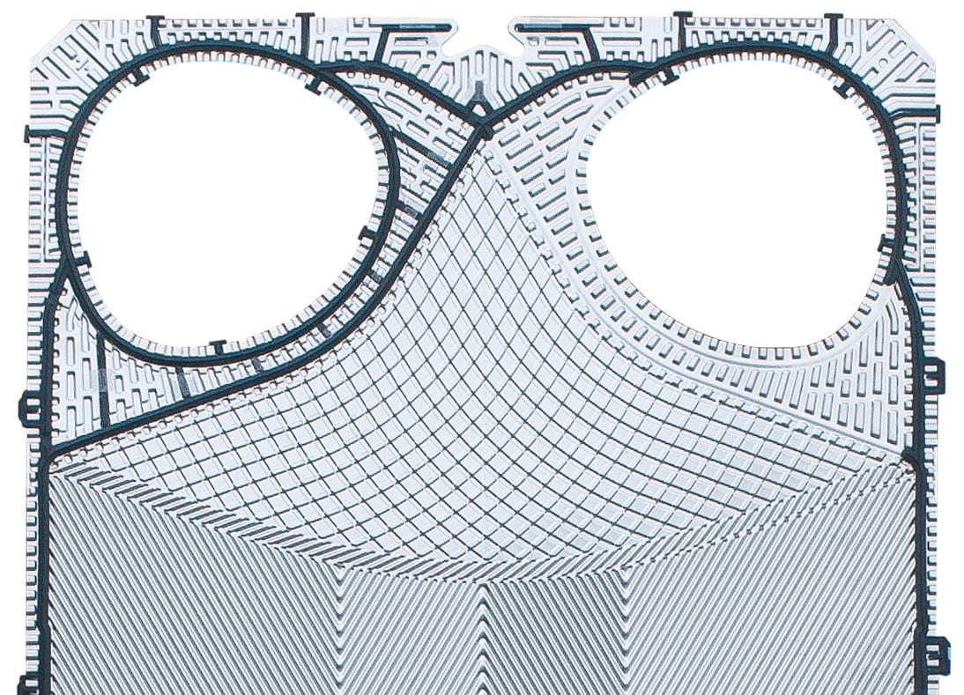
Heat transfer area
Heat transfer area alone does not tell the whole story
  Plate efficiency
  Design
  Overall efficiency

Slide 20
Pressure drop

Slide 21
Pressure drop
Are caused by fluid friction, both internal in the fluid itself, as well as with the channel surfaces, channel restrictions or sudden changes in the geometry of the flow path
  Where:
    λ = Friction coefficient
    L = Length
    v = Channel velocity
    d_{h} = Hydraulic diameter
    ρ = Fluid density
dP = λ * (L/d_{h}) * (ρ v² / 2)
D’Arcy-Weisbach equation
Notes:
Pressure drop equation.

Slide 22
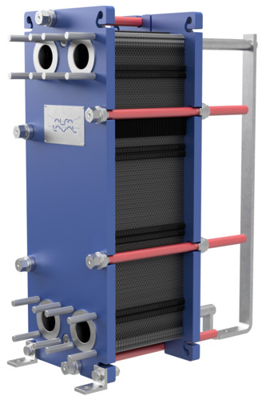
Pressure drop in a plate heat exchanger
Causes
  Connections
  Distribution pattern on the plate
  Surface roughness on the plate
  Surface geometry on the plate
  Turbulence in the channel
Notes:
I forgot to add two pass arrangements add considerable pressure drop because you are radically changing directions of the fluid.

Slide 23
Pressure drop in a plate heat exchanger
Wanted
  Full coverage of the plate (with a minimal ∆P)
  Modern plate pattern (good surface geometry)
  Turbulence in the channel (at lower Re numbers)
  Rest are unwanted
Notes:
You want all as much of the pressure drop in the heat transfer area of the plate. To vet that the distribution zone of the plate has to be very good. Otherwise you have areas that are not transferring heat. So you wont get the mathematically calculated result.

Slide 24
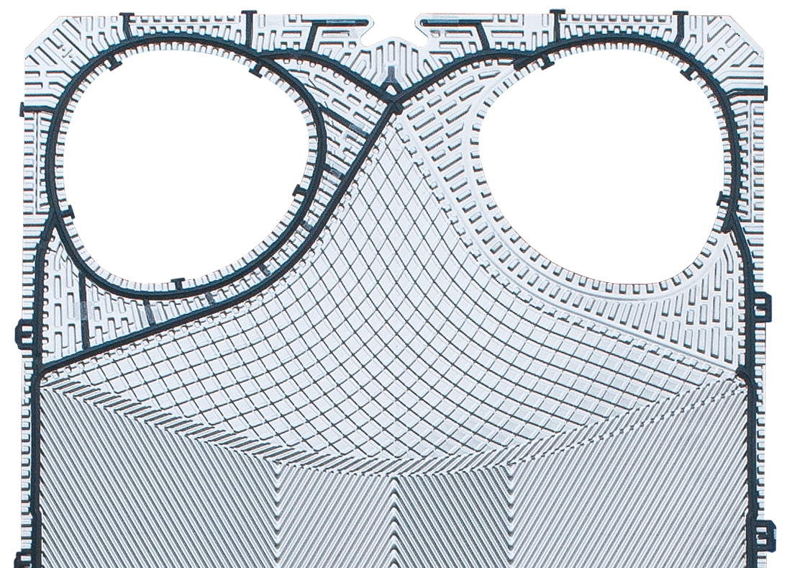


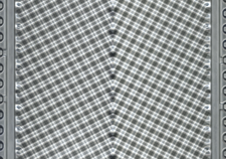
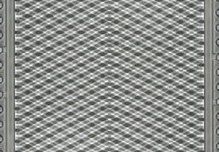
Pressure drop in a plate heat exchanger
Choose manufacturers who have:
  Smooth surface areas (2B)
  Recently patented distribution designs like CurveFlow™
  Single pressing (avoiding sudden geometric deviations and weak spots due to fatigue)
  Ability to mix channel types in a single heat exchanger
Low
Medium
High

Slide 25
Pressure drop in a plate heat exchanger
Pressure drop is the price for efficiency and lower capital cost
(don’t waste it in the ports)
Not giving enough allowable pressure drop is like asking for a very tight temperature approach
It causes a pressure drop limited design where we add unneeded area (add channels, read cost) just to satisfy the limitation.
Adding channels, lowers the velocity, shear stress, and turbulence, which can cause a much higher rate of fouling (read cost)
  Give all ∆P possible – watch for quotes with smaller ports and area
Notes:
We can also get designs that do not use all of the available pressure drop. There may be ways to make the design smaller.
Check to see if the available pressure drop is used.

Slide 26
Shear stress

Slide 27
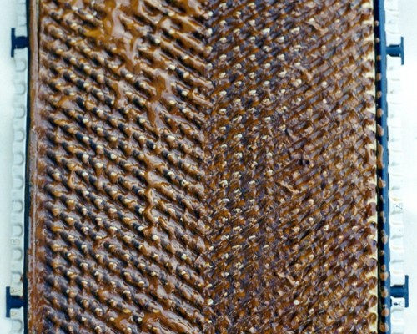
Fouling
All heat exchangers foul but there are but there are things you can do to mitigate it
Do not apply S&T fouling factors
  A typical S&T factor can add 60% to the surface area
  Ask instead for a reasonable 5-10%
More surface area does not translate into a longer period between cleanings. In fact it can have the opposite effect

Slide 28

Shear stress
What is shear stress?
  The force of the flow on the heat exchanger wall
  A measure of the turbulence in the heat exchanger
  Also called the Tau value (τ)
A high shear stress ensures:
  High turbulence → High heat transfer
  High force on the wall → Reduced fouling
Notes:
Design engineers in AlfaLaval are always talking amonst themselves about pressure drops and tau values.

Slide 29

Shear stress (τ)
  Higher pressure drop → Higher shear stress
  A longer plate requires a higher ΔP to achieve the same shear stress as in a shorter plate (ΔP/L constant)
  A plate with a larger pressing depth gives higher shear stress providing that it has the same ΔP as a plate with less pressing depth
$τ_{w}$ $=\frac{f ρ V^{2}}{2}= \frac{∆P D_{h}}{2 L}$
Where:
τ_{w} = shear stress at the wall, N/m² (Pa)
F = friction factor
V = flow velocity
L = channel length, m
D_{h} = hydraulic diameter (m)
(2 * pressing depth for PHE)

Slide 30
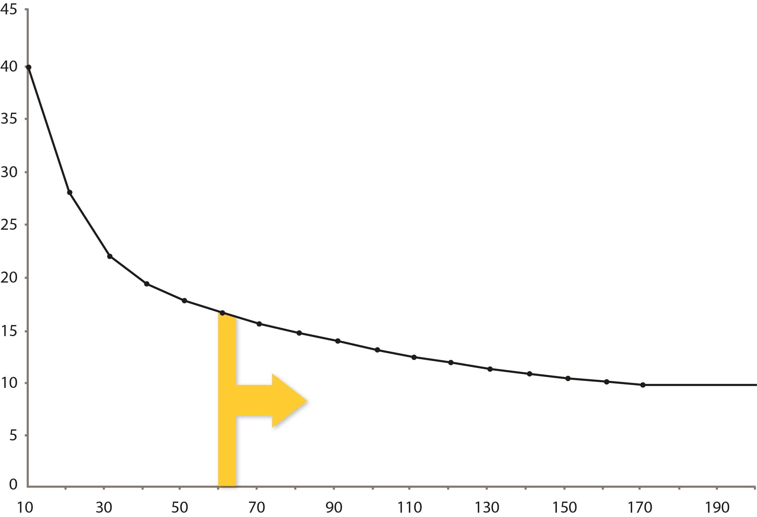
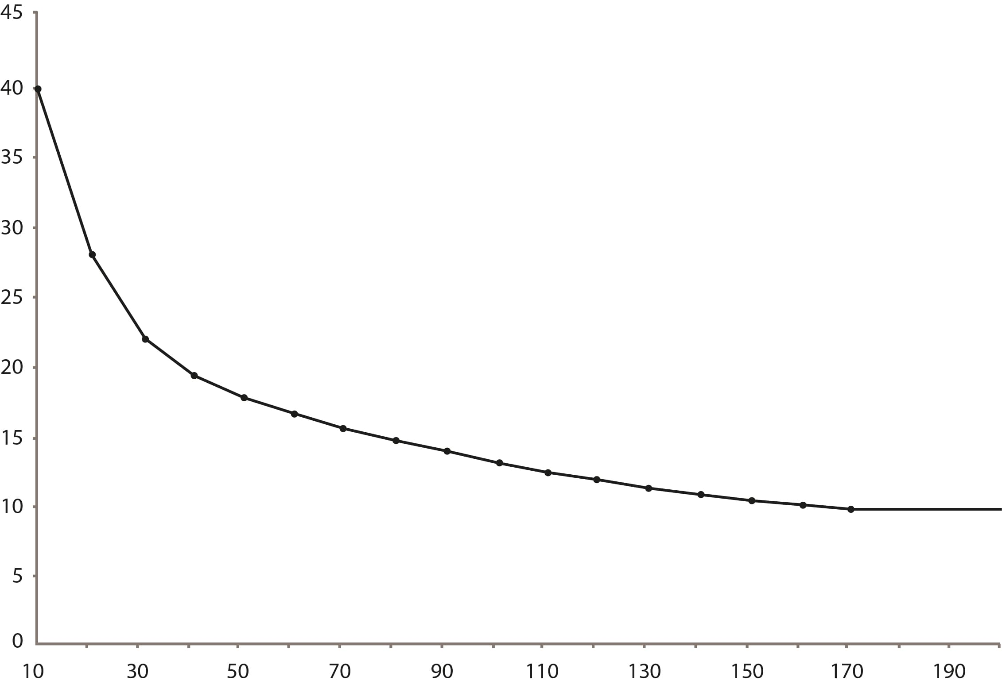
Shear stress versus fouling rate
Each duty type has a rule of thumb for best performance
Fouling resistance growth rate
(10E-8 m²K/Wh)
Shear stress (pa)
Notes:
So how do we use tau. The higher the Tau the more fouling resistance but it has a limitation. At a certain point higher stress does not confer much more fouling and it is not worth the additional pressure drop.

Slide 31
Shear stress – Fouling

Slide 32
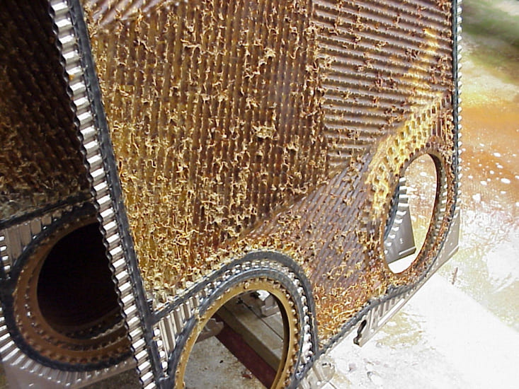
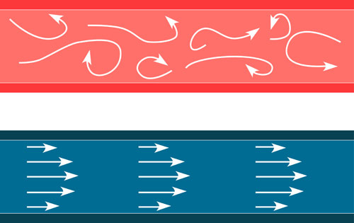
Danger of low shear stress
Designed flow rate – relative ∆P
Real flow rate – ∆P decreases with the square of the reduction of th flow rate
∆P drops square of the flow decrease
Notes:
Keeping the LMTD constant, for the same duty if the specified maximum pressure drop is 30kPa, the supplier can select the PHE with a higher pressure drop and show the desired on the technical printout.
Again the effect of pressure drop is quite significant for the selection of the PHE.

Slide 33
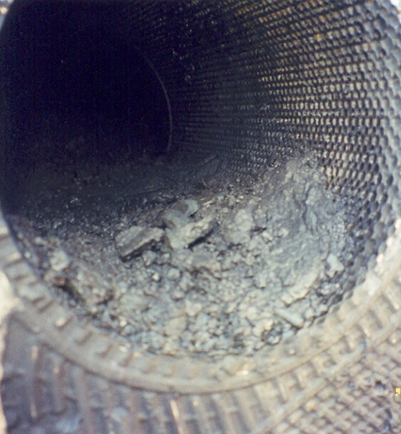
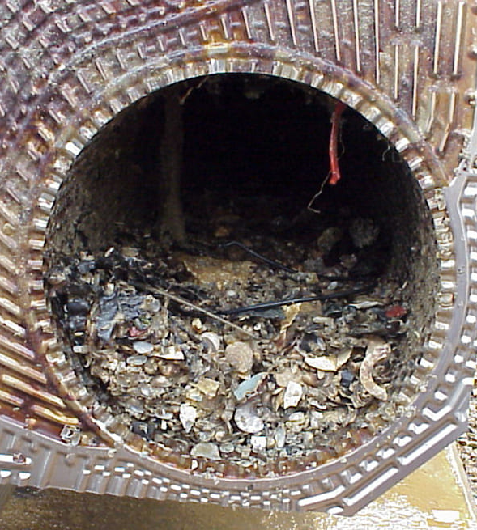
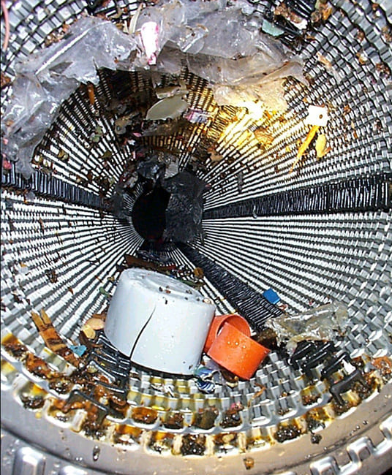
Immediate failure
Fouling - major debris clogging / plugging
Filter, re-design, cleaning, training…

Slide 34
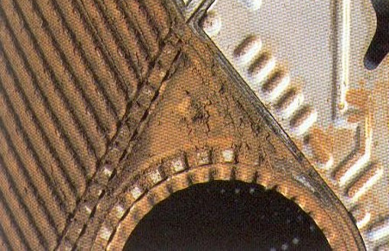
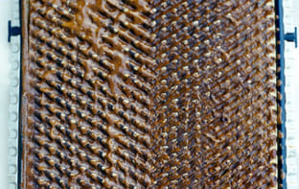
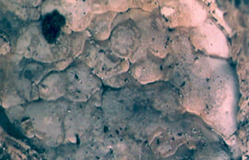

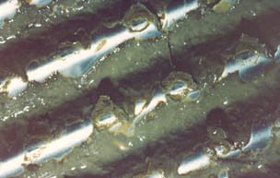
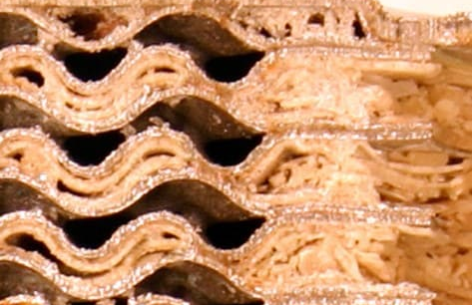
Course fouling
Biofouling
Scaling
Cleaning, re-design, condition based monitoring…

Slide 35
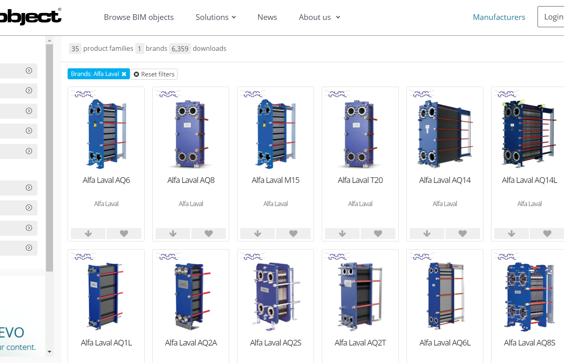
Alfa Laval in BIM Object
https://www.bimobject.com/en-us/product?brand=alfa-laval

Slide 36

Particle size
Related to fouling
At Alfa Laval we say the particles should be no bigger than 75% of the pressing depth
Pressing depth
Be aware some define max particle size against 2 times the pressing depth
Notes:
When plates are put together they don’t line up crest to trough. This is done deliberately to create the corkscrew pattern. This also means that you will get different diameters in the channel. So be aware that there are some that use 75% of two times the pressing depth. That has a much greater chance of plugging the unit even at higher tau values

Slide 37
Fouling using shear stress
Shear stress is a better indicator of fouling rates than both a fouling factor or adding a percentage excess area
Specify a shear stress rather than fouling factor
Approximately 50pa is a good rule of thumb, but a discussion may be in order for optimization

Slide 38


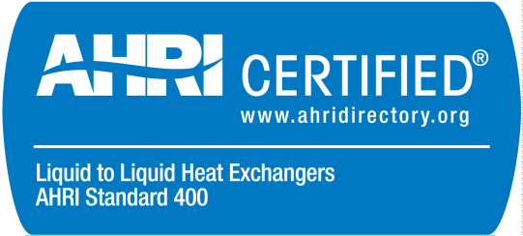
You can never be sure…
Or you can always be sure!
Notes:
Datacenters cooling systems are NOT required to be AHRI certified, BUT that doesn't mean that you can always require AHRI certification!
We’ve seen the importance of the heat duty calculation and corresponding sizing of heat exchangers.
The question now is: how do I know the offer I’m looking at will meet my performance calculations?
And the answer is onscreen: AHRI.
When you specify “AHRI-certified only” on your bid documents, only heat exchangers that are proven to deliver the performance you calculated can be offered.
There’s simply no other way you can be sure.

Slide 39
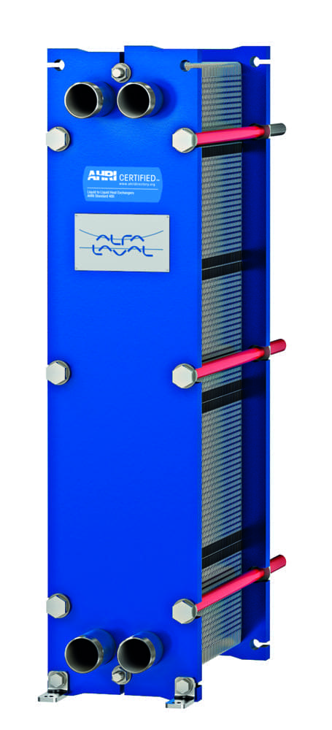
AHRI protects you and your clients
Air-Conditioning, Heating & Refrigeration Institute
Non-profit trade organization
Develops and publishes technical standards for industry products
Establishes procedures for measuring and certifying performance
Independent third-party verification of thermal performance of plate heat exchangers in the ‘AHRI Liquid to Liquid Heat Exchangers (LLHE) certification program’
Lab testing principles in the AHRI 400 rating standard
Holds latest design software for member manufacturers
Notes:
You all must know AHRI for when specifying Chillers and boilers?
AHRI is the Air Conditioning, Heating and Refrigeration Institute based in Arlington, USA. It is a non-profit trade organisation – not an authority.
Its purpose is to develop and publish technical standards for industry products.
The organization also establishes rating criteria and procedures for measuring and certifying plate heat exchangers and other products’ performance.
They are also always looking for the latest technology improvements that improve efficiency and benefit the environment. As new technology develops, it can become part of the standards and certification.
That means AHRI-certified products are usually based on the most advanced technological developments in their field.

Slide 40
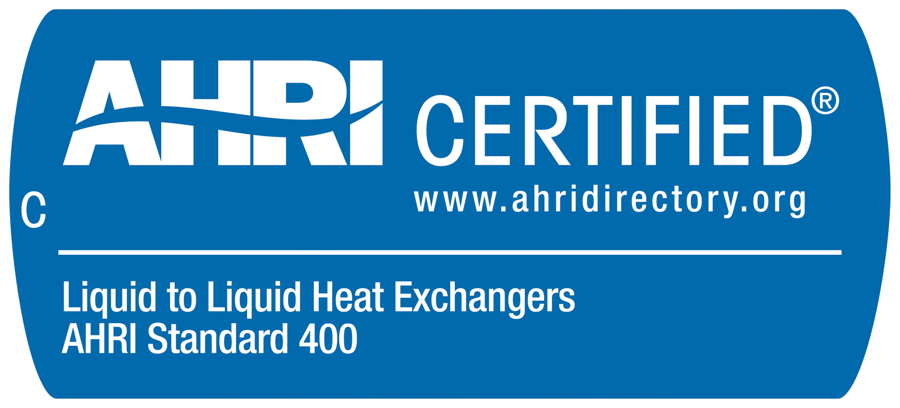
How to specify AHRI
Should I require AHRI certified units for datacenters?
One sentence:
”The plate heat exchangers shall be AHRI certified in accordance with the AHRI Liquid to Liquid Heat Exchangers Certification Program”.
“The gasketed plate heat exchanger specs can be verified and registered by AHRI before purchase”
Notes:
Some suppliers can come up tricks like ‘this is according to AHRI’ or similar. The last statement does not guarantee that YOU are protected and safe.

Slide 41
Service

Slide 42
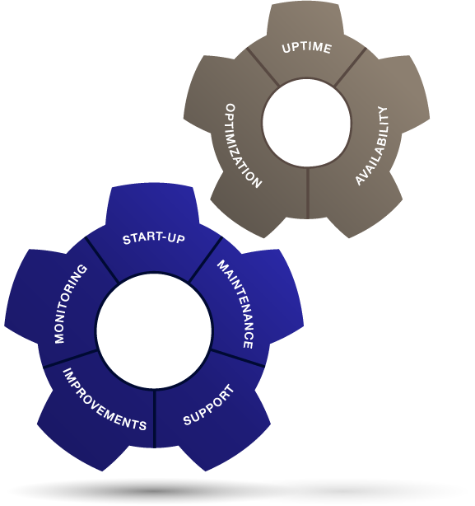
Service
As an engineer specifying equipment you want to be able to make recommendations that will outlive the current project and give your customers confidence they are buying quality. equipment that has a reliable team to back it up

Slide 43
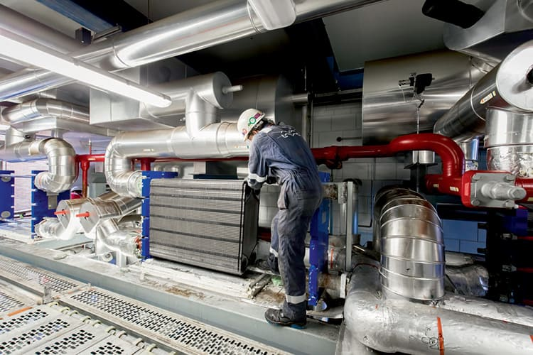
What does service do?
Regasketing and repairs
Integrity testing
Chemical cleaning
Crack detection
Gasket gluing
Oven curing
Pressure testing
Modifications and upgrades

Slide 44
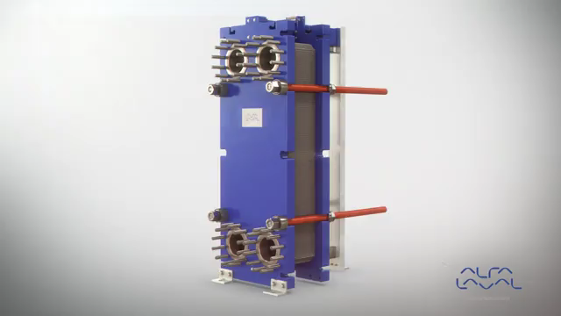
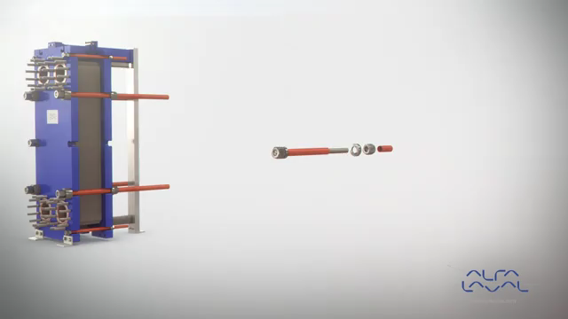

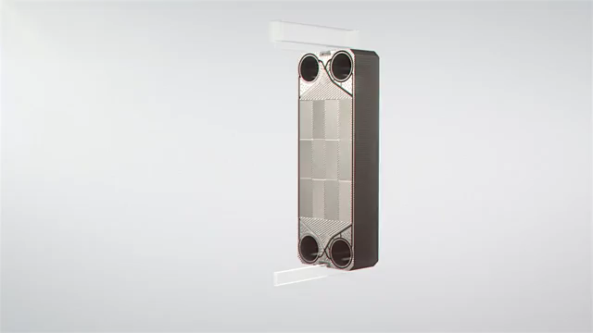
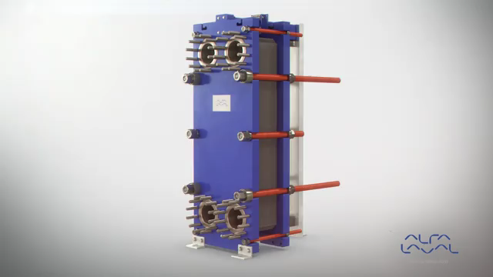
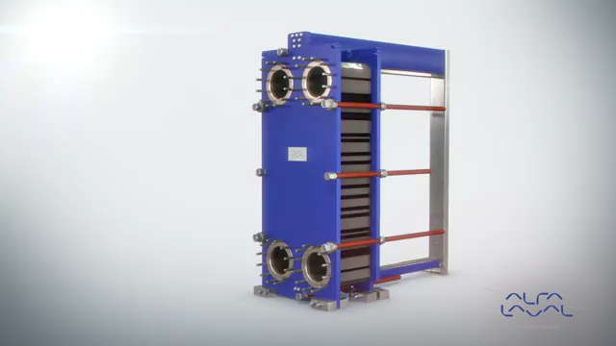
Service
The unit is constructed with serviceability built into the design
Bearing box
Elongated nuts
Fixed bolt head
Five-point alignment
Pressure plate roller
Pressure plate roller on T-bar

Slide 45
Conclusions

Slide 46
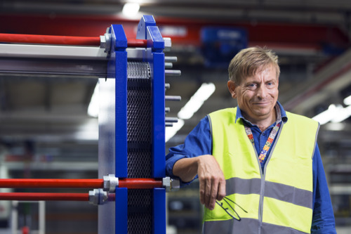
Conclusions
Gasketed plate heat exchangers work best with similar flow rates on each side, but optimization in the design can be done to accommodate different flow rates
Beware of the difference between design flow rate and actual flow rate
Give all ∆P possible
Specify a shear stress (rather than fouling factor) – approximately 50pa is a good rule of thumb, but a discussion may be in order for optimization
Specify AHRI certified units
Plan to service your heat exchangers
Talk with the Heat Exchanger supplier!

Slide 47

Asymmetry
Plate design
FlexFlow™
The FlexFlow™ plate design eliminates the compromise between thermal efficiency and pressure drop for duties with different hydraulic loads on the two sides of the heat exchanger. The heat exchanger is optimized for maximum thermal efficiency and lowest pressure drop on both the hot and the cold side. The result is up to 30% higher efficiency along with reduced fouling, for long-term, cost-effective performance.

Slide 48

Summary of benefits
More channel configurations possible
Design optimized on both sides for dissimilar flows
Up to 20% more plates fit in frame
No transition plate needed
Notes:
70% of the water/water duties are asymmetric. 60% of the duties don’t use even 50% of the allowed pressure drop. 15% don’t use even 10% of the pressure drop. Asymmetric plates make it possible to configure more channels than with traditional plates, and these channels can be configured to have different channel volumes on the two sides.
With two different plates (H and L) it is with traditional plates possible to make 3 different channels in 3 different configurations.
With two different plates (H and L) it is with asymmetric plates possible to make 10 different channels in 6 different configurations.
Thanks to the new gasket design, it is possible to fit up to 20% more plates in the frame (the more plates, the higher is the figure). This is due to that when the plates during assembly are gently pushed together with manpower, they come closer to each other than with traditional plates. After final tightening with help of tools, the A measure is of course the same as with traditional plates.
As the gasket can be placed on both sides of the plate, there is no need for transition plates when multi pass design is used.
These are technical benefits and all of them can bring customer values, depending on application and customer needs. Examples of customer values are higher thermal efficiency, energy savings, less frequent cleaning, more uptime, less use of cleaning chemicals, more compact unit, smaller footprint, less environmental impact, more sustainable operation and less use of metal as a natural resource.
Don’t be surprised if the designed heat transfer area becomes much less than competitions’. This is exactly what is expected!

Slide 49
Symmetrical channels with symmetrical plates
Notes:
These are the channels that are used in traditional heat exchangers with symmetrical plates.

Slide 50
Symmetrical channels with asymmetrical plates
Notes:
Also with asymmetrical plates it is possible to make symmetric channels. Each channel is then facing the narrow side of one plate and the wide side of another plate.

Slide 51
Asymmetrical channels with asymmetrical plates
Narrow
channel
Wide
channel
Notes:
The asymmetrical channel configuration is achieved when every second plate is flipped so that one channel is only facing narrow sides of plates and the other channel is only facing wide sides of plates.

