Slide 1
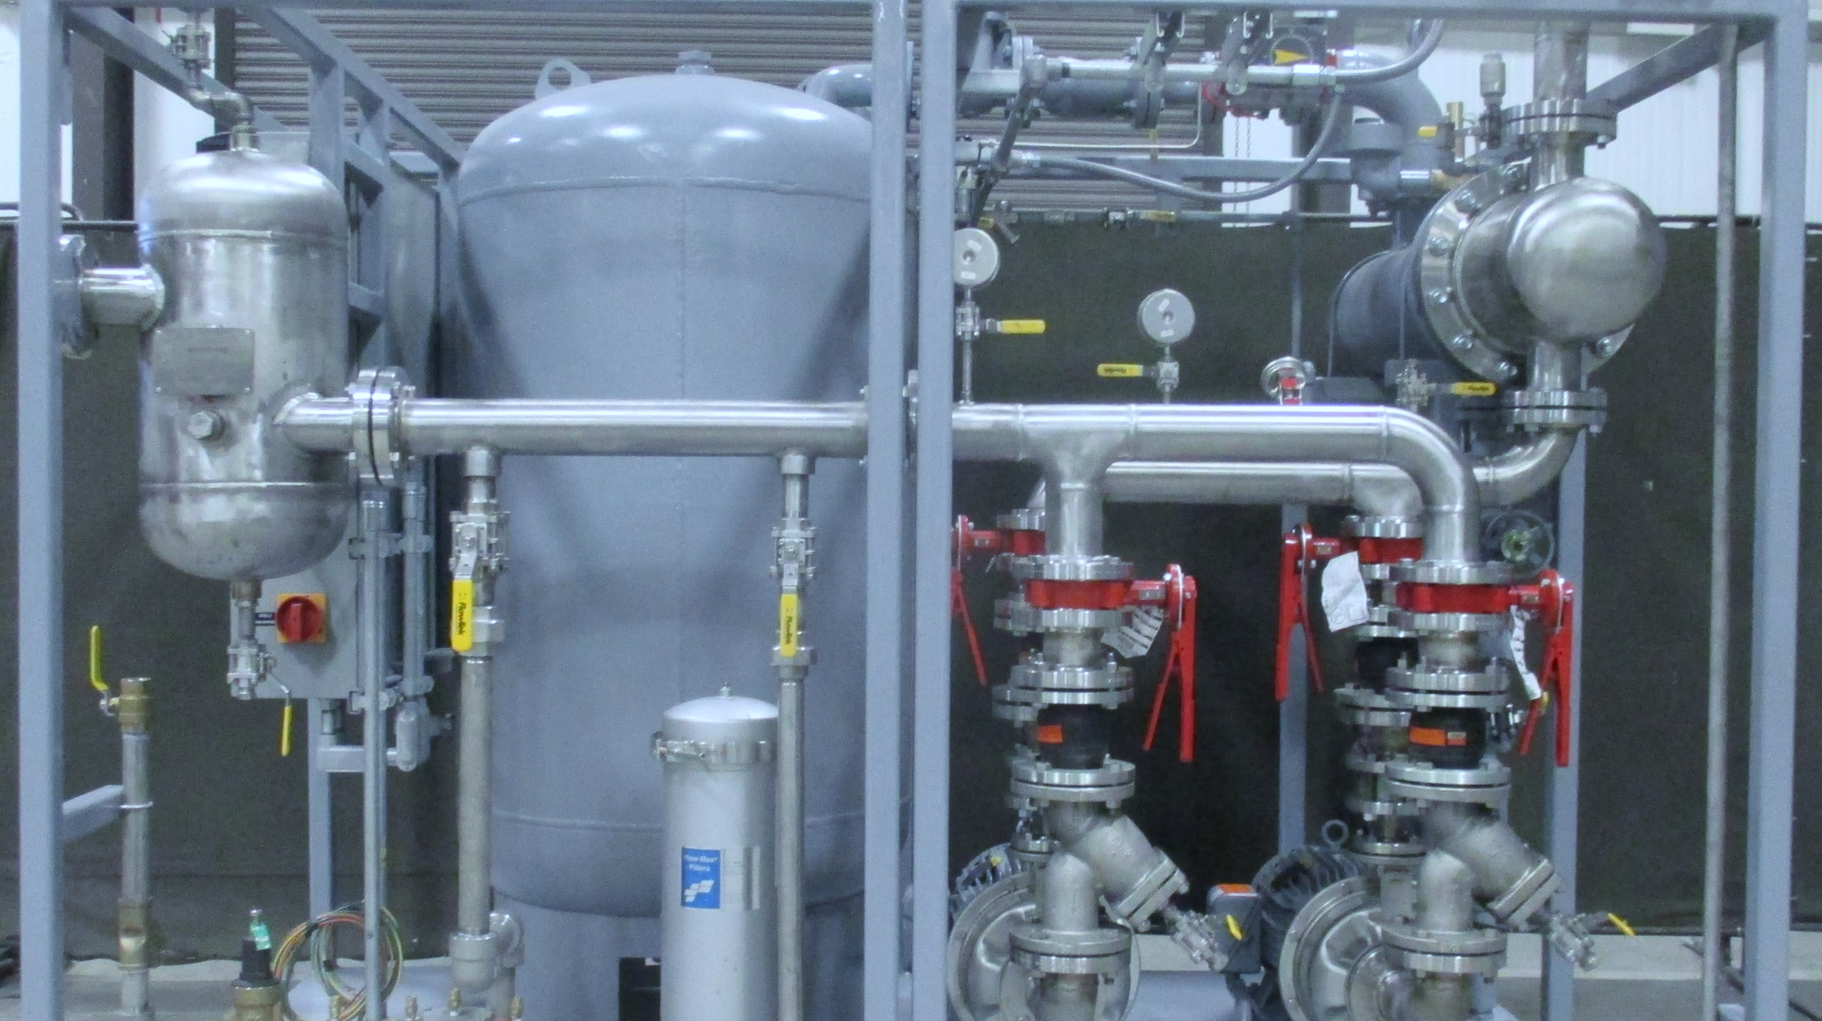

Engineering energy to fit your needs

Slide 2


Who we are…

Slide 3
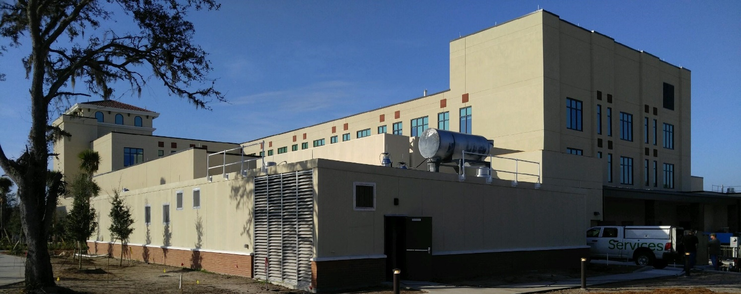
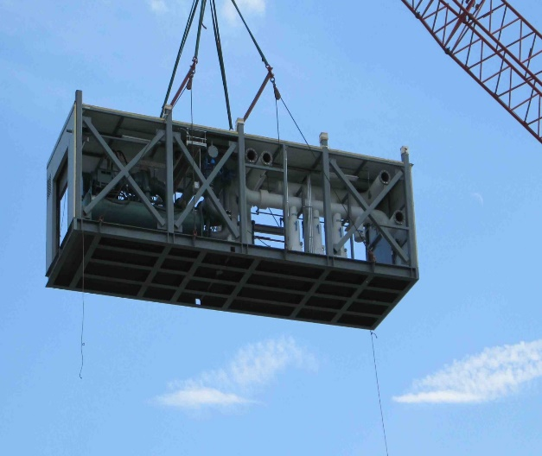
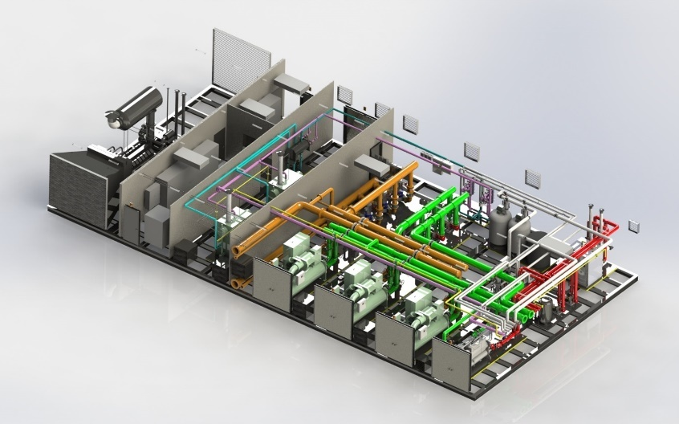
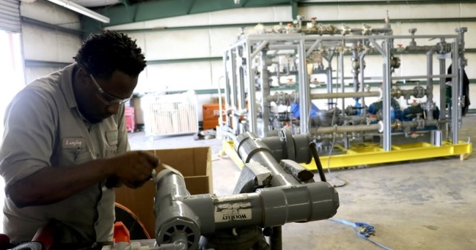
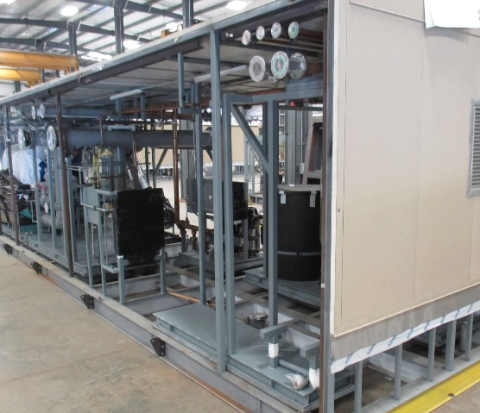
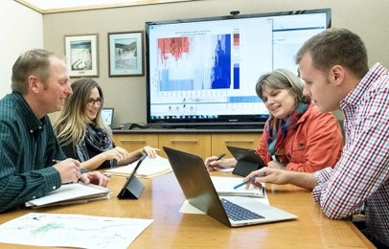
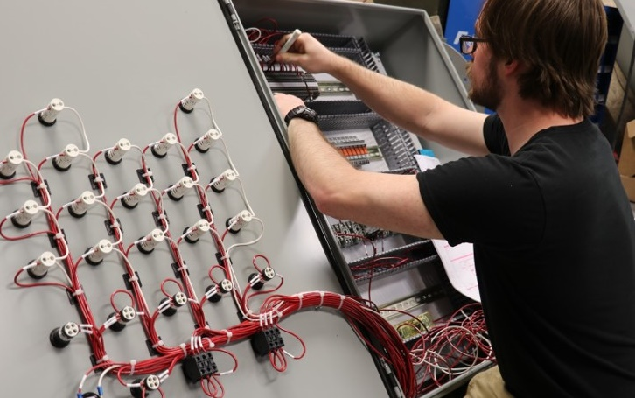

installed system for hospital
our company
Envirosep is a custom engineering and manufacturing company specializing in design and fabrication of pre-packaged mechanical and electrical facilities equipment, with integrated controls.
Capabilities range from small standardized pumping equipment packages to complex, engineered systems.
As reflected in our corporate identity, Envirosep systems often help our customers improve both environmental responsibility and energy efficiency.
custom design
modular
pre-packaged
Factory manufactured
Integrated controls
engineered

Slide 4
product expertise
Packaged pumping systems
Modular mechanical rooms
Process cooling systems
Heat transfer system
Hot water heaters
Central chiller utility plants
Central boiler plants
Integrated PLC controls
Domestic booster pump skids
Wastewater heat recovery
Loading/unloading skids
Custody transfer skids
Metering skids
Steam applications

Slide 5



our credentials
Unfired Pressure Vessels
Pressure Piping
Miniature Unfired Pressure Vessels
National Board
Repairs and/or Alterations
Process Piping & Power Piping
NIST Certified Testing Equipment
OSHA complaint Safety Program
LEED AP expertise

Slide 6
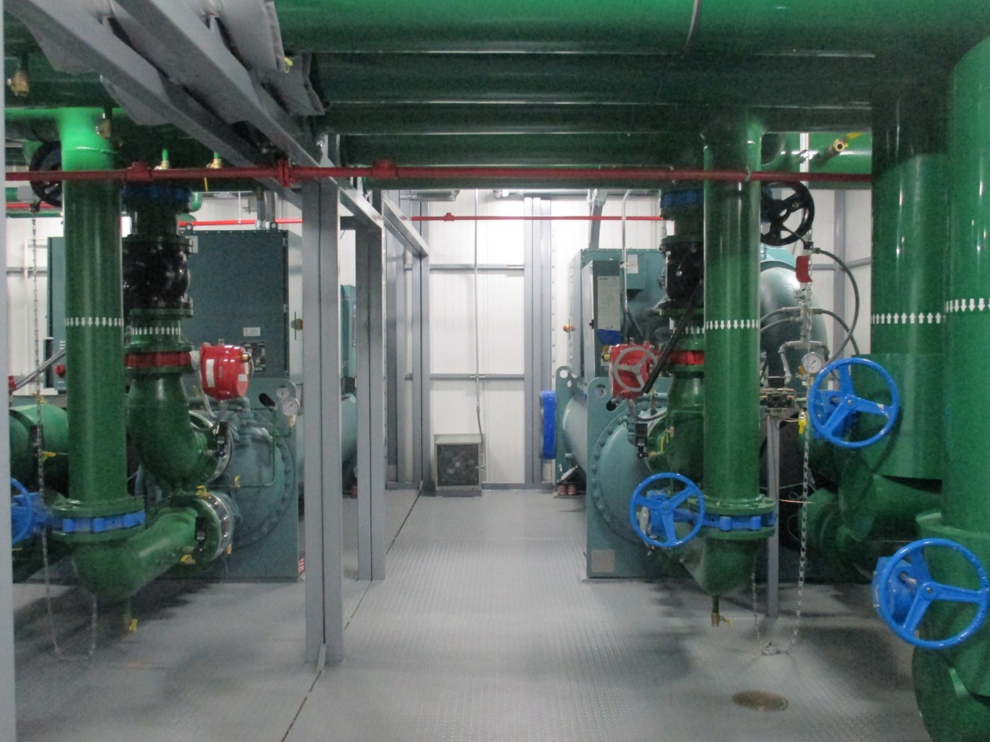
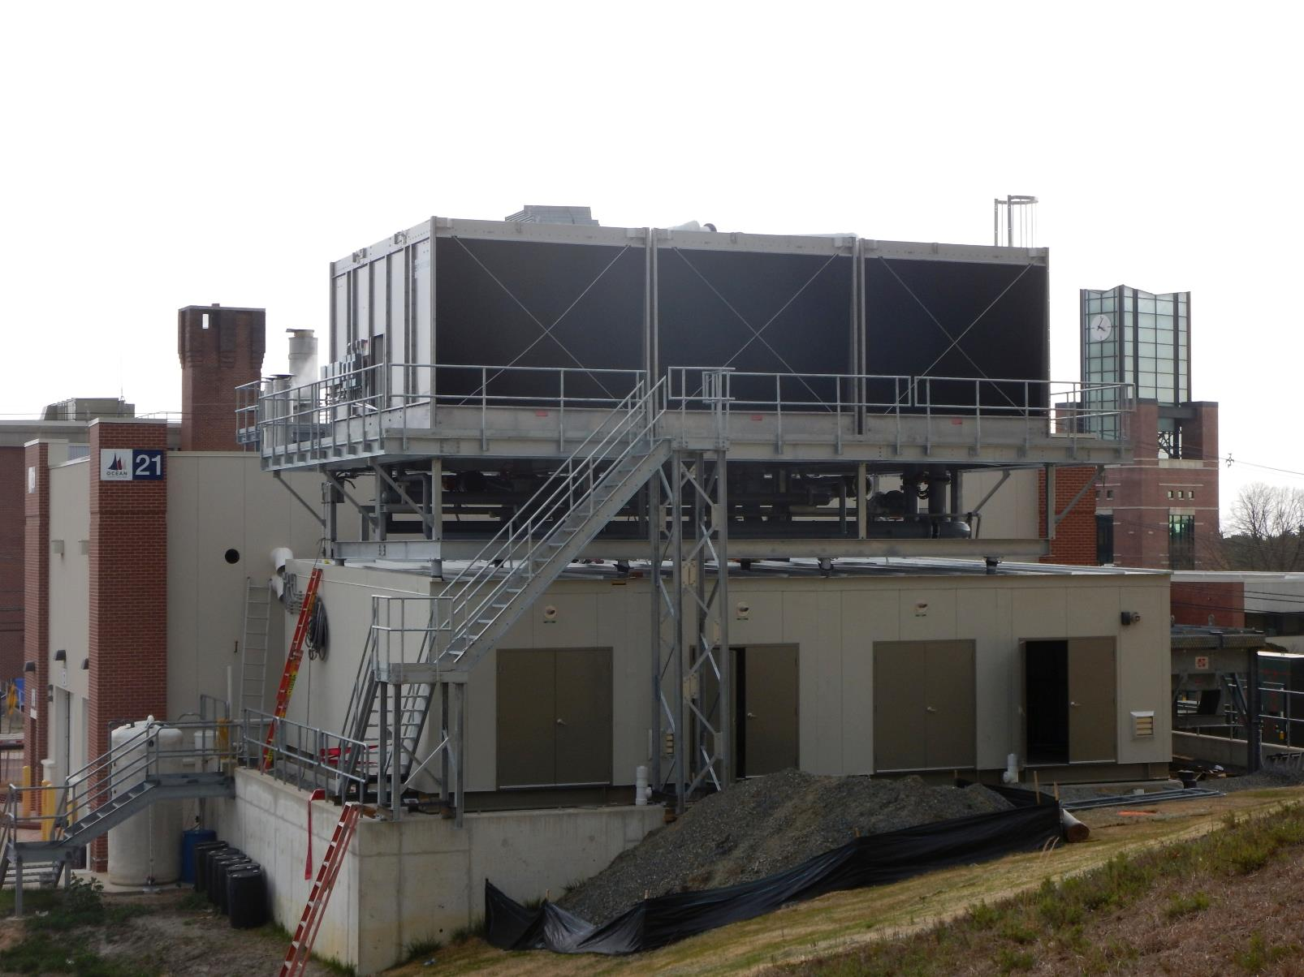
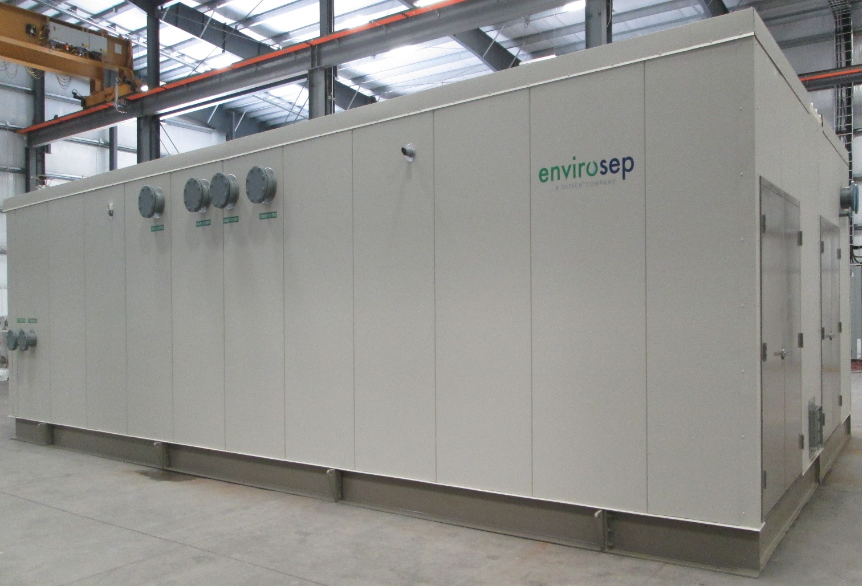
markets served
Healthcare
Biotechnology
Nanotechnology
Pharmaceuticals
Educational & Institutional
Hospitality
Data Centers
Automotive
Chemical Industries
Power
Oil & Gas
Transloading & Distribution

Slide 7

Why choose pre-packaged equipment?

Slide 8
packaging benefits
Overall job costs lower
Shop construction ALWAYS less expensive than field construction
Sole source manufacturing responsibility, just one manufacturer to coordinate
Reduced installation & start-up time
Integration of system controls
Optional system run testing available at factory
Management and skill of field labor
Management of materials
Reduction of construction scheduling delays
System fabrication simultaneous to site construction
Lower engineering costs to project
Issues easily addressed at the factory
Constructed in controlled environment, no weather delays
Why packaged equipment?

Slide 9
cost factors

Slide 10
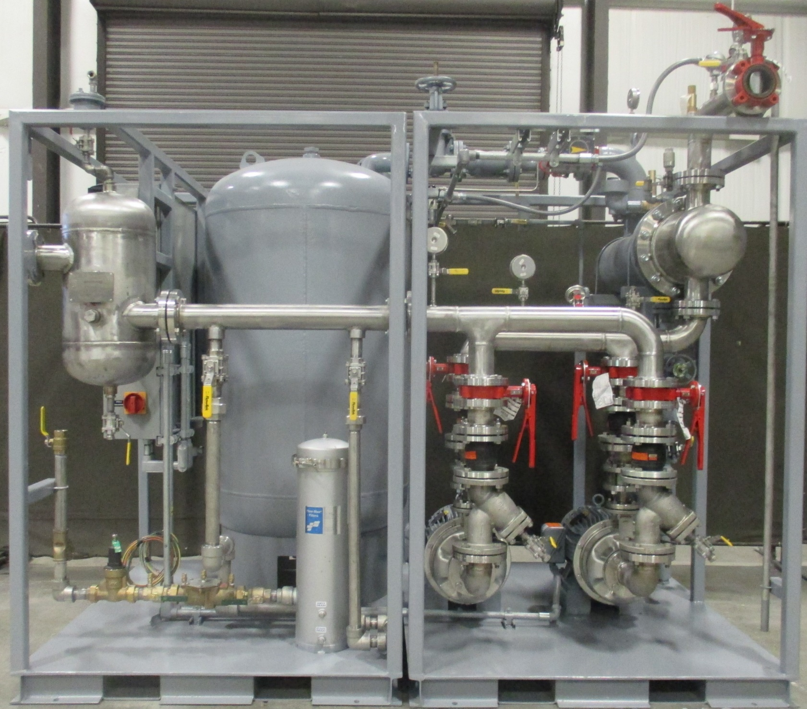
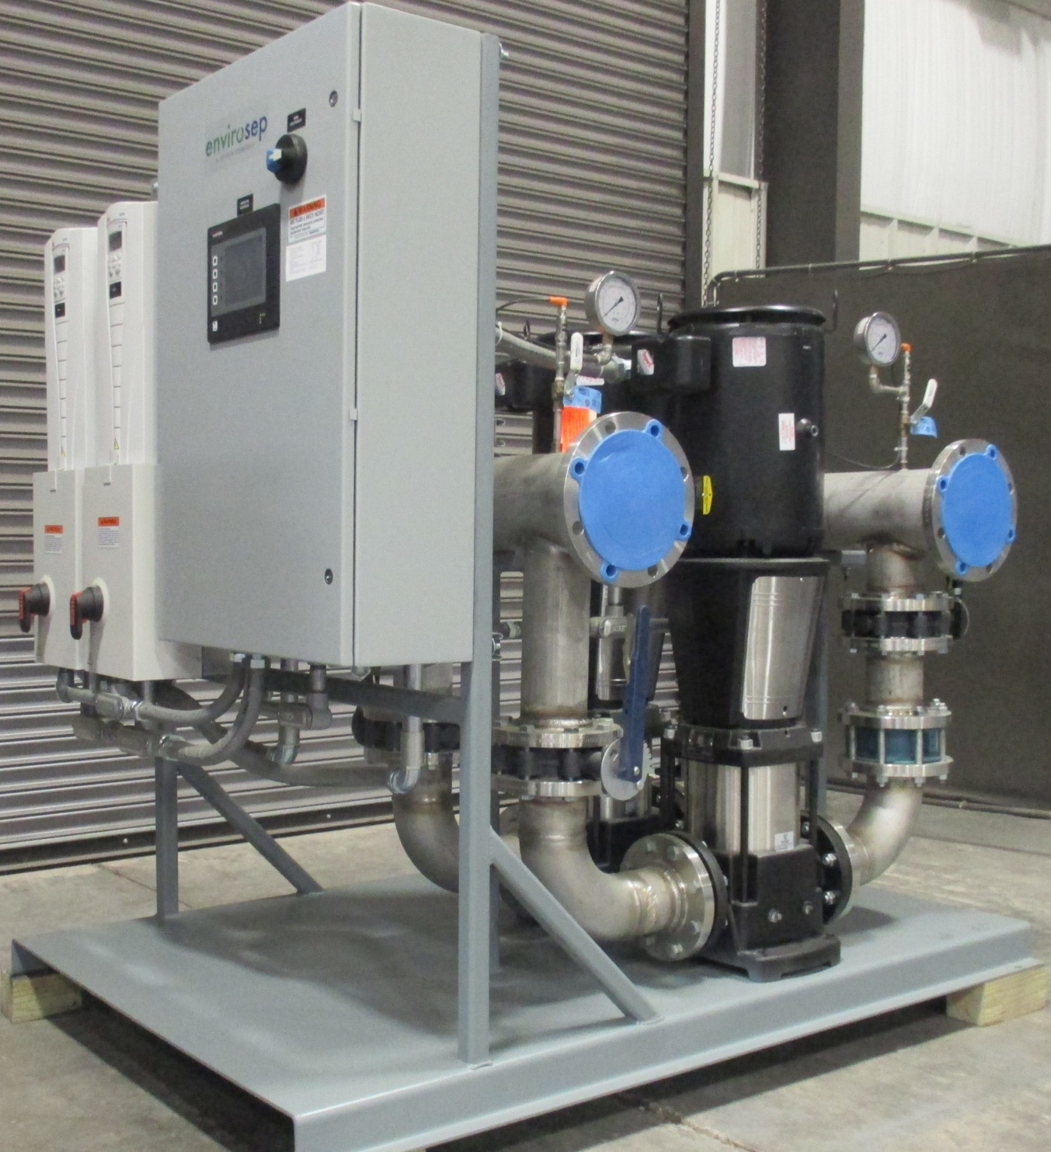
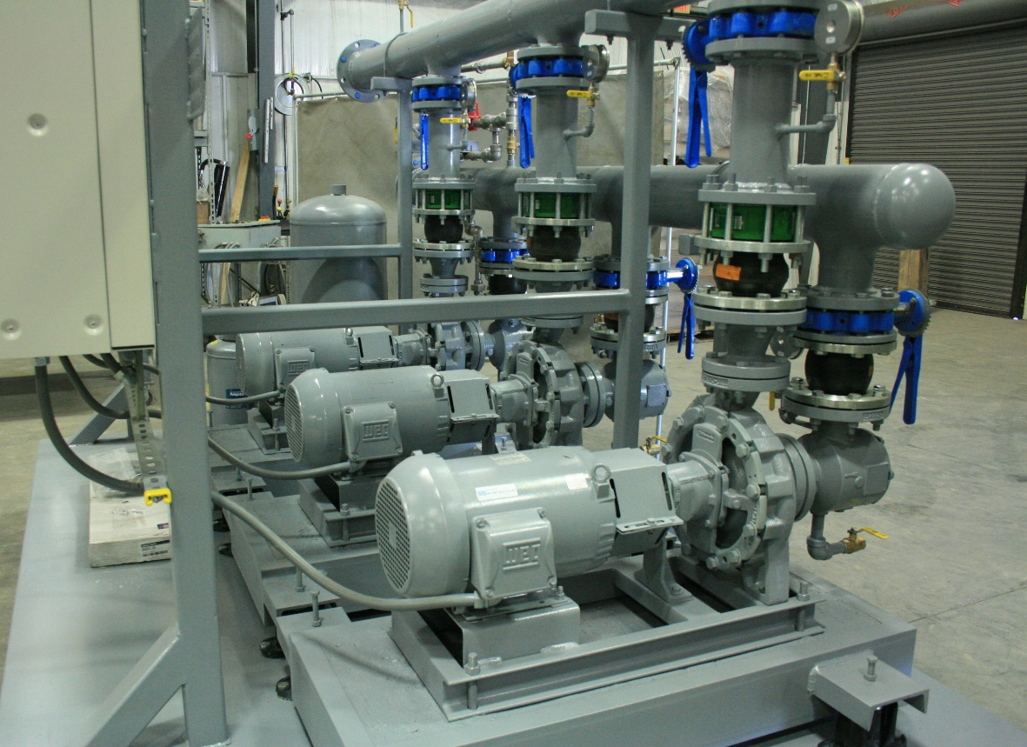
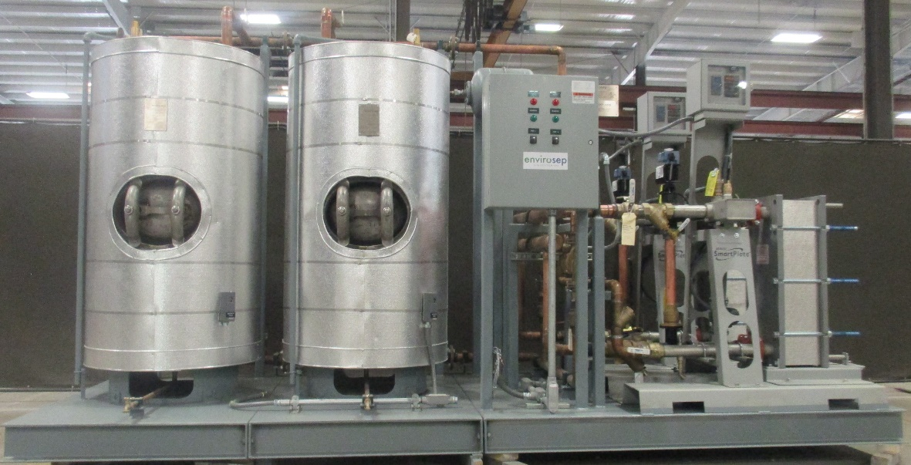

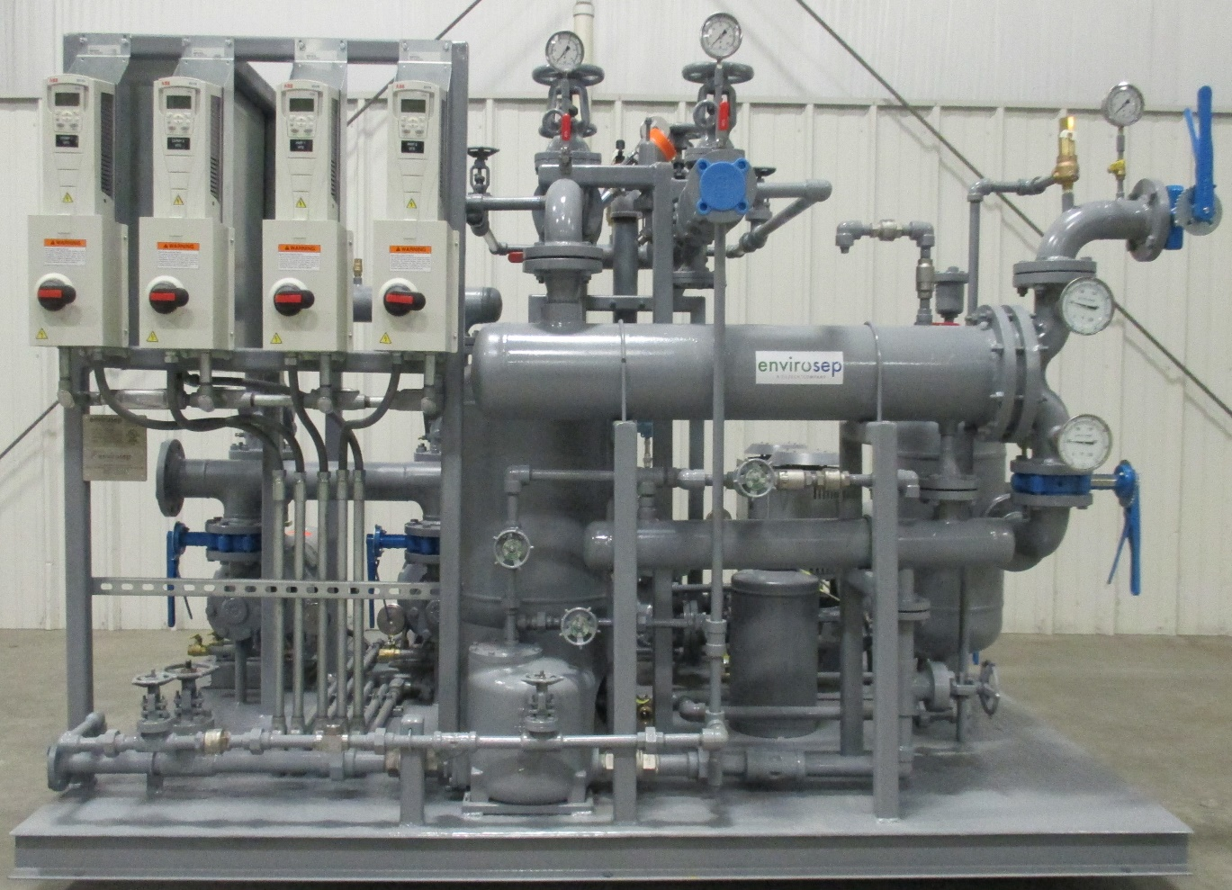
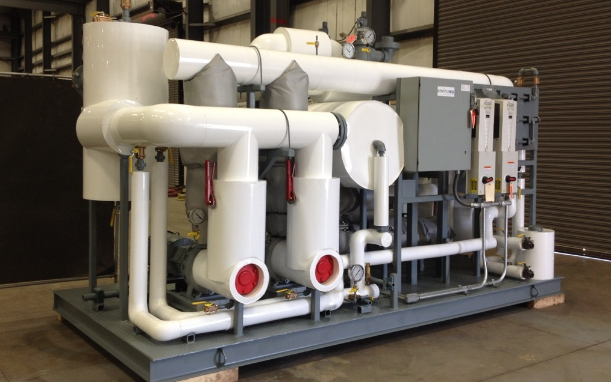
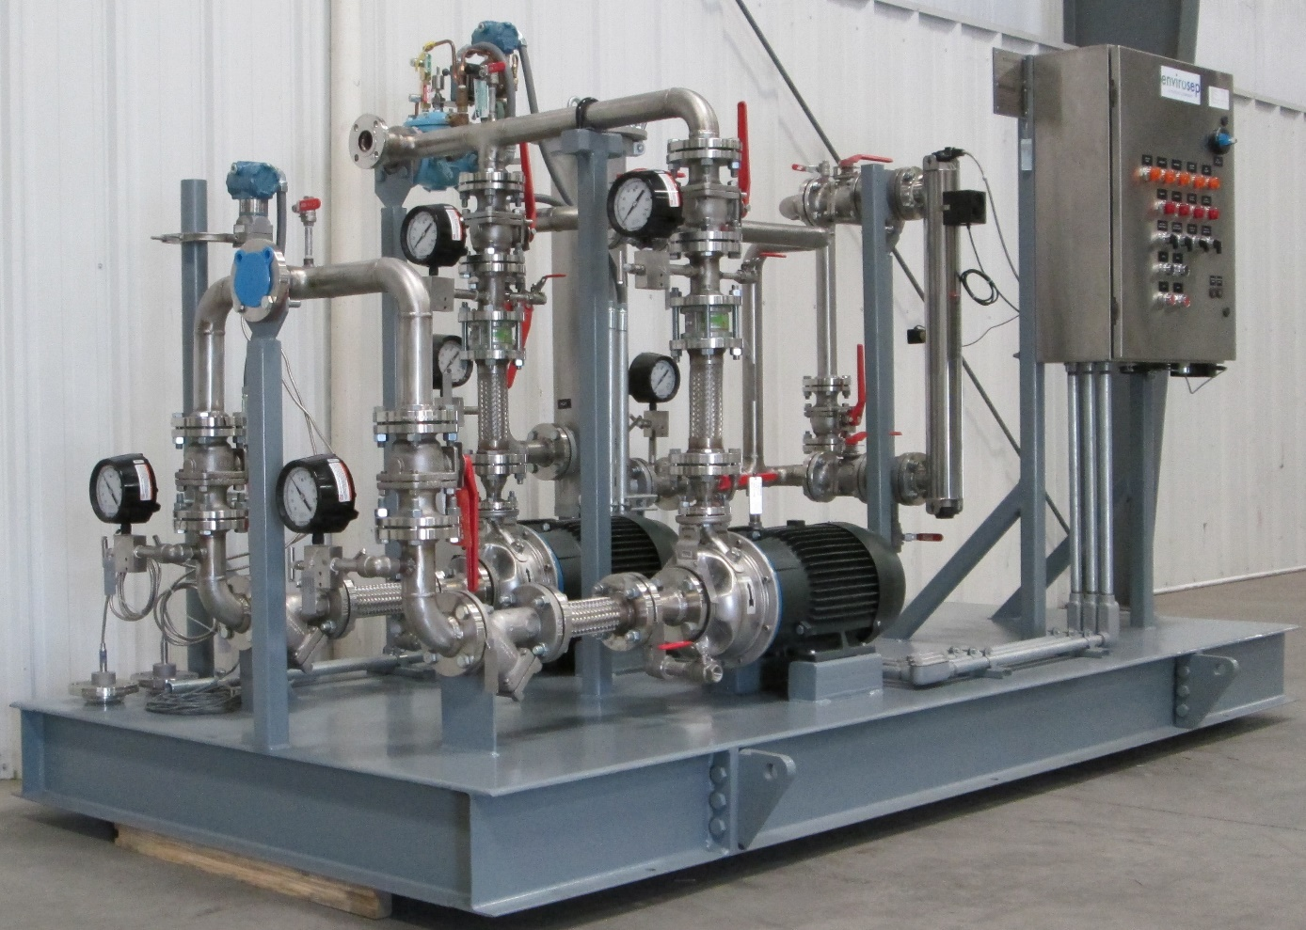
pumping systems

Slide 11
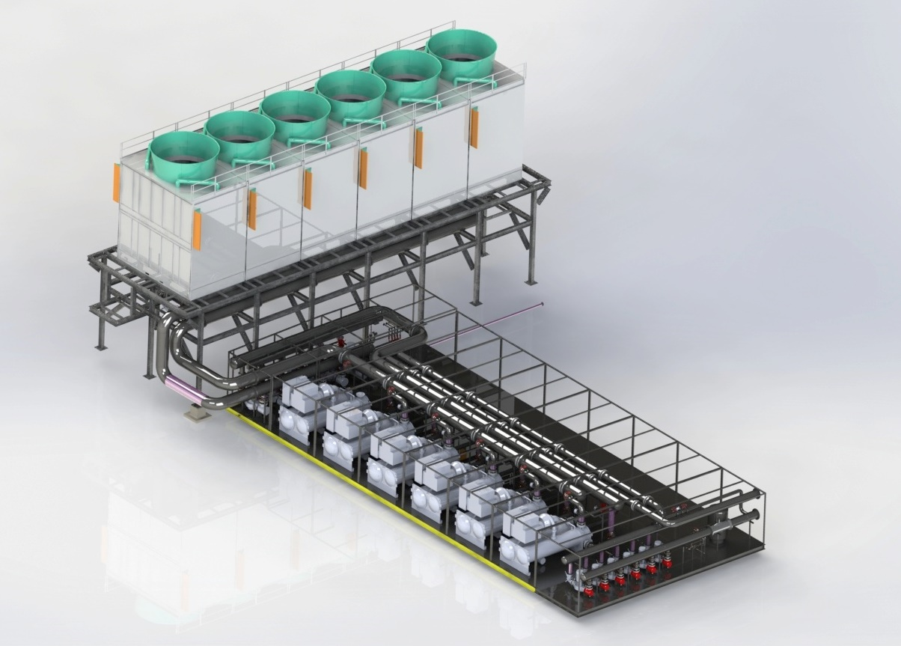
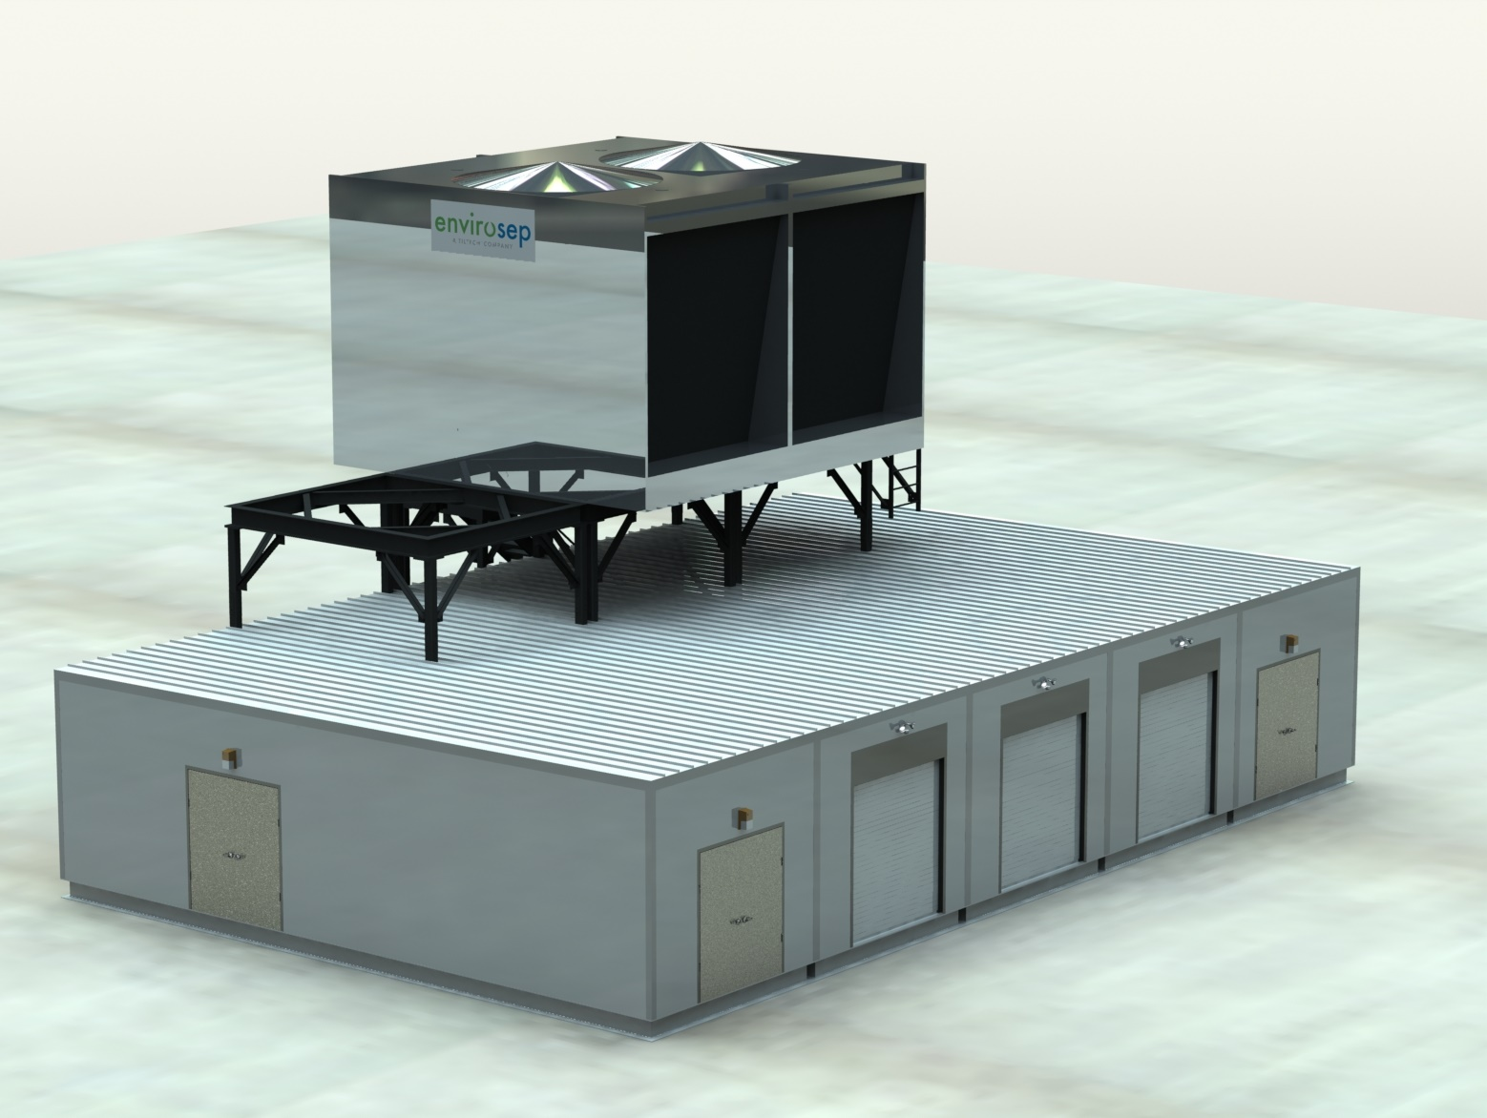
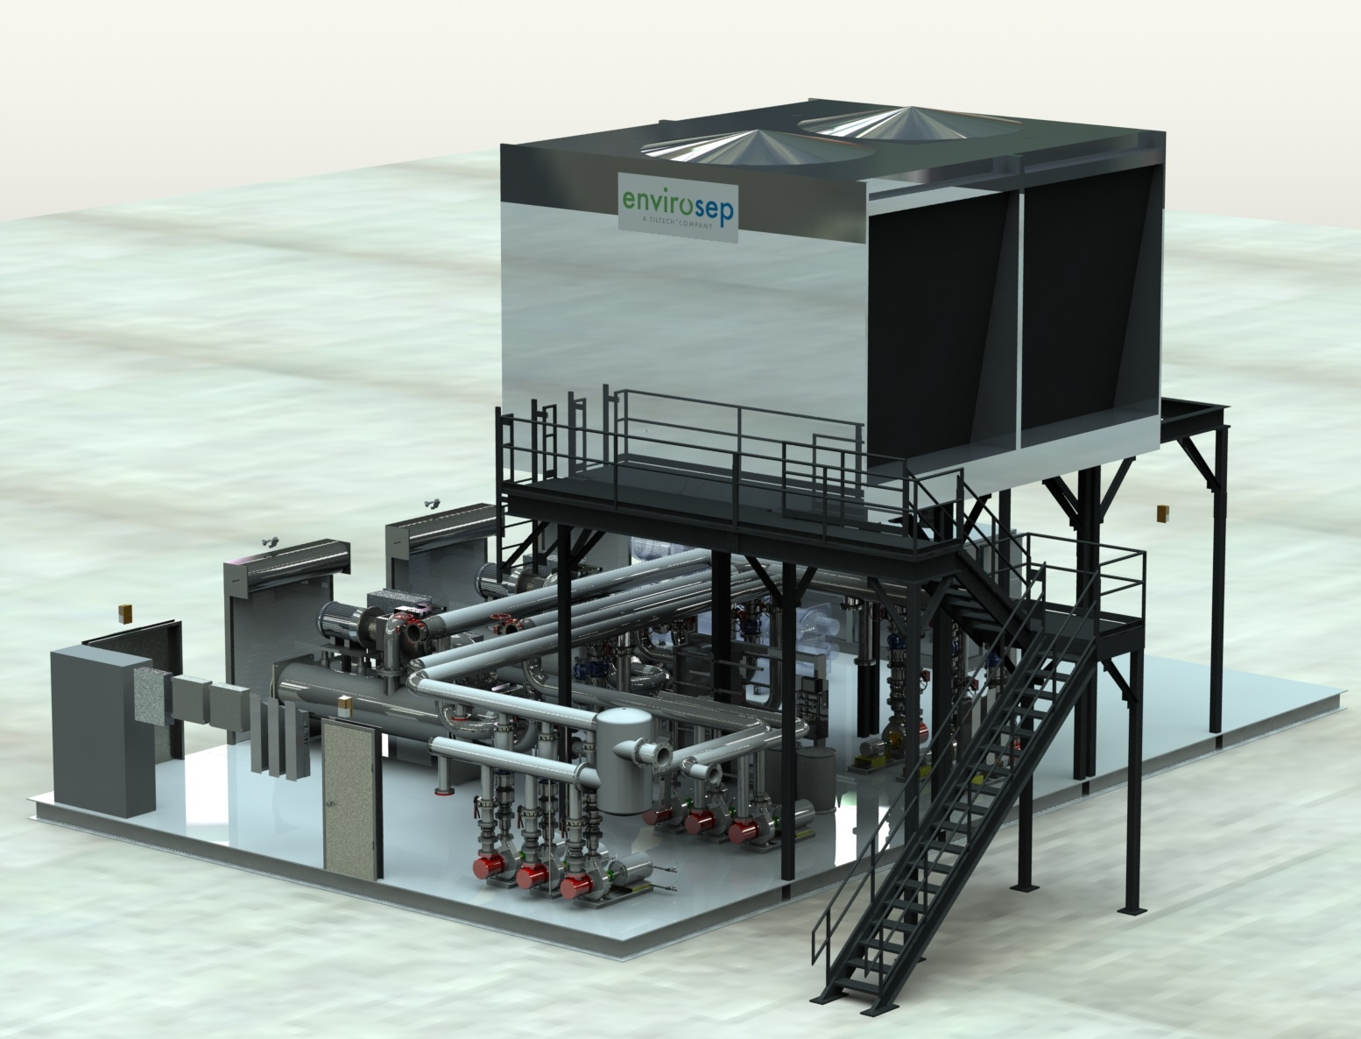
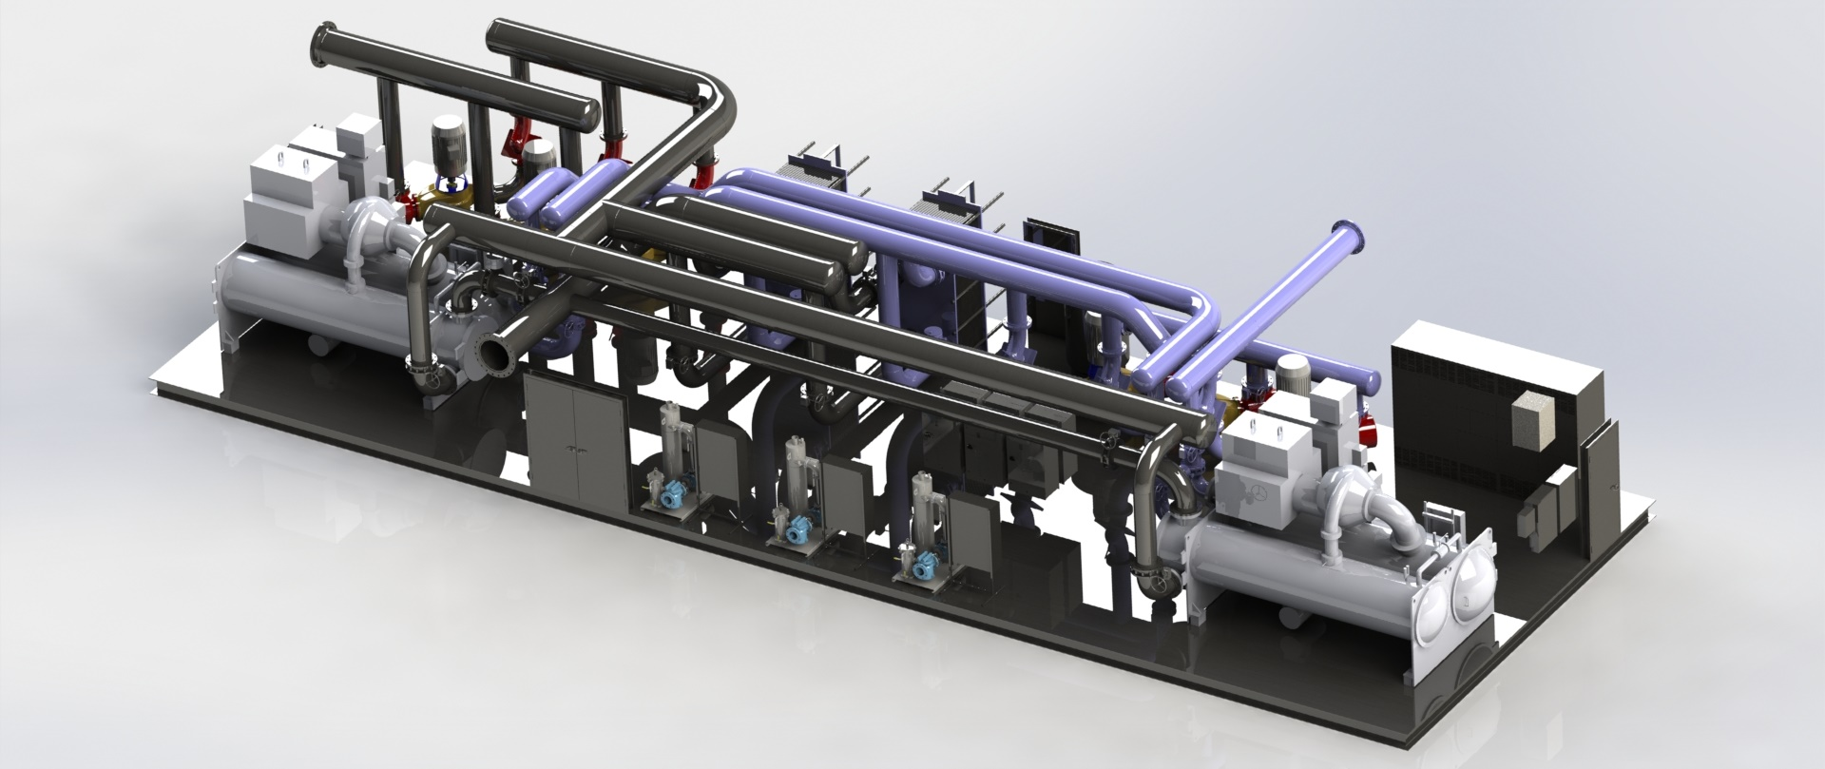
Proprietary & Confidential
engineered designs

Slide 12


