Slide 1
Power Generation Overview
in Asia
Updated on September 15, 2020

Slide 2
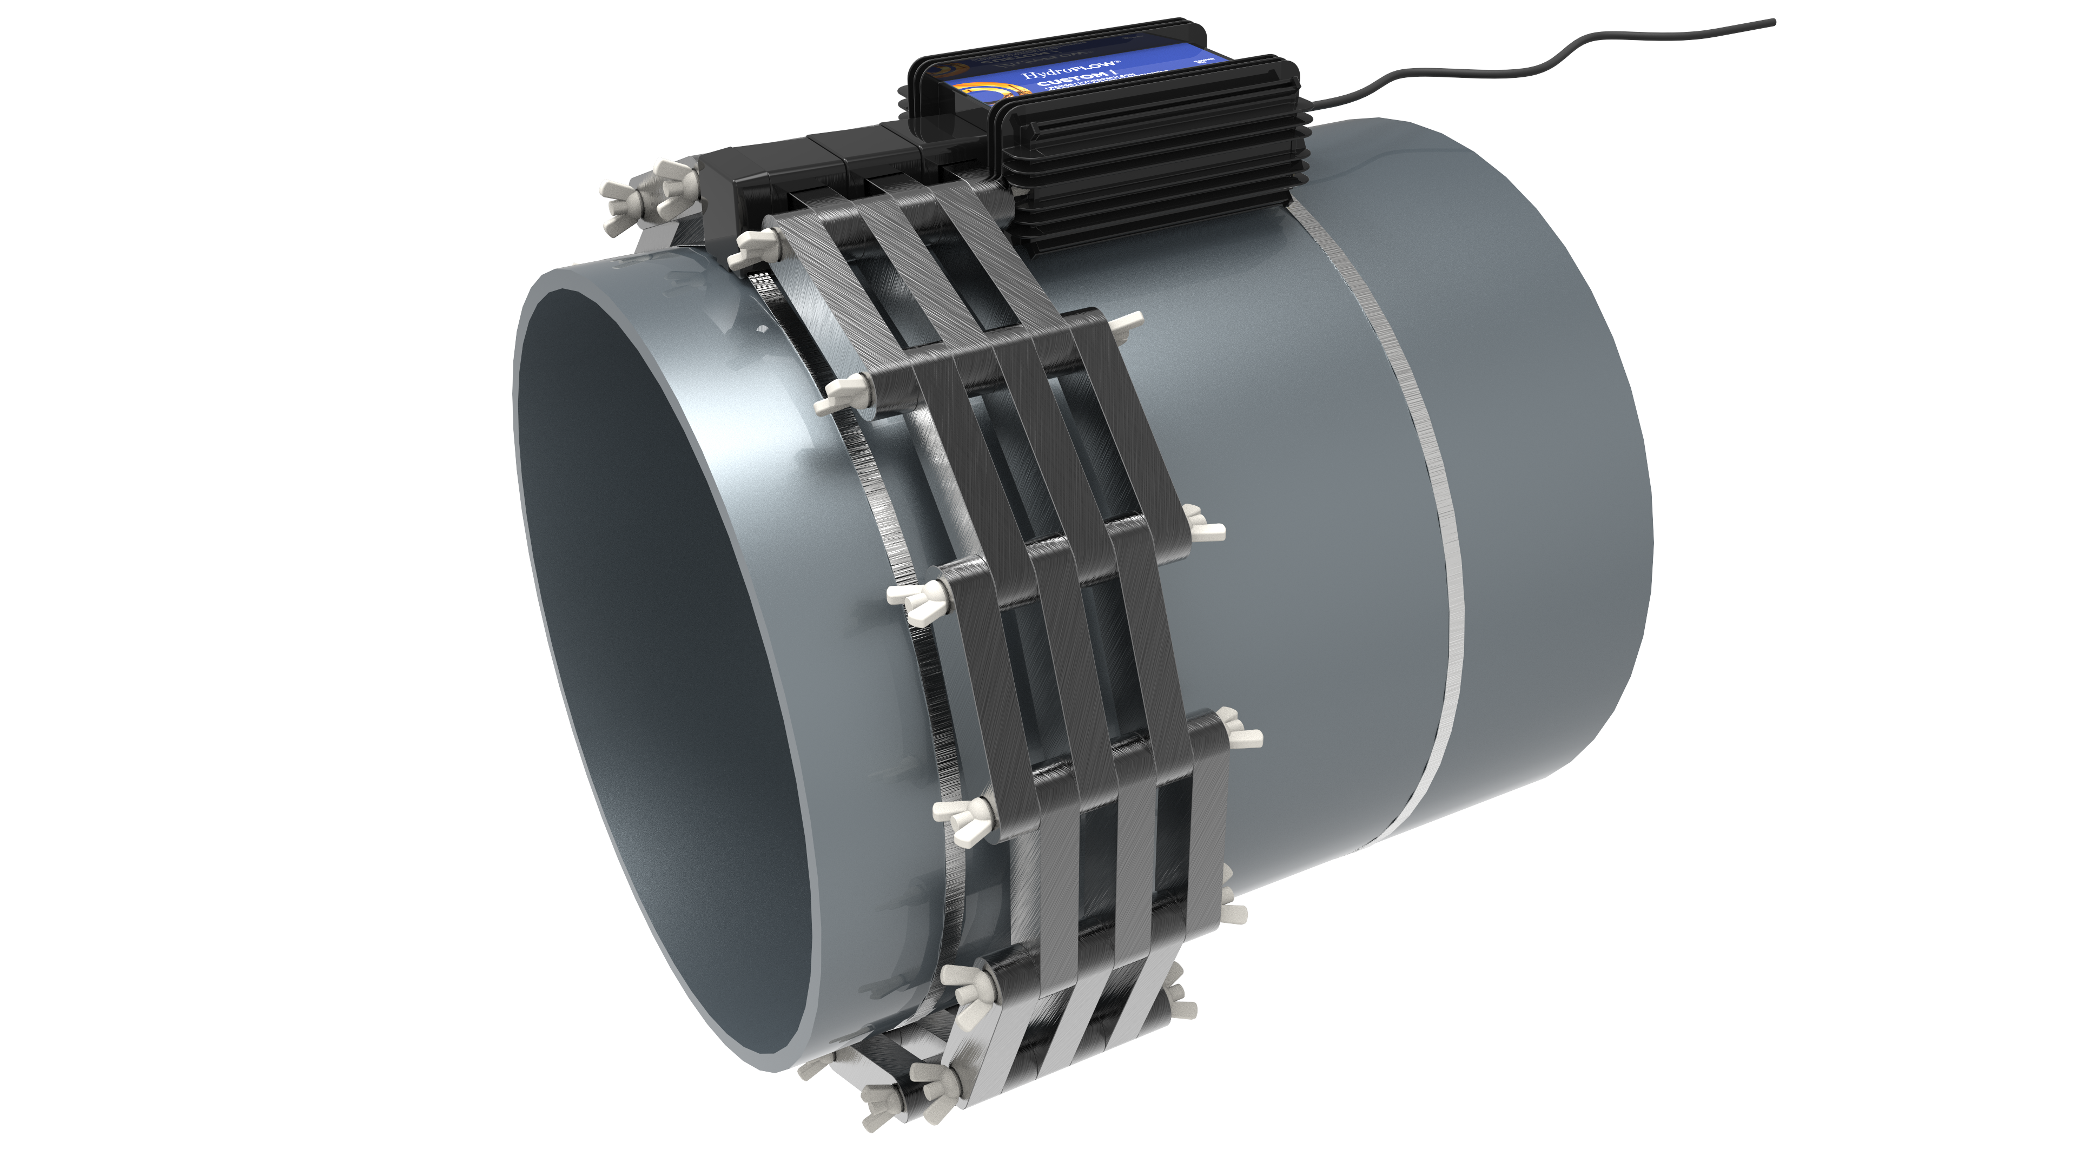
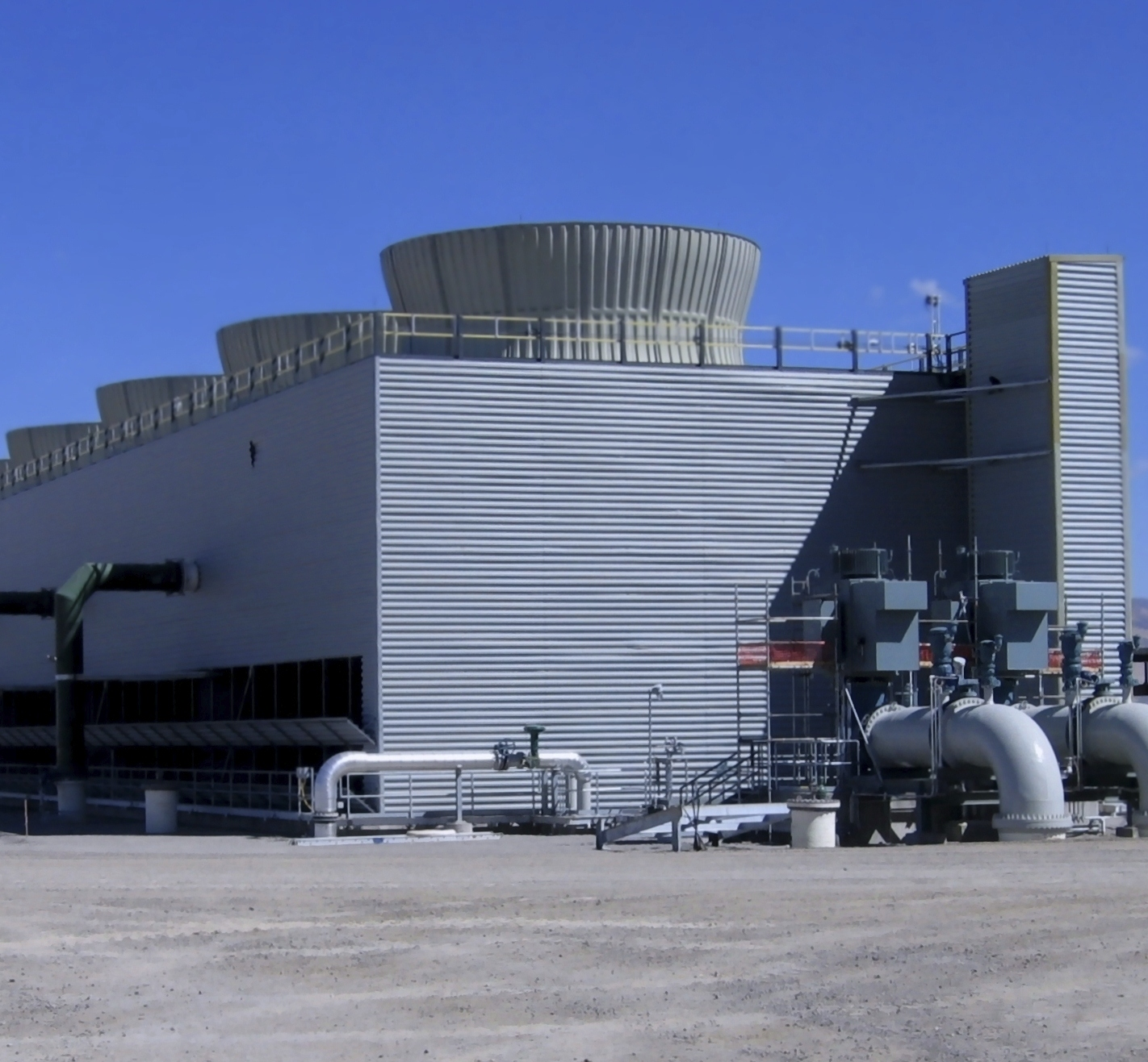
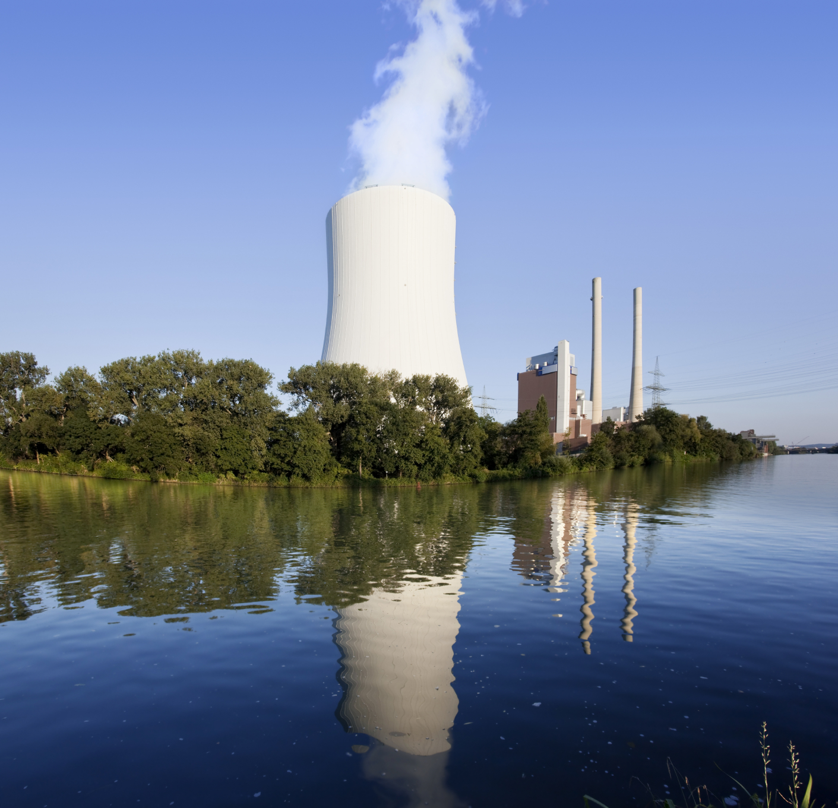
This document comes to provide a brief overview
of the progress made within the power generation sector in Asia.

Slide 3
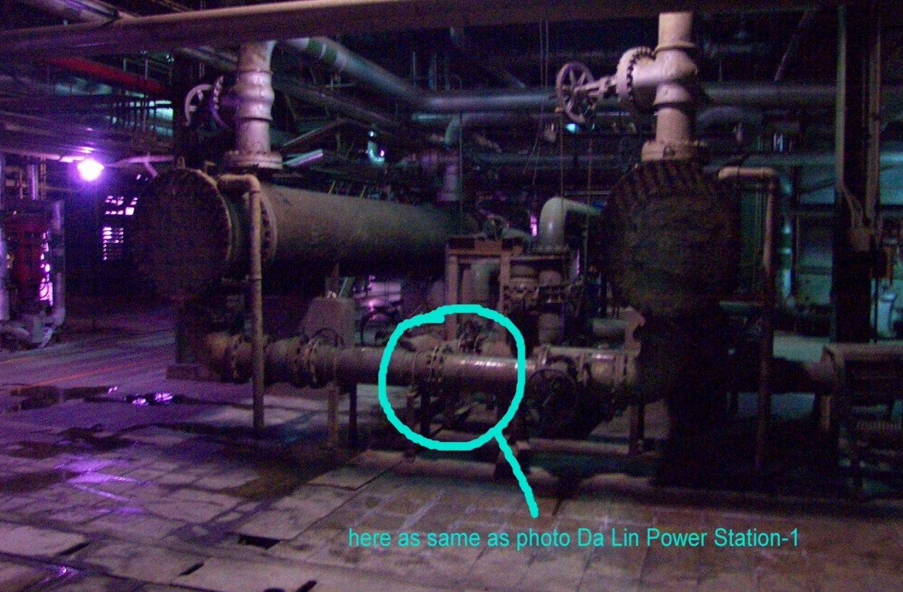
Taiwan
Da-Lin Power Station - Seawater is used for cooling. A HydroFLOW Custom 10” unit was installed at the inlet of a heat exchanger to treat biofouling problems.
After two months, the heat
exchanger was opened for
inspection.
Biofouling was greatly reduced,
heat transfer efficiency was
increased, and the maintenance
cycle was extended from two
to six months.
Installed HydroFLOW 10” unit

Slide 4
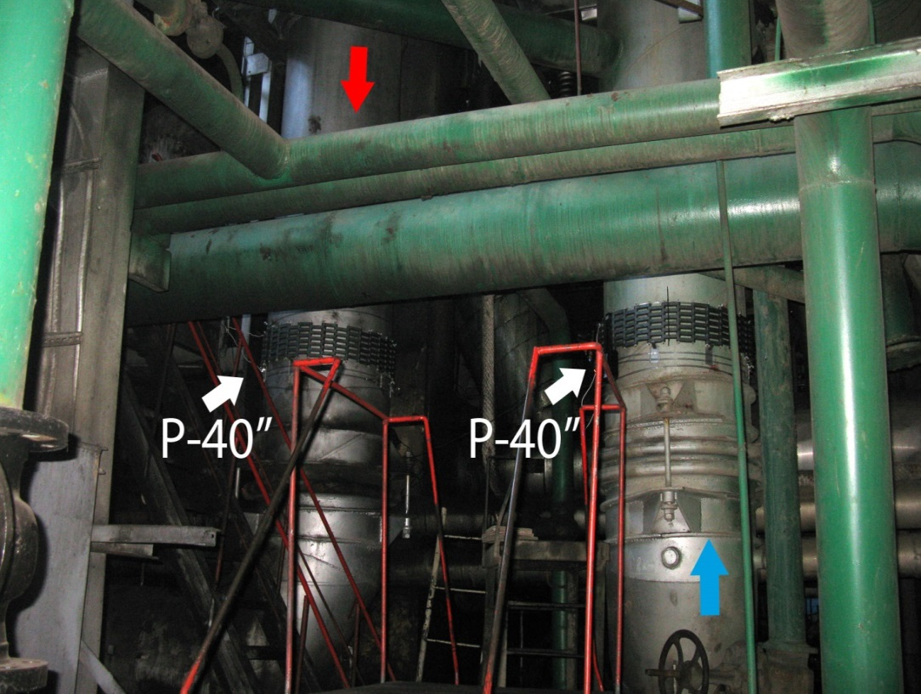
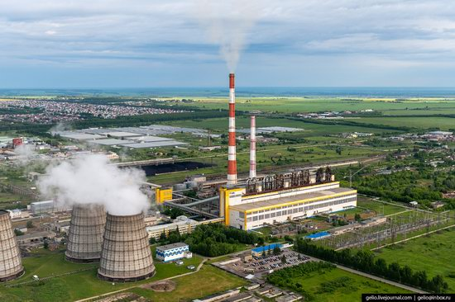
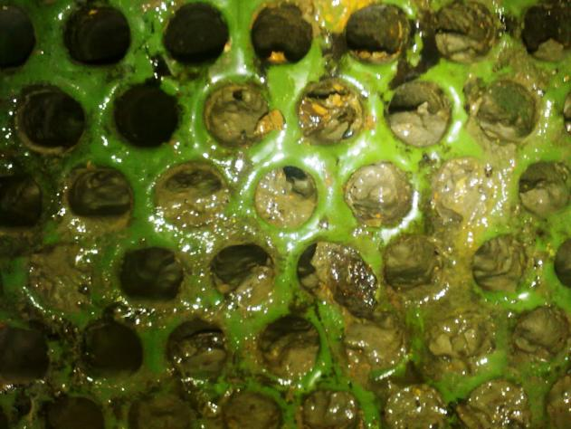
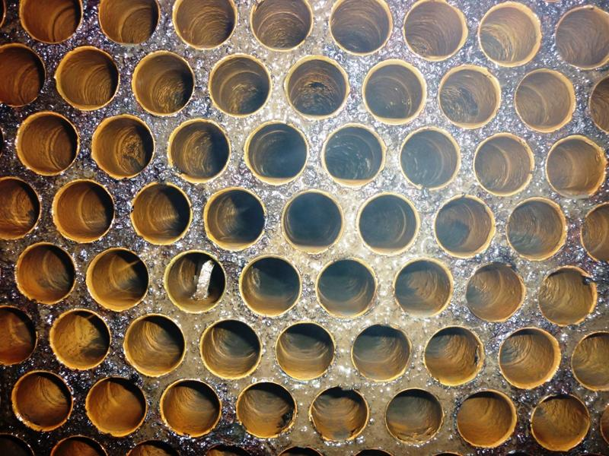
Russia
Barnaul Thermal Power Plant #3 - Two custom 40” HydroFLOW units were installed on the pipes feeding the steam condenser. Reduced biofilm accumulation inside the steam condenser was observed.
Before
After

Slide 5
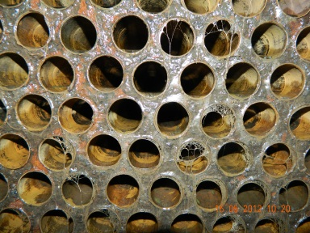
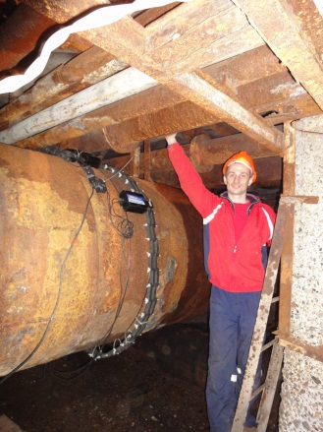
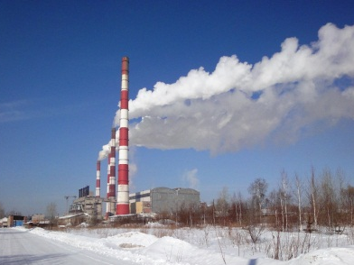
Russia
Nazarovsky Regional State Power Station - One custom 56” HydroFLOW unit was installed on the pipes feeding the steam condenser. The power station utilizes untreated river water in its cooling process, which created significant biofilm problems. After a few short months, biofilm accumulation was greatly reduced thanks to HydroFLOW.
After the custom 56” units was installed - Tubes free of biofilm

Slide 6
Japan
Nuclear Power Station in Hokkaido - The cleaning cycle of the submersible pumps was extended from 1.5 months to 12 months.
Isogo Thermal Power Plant - The RO system Bacteria count was reduced.
Shimonoseki Thermal Power Plant - CaSO₄ (Calcium sulfate) became soft and was easily removed.
Tata Sago Thermal Power Plant - The hard scale accumulation was greatly reduced.
Ahresty Tochigi Plant - Bacteria count reduced from 35,000 CFU to 8,000 CFU.

Slide 7
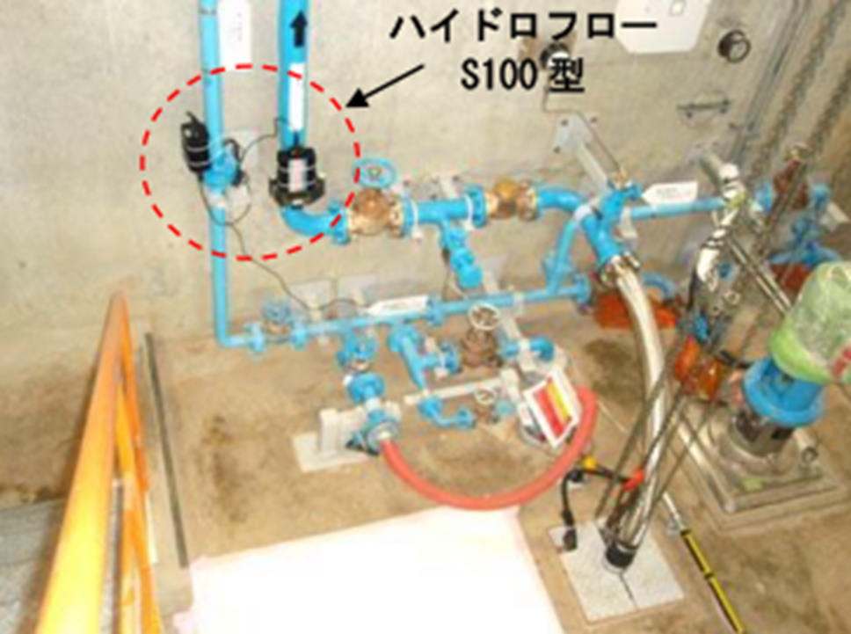
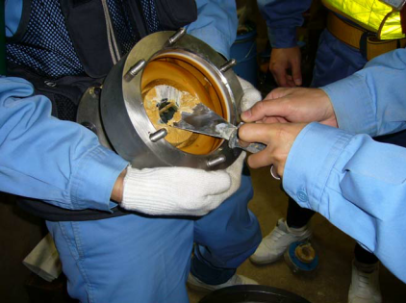
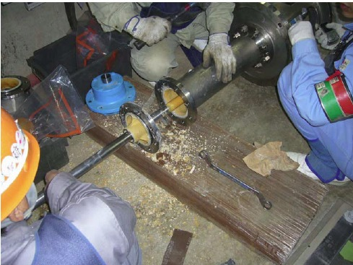
Nuclear Power Station in Hokkaido
Installed HydroFLOW unit on the line feeding the submersible pump.
After - Significantly less scale. Remaining scale is softer, and cleaning was extended from 1.5 months to 12 months.
Before - Hard scale in the pump.

Slide 8
South Korea
KOEN Power Station - A HydroFLOW Custom 24” unit was installed on a dirty heat exchanger. After 12 months, both delta T and P were still within operation limits. The heat exchanger was opened for inspection and was found to be clean. The client was happy with HydroFLOW’s performance and plans to order additional units.
Gunsan Power Station - The installation was on a heat exchanger. The time between maintenance cycles doubled.
Yeosu Power Station - Awaiting budgetary approval.

Slide 9
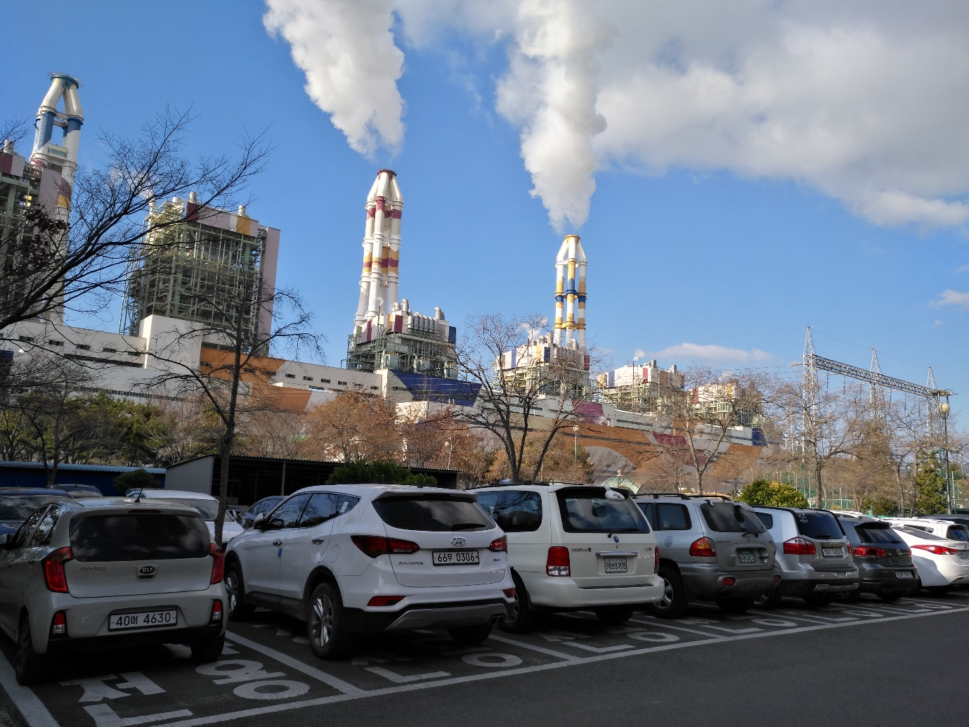
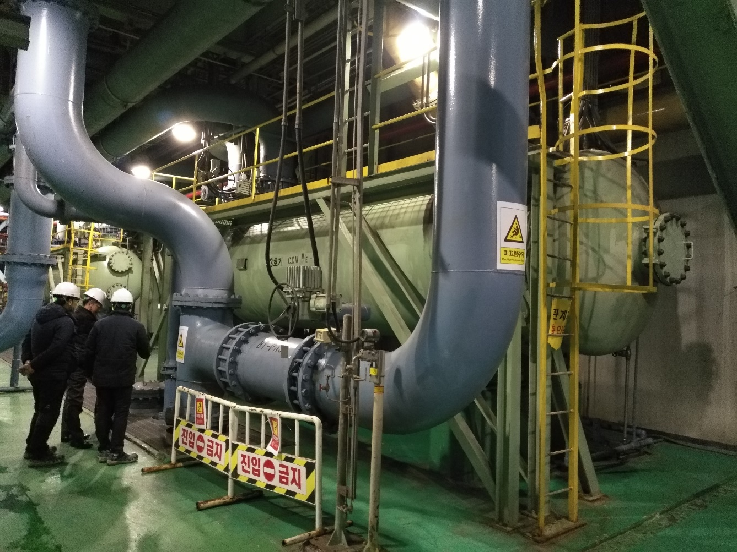
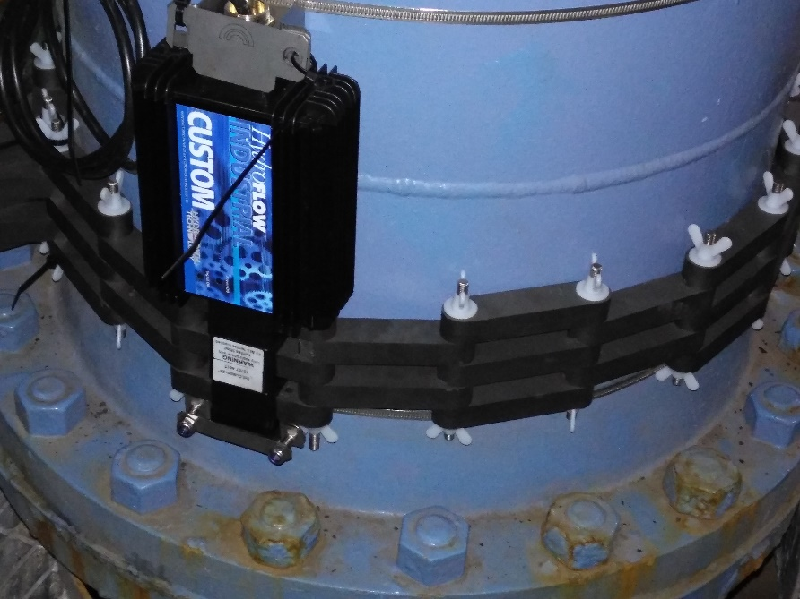
KOEN Power Station

Slide 10
China
(plant name cannot be disclosed)
2 x 600 MW coal plant (river water cooled) - Two 72” custom units were installed on the steam condensers. The objectives was to reduce chemical usage and increase efficiency. After one year; anti-scalant chemical were eliminated and biocide dosing was reduced by 90%. The steam condenser transit temperature reduced by 1.5⁰C and vacuum pressure increased by 1 KPa compared to the same period in previous years. No hard scale was found inside the condenser and cooling tower.

Slide 11
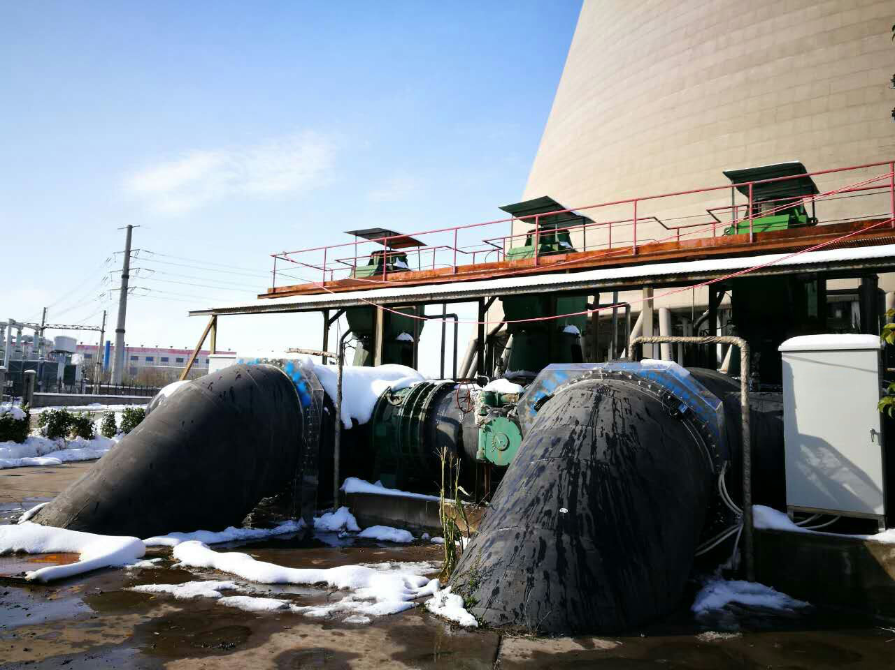
2 x 600 MW coal plant
Installed HydroFLOW units

Slide 12
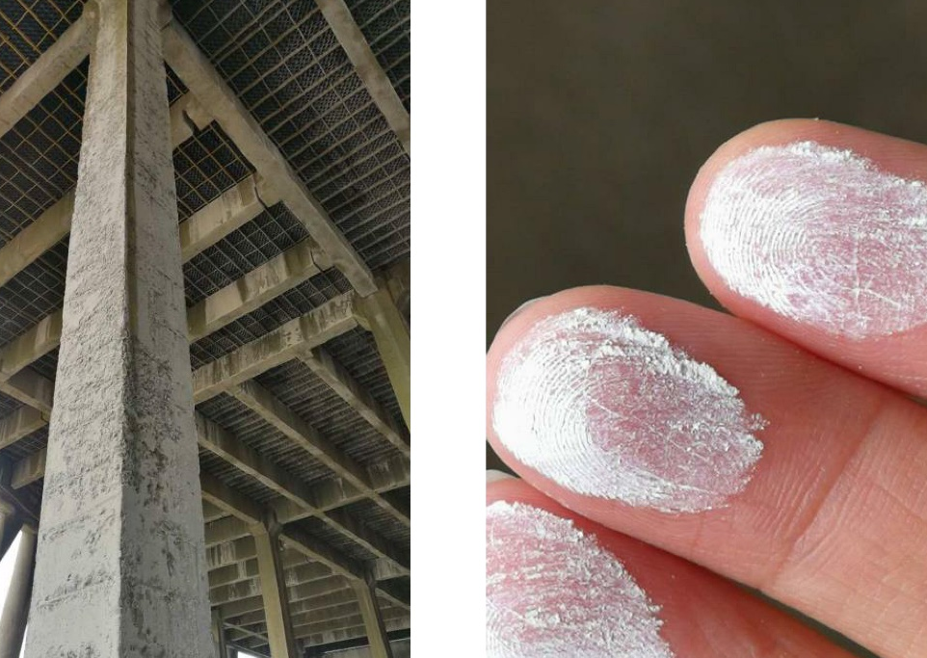
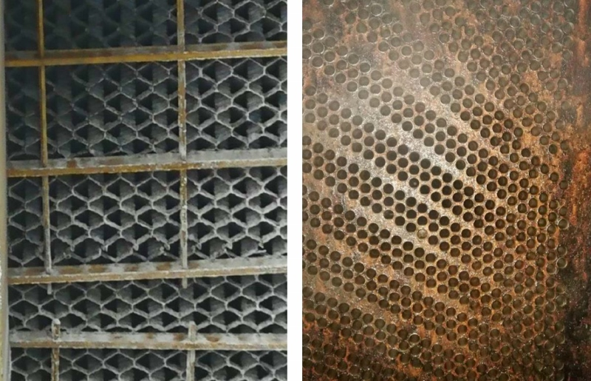
2 x 600 MW coal plant
No hard scale on the cooling tower’s infrastructure. The little scale that accumulated was soft and powdery.

Slide 13
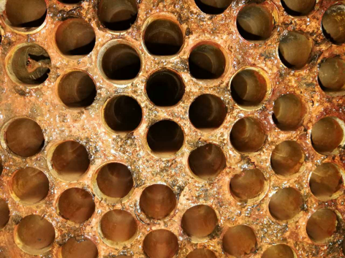
2 x 600 MW coal plant
Steam condenser tubes free of scale and biofilm.

Slide 14
China
180 MW Zhongshan Power Plant (river water cooled) - Two HydroFLOW Custom 50” units were installed to treat scale and bio issues.
Chemical usage was decreased by 80%.
No hard scale or biofilm was found inside the condensers.
Total bacteria count in the recirculating water was reduced from 300,000 CFU to 9,000 CFU.
The steam condenser’s transit temperature dropped by 7.4% and vacuum pressure increased by 0.86% compared to the same period in previous years.
Estimated annual savings of $56,000.

Slide 15
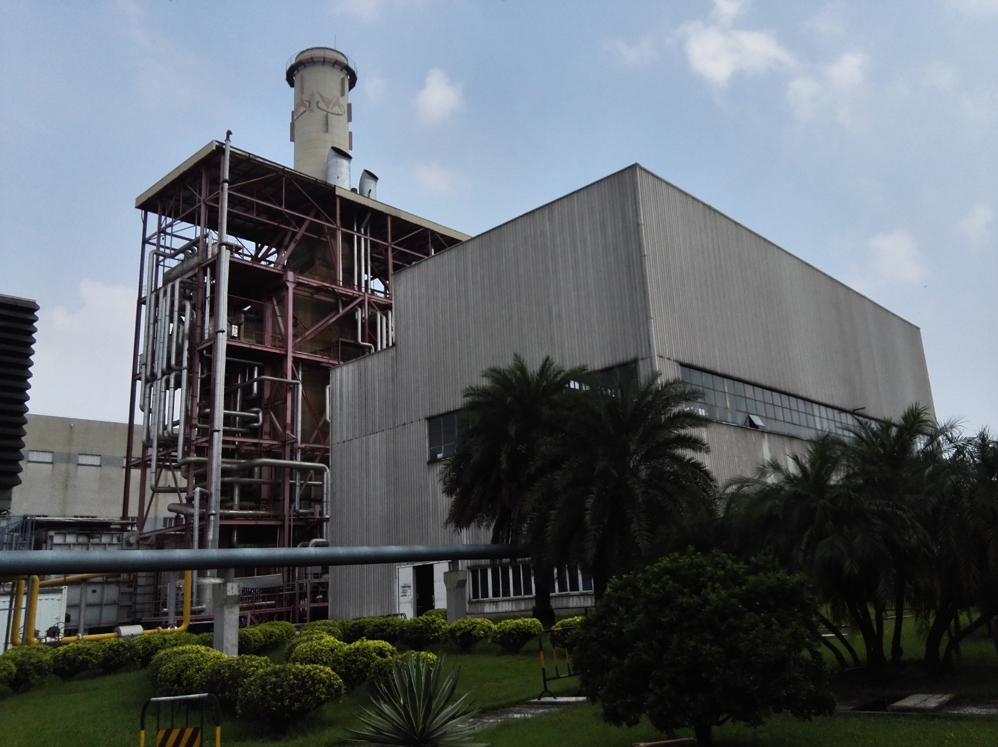
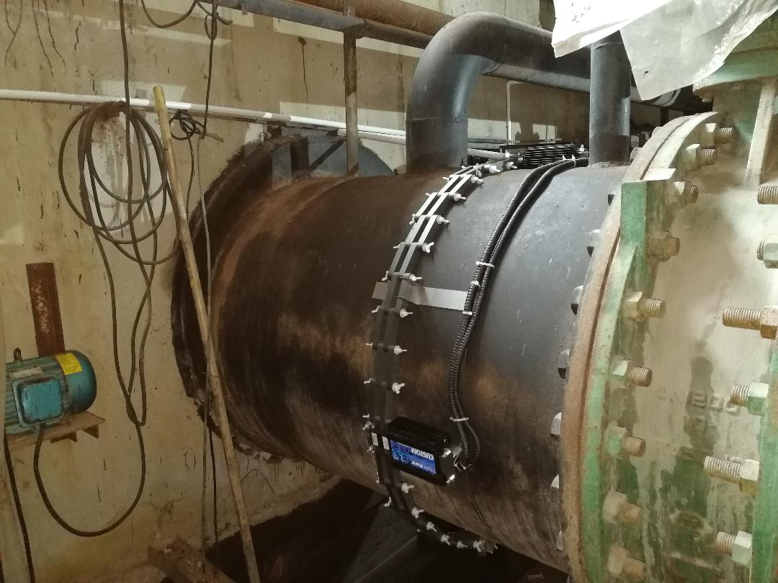
180 MW Zhongshan Power Plant (river water cooled)

Slide 16
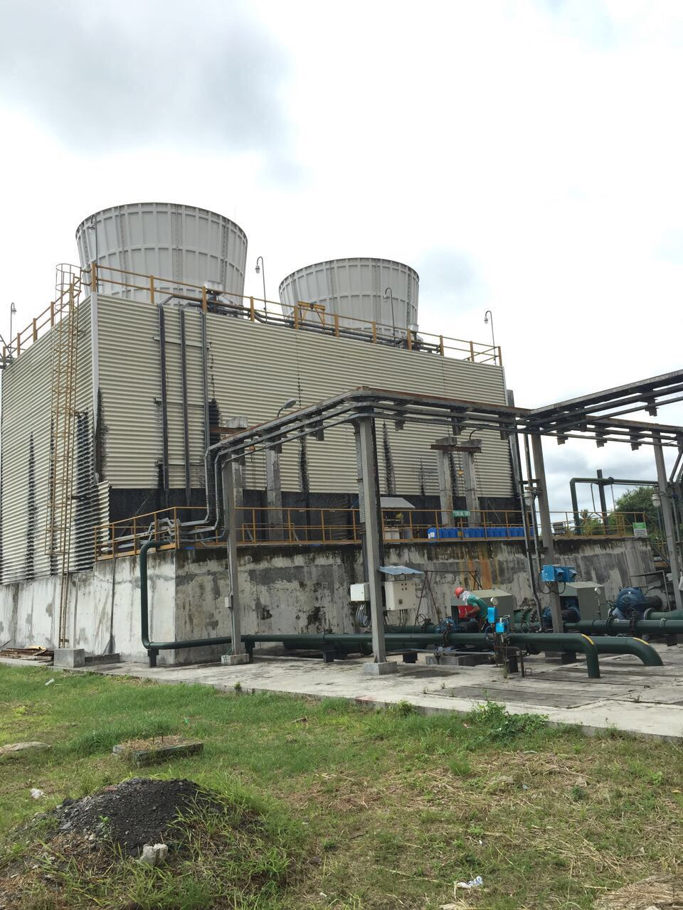
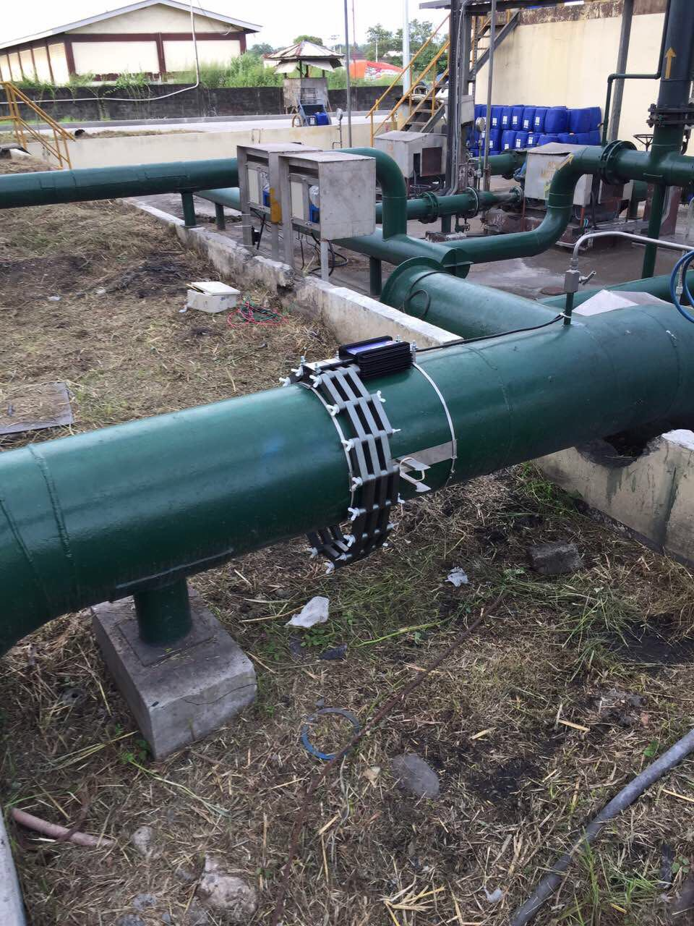
Philippines
3.5 MW Lamsan Biomass Power Plant - This is a small power plant that uses rice hulls (the protective coverings of rice grains) as fuel. The objectives were to reduce chemical usage and increase heat transfer efficiency. Two HydroFLOW units were installed.
Chemical usage was reduced by 30%.
The heat exchanger’s efficiency was maintained within required parameters.

