Slide 1
Ohio Living Home Health & Hospice
Mobile Supply Closet® Program Inservice
Training 12/11 – 12/13 Go Live 12/18

Slide 2
Order Processing Hours of Operation
Hours of operation:
Monday-Friday 9:00 am – 6:00 pm EST
Customer Service: 1-866-991-9944
Order cut-off time for shipping is 5:00 pm EST
All orders must be received by 5:00 pm EST in order to ship out that day and be delivered within 2 business days.
Aim for 4:00 pm EST to be on the safe side to ensure your order ships!

Slide 3
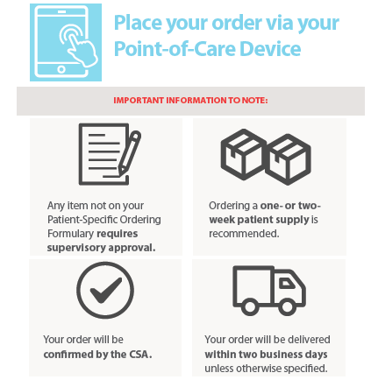
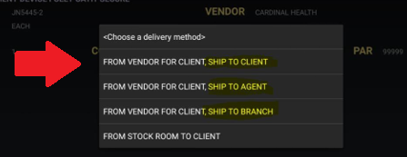
Patient Direct Orders
Patient Direct Highlights
Staff will continue to place orders on their Point of Care Device for patient direct shipments. ALL ORDERS, commercial included, flow through HCHB.
Same internal procedures exist regarding order frequency and Medicare guidelines.
$5.50 Shipping fee applied to orders, so order 1 week’s worth of supplies at a minimum.
Order delivery time will vary based off of the patient’s insurance type. Tracking available through the Mobile App!
Descriptions/Categories could also be slightly different than what you are used to.

Slide 4
Patient Direct Ordering Key Points
The workflow is the same as it is today:
Clinician places the order and sync’s the HCHB device.
Order is sent to the Ohio Living team for approval.
Once approved, order is sent to the vendor for processing.
If the item is not in the device, see your supervisor.
Depending on the Insurance type, the order will either be transmitted to the HHS Team (Medicare and Hospice) or to our MedConnect Team (Commericial Payers.)
If you have an urgent commercial payer order, see your supervisors.

Slide 5
How long will it take to get my order?
Medicare/ Hospice Patient Orders & Car Stock orders will arrive in 1-2 business days.
Place by 4pm EST to ensure next day delivery!
Faster because insurance is not being billed by HHS.
Formulary Controlled because your agency absorbs the cost.
Non-Medicare/Commercial Payer Patient Orders will be sent to over to our MedConnect Team for processing.
These orders will take could take on average 3-4 business days for delivery.
Slower because we are billing the patient’s insurance and doing all the running around for you.
Order whatever brand you feel best suits the clinical need!

Slide 6
MedConnect® - Commercial Payers
Follow-Up/Order Issue Communication:
The MedConnect team will send a daily encrypted email out to site champions on order status. Potential issues include, but are not limited to:
Insurance termination
Physician signature
Prior authorization
Items considered routine and not covered by insurance
Questions?
For questions regarding orders, please contact HHS Customer Service, ask to speak to the Medconnect Team at 855-450-2507

Slide 7
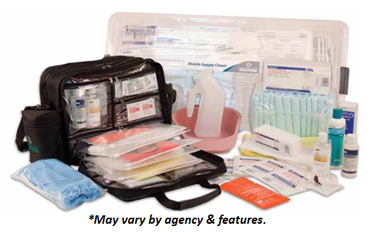
The Mobile Supply Closet®
On demand supplies for new admissions & emergency needs
Discipline specific and amended as needed.
Can be ordered pre-assembled for new employees.
Items will be shipped directly to Clinician’s homes using their HCHB device for patient specific items and our Mobile App for Routine items (gloves, hand sanitizer, etc.)

Slide 8
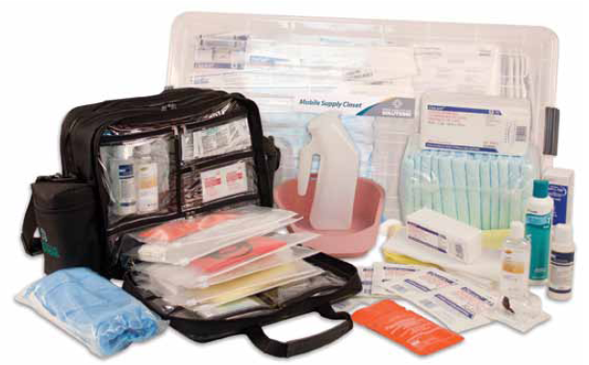
Mobile Supply Closet® “Dos &Don’ts”
Do!
Use for new admissions & emergent needs
Replenish at least once per week or as needed
Attribute Non-Routine/patient-specific supplies to patients as they are used and replenished
Leave minimal supplies to get the patient by until the first order arrives.
Don’t!
Supply patients entirely out of your Mobile Supply Closet
Wait until the last minute to replenish
Don’t deplete your stock for a singular patient.

Slide 9
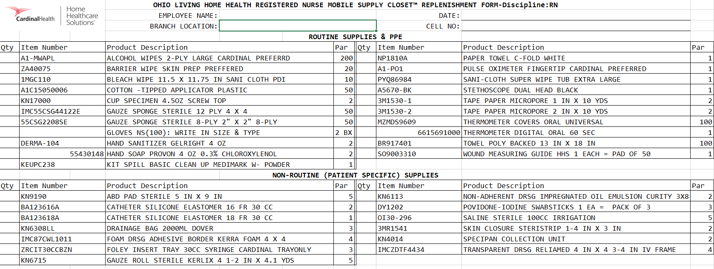
Your Mobile Supply Closet® Form
Order on the App!!
HCHB: Ship to Agent!

Slide 10
Mobile Supply Closet Replenishment
Key Points
All the items listed on the MSC forms provided in the back of your implementation booklet.
For patient chargeable items, order through the device and select “Ship to Agent” to deliver supplies to your home.
Items on this list are pre-approved at the par levels assigned.
Order totals exceeding a monetary limit (i.e. $50.00) will be held for your supervisor’s approval before shipping.

Slide 11
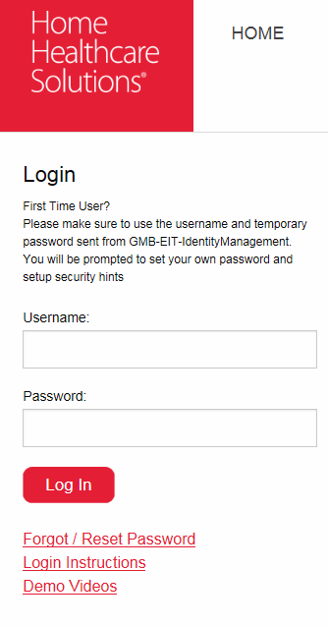
Logging into the Mobile App
Mobile App should be already be preloaded on your HCHB device.
Name: HHS Cardinal
You will receive a User Name & temporary password from our network
Emailed on Monday 12/10/18
Hint: Copy and paste the temp password!!!!
Each user sets up their own password and security questions.
Hint: Passwords are required to be reset every 90-days
Our system knows what company you are with through login
Information is ready & waiting!

Slide 12
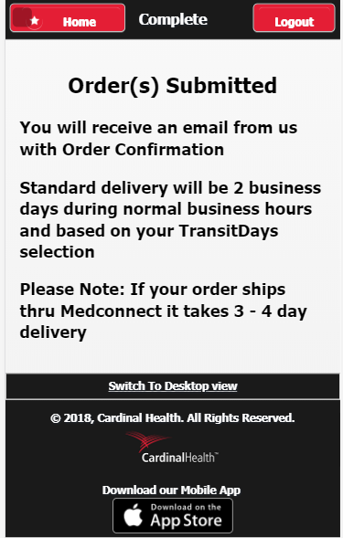
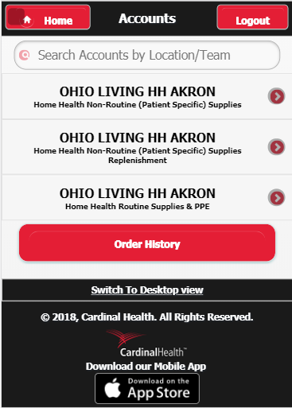
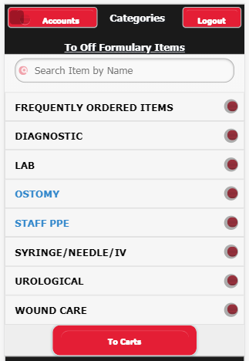
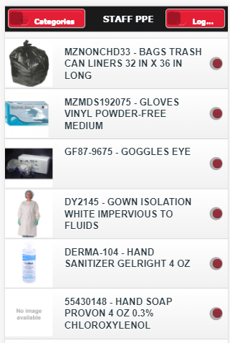
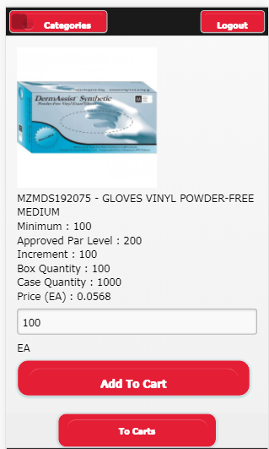
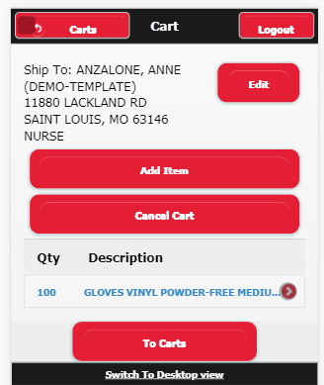
Mobile App Ordering
If the item is Routine, you will order on your Mobile App:

Slide 13
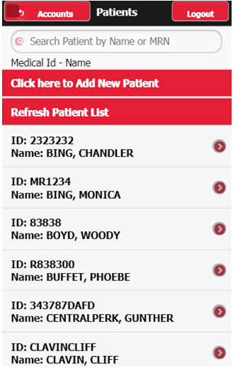
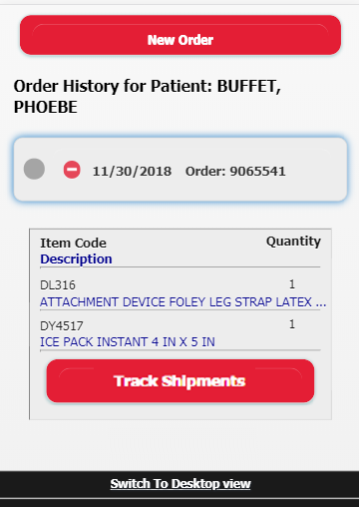
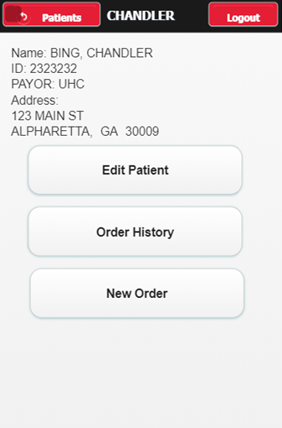
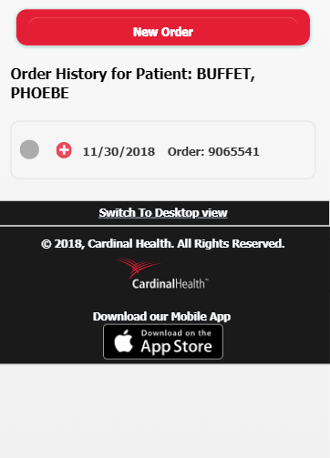
Mobile App Features – Patient History!

Slide 14
Clinical Support – Desktop version only!
Access to certified CEU opportunities
Guides and Tools developed by industry WOCNs to help clinicians deliver bedside care in a home or facility
Informative articles on wound, ostomy, incontinence care... and more!

Slide 15
MedConnect® - Patient Discharge
Does your patient still need supplies upon discharge?
If so, call into HHS and ask for the MedConnect Department.
Is this for just Commercial Payers that already use the MedConnect platform?
This program is for all your patients including Medicare! Call 1-866-991-9944 for all your discharge patients!
What happens after you notify MedConnect of the discharge?
We will take all the necessary information to send the patient to a provider for continuing care.
We will let you know who the long term care provider is.
Providers will reach out to the patient every 30 days.

Slide 16
Final Thoughts
When do I use the HCHB Device or the Mobile App?
Anything patient related MUST be done on the HCHB device.
Only Car Stock orders are allowed to be placed on the Mobile App. No orders should be placed for patients under the Mobile APP.
What do I do if I need an item NOT on formulary in the HCHB device?
If you need something outside of the formulary, please reach out to your supervisors. They will be able to order outside of the formulary.
When will my product arrive to my patient?
Commerical Payers will take on average 3-4 days. See your supervisor for Urgent needs. Medicare and Hospice payers will arrive in 1 day as long as they are placed prior to the cut off of 4pm EST.
Is there anything else that is helpful to know when using the Mobile App?
For security reasons, your session will time out on the Mobile App or while using the Desktop version of the site. If you receive a error message resulting from this, please log out and log back in.

Slide 17
Next Steps
Go live is Tuesday 12/18/18
Order some gloves from the Mobile App and test it out!
Sync & Refresh on Tuesday morning
Staff will still need to complete their normal Sync & Refresh on Wednesday morning.
Verify your home address when placing your first car stock order from the Mobile App.
If the address is incorrect, you may update it from the App however make sure to update it in HCHB as well.

Slide 18
Leadership Roundtable

Slide 19
Supervisor Roundtable Discussion
Topics to Cover:
Program Changes/Notes
New Employee Needs
Additional Web Capabilities for Management

Slide 20
Program Changes/Notes
Field staff will not be allowed to place patient orders on the Mobile App, only car stock orders for themselves. Management listed below will be able to place orders for patients via Web or Mobile App for Medicare and Hospice patients.
Patient specific items used out of car stock will be tagged to patients using the HCHB device.
Car stock orders may need approval prior to shipping.
Ohio Living Management may remove the need to approve the order in Workflow. More to come on that!
Items not in the HCHB device:
Medicare/Hospice - Can be placed via web by managers listed below.
Commercial Payers – Can be placed by calling our main number and placing the order with our MedConnect team.

Slide 21
New Employee Kits *Ohio Living HR Team
When you have a new employee, we will send the complete Mobile Supply Closet for the discipline for an easy orientation for your staff.
To order these, please email GMB-CHH-HHS-Express@cardinalhealth.com
This email goes to our Customer Service Leaders. Please let them know you need to order a new employee Mobile Supply Closet and include the following pieces of information:
Employee Name
HCHB Employee Number
Employee Discipline
Address for shipping the new employee kit
Phone Number

Slide 22
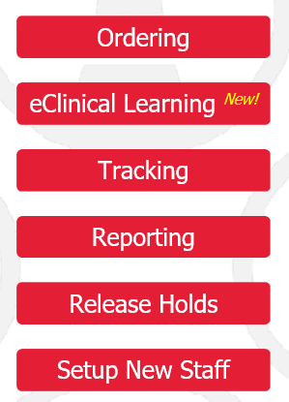
Online Access for Supervisors
Web Portal Special Features:
Managers will have enhanced capabilities on the website including:
Ordering Supplies for Patients & Office Supply rooms
ON-DEMAND Reporting
Approving orders online (automatic hold customers only)
Not available for HCHB agencies - Set up new staff and request new employee Mobile Supply Closets®

Slide 23
Placing Orders via Website
Patient Orders
Office Supply Room Orders
Patient Orders should only be processed via web when the item is NOT currently found on the HCHB device.
Only supervisors who are set up with this special access will be able to place patient orders outside of the HCHB.
Supply Room Orders can be placed under Mobile Supply Closet Routine/PPE and shipped to the branch.

Slide 24
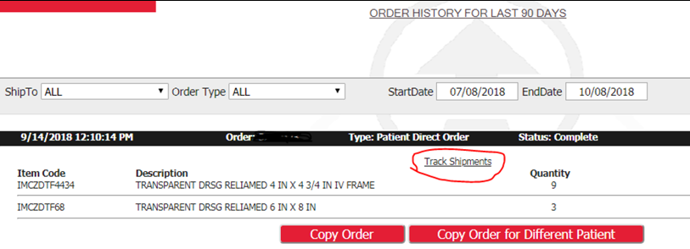
Patient Selection & Order History
Accessing the Patient’s order history
Select your patient (Please note, you may need to provide the payer source if not listed as available.)
Order Tracking regardless of which courier shipped the package.
Screen will auto present 90-days, but to view longer simply change the date range.
MedConnect orders for items NOT in the device must be placed via phone.

Slide 25
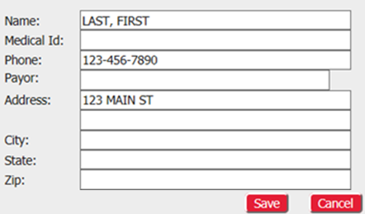
New Patient Additions (just in case!)
Click the ‘Add’ button for simple online data entry!
Hospice patients will always default to hospice.
Provide the patient’s physical address – note that FedEx and other carriers do not ship to P.O. boxes.
MedConnect payors need to be placed via the phone or through the HCHB device.

Slide 26
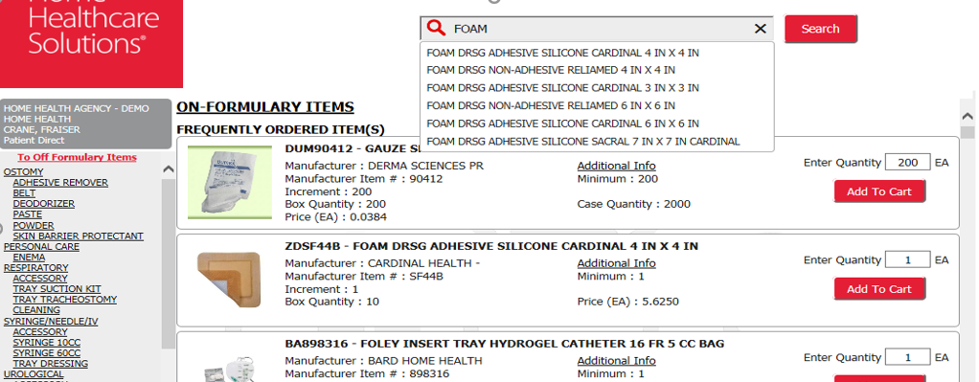
Choose the Supply
Initial list is ONLY formulary. Since web patient orders will likely be due to the item not being on formulary, the majority of these orders will need to access “off formulary items” in the upper left side of the screen.
Search by clicking category links or accessing the search bar. Please note, categories & descriptions may differ in HCHB or our site.
We recommend ordering a 1 week supply for Hospice, 2 week supply for Home Health.

Slide 27
Your Order Cart
Check mark orders you wish to hold! Only checked orders will process!
For supply room orders, you MUST select “SHIP TO BRANCH” in order to have the order ship to the office you are placing the order for. Failure to check this box will result in the order being shipped to Sylvania as the default.
Click ‘Confirm Selected Orders’ to send any checked orders for processing
Then click SUBMIT and OK to save the order.

Slide 28
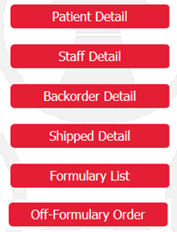
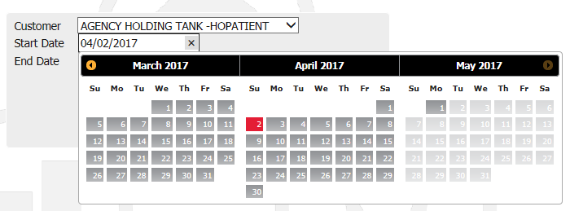
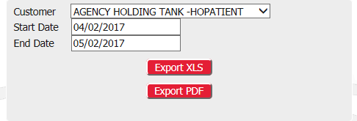
Reporting Options
Management also will have:
the ability to run reports for a desired date range
the option of exporting the data to Excel or a PDF

Slide 29
Mobile Supply Closet Approvals
Our approval process is triggered by the following situations in any combination. These notes will be noted on the PDF order detail attached to the email. The password to open the PDF is “supervisor” (all lowercase). The triggers include:
Off-Formulary Items
If the order contains an item NOT found on the ordering clinician’s MSC form, the order will require a supervisor’s name for approval and will be held until approval is received.
Monetary Threshold Exceeded
Your accounts are set up with a single order monetary limit $50, and this limit is adjustable if desired. If any single order exceeds this amount for a MSC replenishment order, it will require a supervisor’s name for approval and will be held until approval is received.
Par Level Exceeded
If any clinician exceeds the par level for an individual item on their MSC form, the order will require a supervisor’s name for approval and will be held until approval is received.

Slide 30
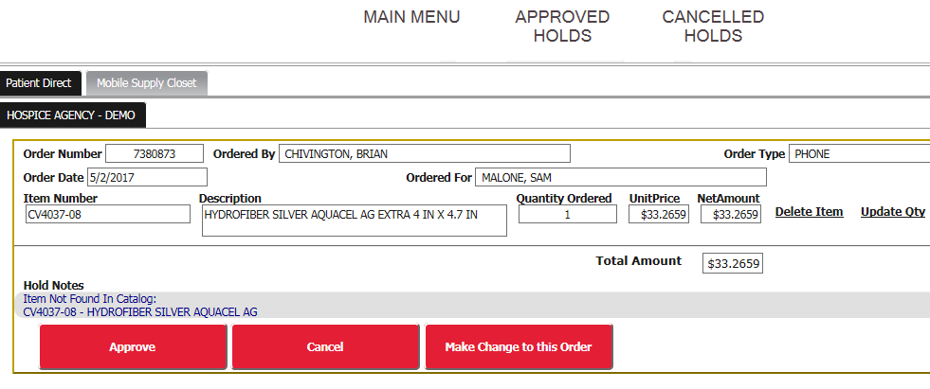
Supervisory Order Approvals Via the Web
To approve orders through the Web portal (details directions available):
Simply log on using your current user name and password
Click button that says ‘Release Holds’ on your main page
Update quantities, delete items or make changes to the order
Once you have updated the order, simply click ‘Approve’ to send it to us for adjustments
Click on ‘Send Notes’ to let us know what additional changes need to be made (i.e. change of item brand)

Slide 31
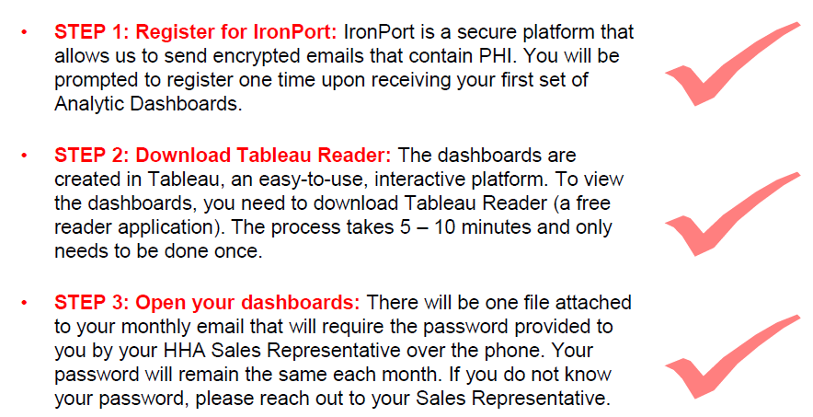
CAREessentials™ additional Set Up required

Slide 32
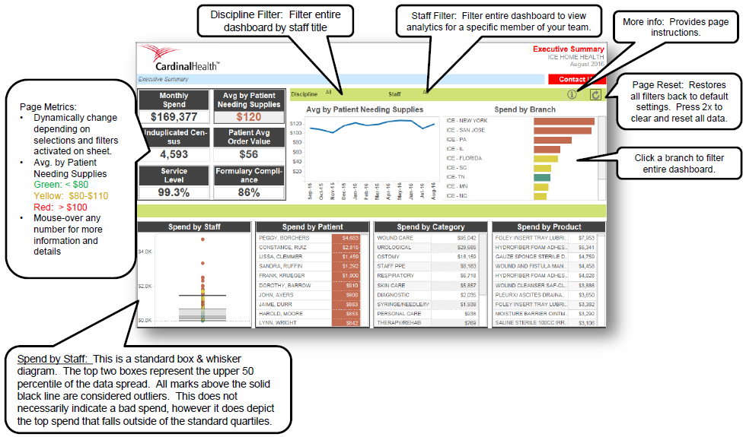
CAREessentials™ Interactive Reporting
After you receive your first round of Dashboards, we will set up a training call with your Relationship Manager and our Clinical staff for review.

Slide 33
Follow Up Support
Follow Up Meetings
Recommend a check in conference call weekly to check on the progress so far.
Follow up meeting once live for information regarding the MedConnect daily communication.
Support Contacts
For now, your continued contact will be either the Onboarding team:
Anne Anzalone, Onboarding Manager Anne.Anzalone@Cardinalhealth.com
Ashley Lauer, Onboarding Specialist Ashley.Lauer@Cardinalhealth.com
Brittany Saraniti, Account Manager brittany.saraniti@cardinalhealth.com
For Customer Service or Order concerns, please call 866-991-9944 or email the Customer Service Management Team at:
GMB-CHH-HHS-Express@cardinalhealth.com

