Slide 1
Accurate Census Tracking
September 2017

Slide 2
Accuracy is Important
Garbage in = Garbage out OR in this case, noting in = Nothing to report
Even more incentive to capture accurate data - better analytics are coming
Only necessary info will be required
At some point, fields may be rearranged

Slide 3
Admission Census Summary
Ability to identify residents admitted from hospitals who make an unplanned return to acute within 30 days
Track Admitted from location (count in INTERACT calculations)

Slide 4
Admission Census Summary

Slide 5
Admission Details
Admitted From:
Options available depending on what has been requested
Once entered option available to check box to indicate Inpatient Stay in an ACH/APH/CAH

Slide 6
Admission Details
Hospital Discharged From if Within 30 Days Prior to admission inclusive:
Options available depending on what has been requested
Enter discharge date and time also

Slide 7
Admission Details
Admission Status
Chronic Long-Term Care
Post-Acute Care
Referral Source
Only option is Bundled Payment

Slide 8
Discharge Summary Details
On Resident Census page
Section is not required to be completed at the time of discharge, it can be edited anytime
The first four fields feed the Readmission reports

Slide 9
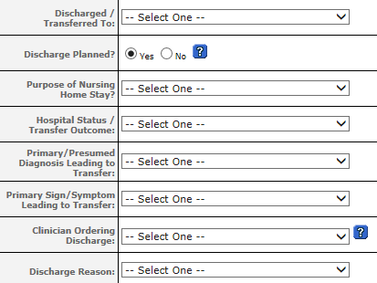
Discharge Summary Details

Slide 10
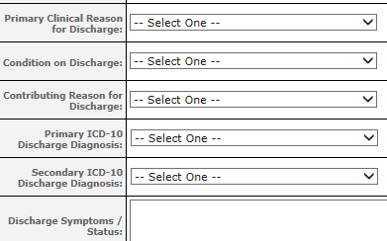
Discharge Summary Details

Slide 11
Details by Field
Discharged/Transferred to:
Facility options available depend on what has been requested
See next slide for other discharge to home options

Slide 12
Discharge To Home Options
Added the following
Moved back to previous residence
Moved home with Ohio Living Home Health
Moved home with other home health
Moved home with Ohio Living Hospice
Moved home with other hospice
Moved out of the area

Slide 13
Details by Field
Discharge Planned?
Self-explanatory
Purpose of Nursing Home Stay:
Field required if Discharged/Transferred To field answered
Chronic Long-Term Care
Post-Acute Care

Slide 14
Details by Field
Hospital Status/Transfer Outcome:
Leave blank with discharge to home
The following count toward hospital readmission and INTERACT calculation:
Admitted, Inpatient
Admitted, Status Uncertain

Slide 15
Details by Field
Primary/Presumed Diagnosis Leading to Transfer (INTERACT):
Pick from list (we cannot edit options)
Primary Sign/Symptom Leading to Transfer (INTERACT):
Pick from list (we cannot edit options)

Slide 16
Details by Field
Clinician Ordering Discharge:
Okay to leave blank
Discharge Reason (options cleaned up)
Change in status
Condition Improved
Expired
AMA
Other

Slide 17
Details by Field
The remaining fields can be left blank
Primary Clinical Reason for Discharge
Condition on Discharge
Contributing Reason for Discharge
Primary ICD-10 Discharge Diagnosis
Secondary ICD-10 Discharge Diagnosis
Discharge Symptoms/Status

Slide 18
Monitoring
Establish an audit process
Discuss in morning meetings
Identify person(s) responsible for editing
Remember editing can be done anytime
Have a back-up person
Start process immediately

Slide 19
QUESTIONS?

