Slide 1
Preventative Healthcare
September 2015

Slide 2
Located on Resident Tab

Slide 3
Click on Add

Slide 4
The options to add will appear in the list
Click on desired item
Enter details about the vaccine or test
Date defaults to current date

Slide 5
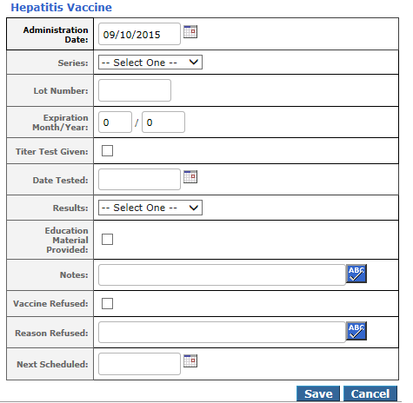
Hepatitis Vaccine

Slide 6
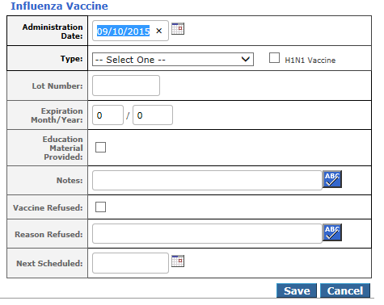
Influenza Vaccine

Slide 7
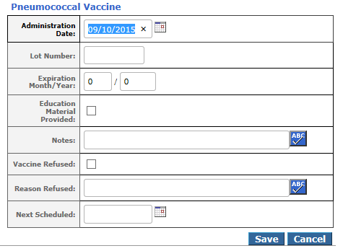
Pneumococcal Vaccine

Slide 8
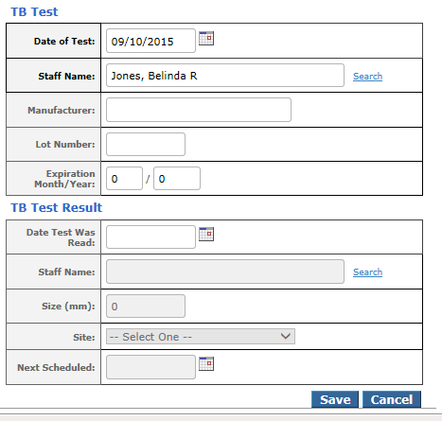
TB Test

Slide 9
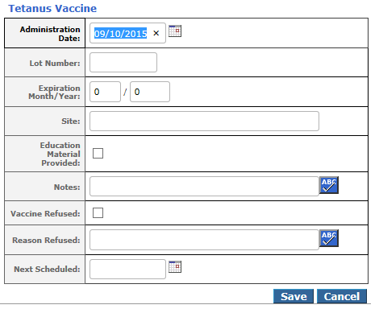
Tetanus Vaccine

Slide 10
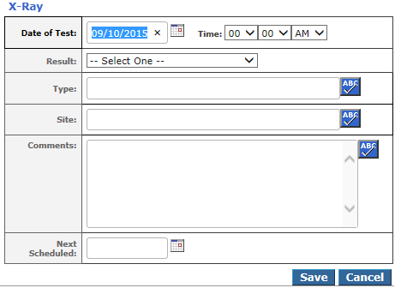
X-ray
When they cannot have the TB test

Slide 11
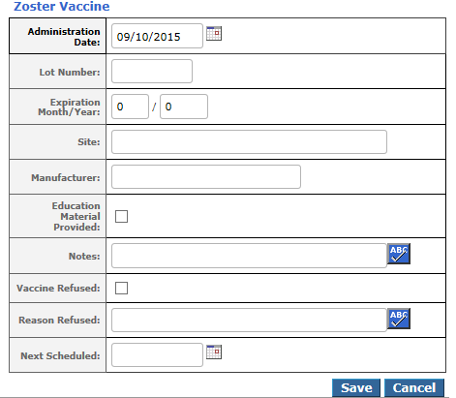
Zoster Vaccine

Slide 12
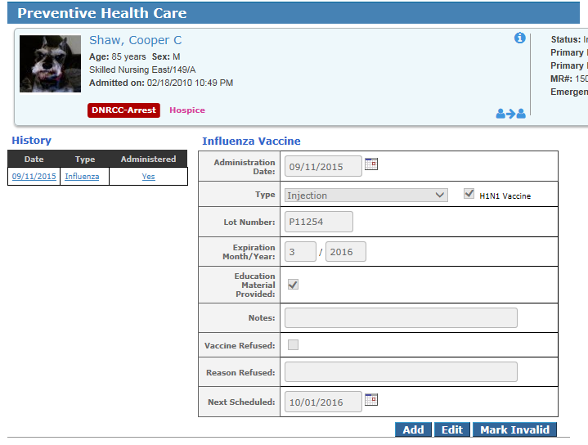
After adding stays on page
Go forward wherever you want to next
When you return to the page it will display the most recently added item in the History

Slide 13
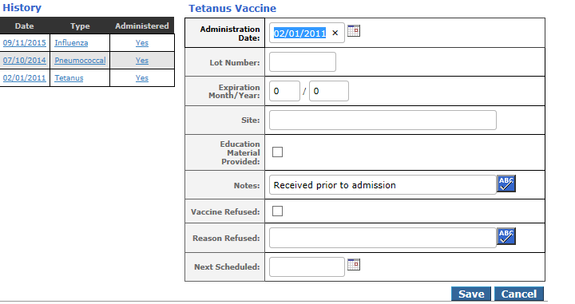
Able to Edit
Select item from History list
The fields will become editable
Make edits then Save

Slide 14
Able to Mark Invalid
Select item from History list
Option to select incorrect test type
Indicate reason and select your name in Requested By field then Save

Slide 15
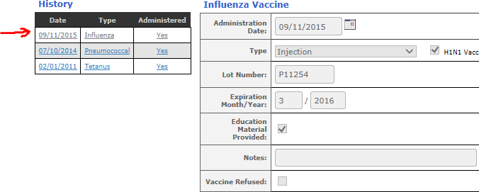
The Invalidated item will appear grayed out

Slide 16
Preventative Healthcare Report
On Facility Tab in Resident Info section
Able to set the following parameters:
Date range, Residents, Units, Care items, Format, Refused Only, Outpatients, Discharged, Scheduled Only, Sort and Output (can run to Excel)

Slide 17
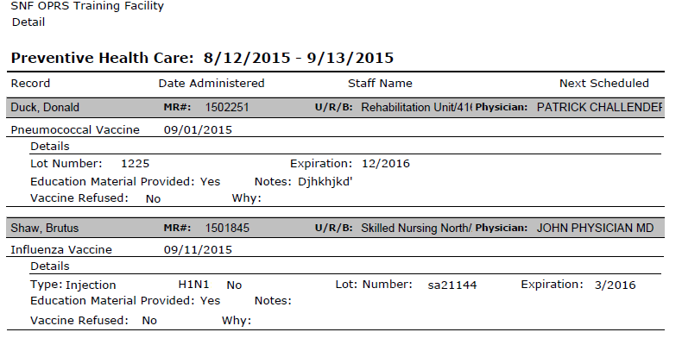
Report with Detail

Slide 18
Summary Only Report

Slide 19
Report for Next Scheduled
Must have entered Next Scheduled date
Remember to change the date range of the report

Slide 20
QUESTIONS????

