Slide 1
RiskWatch Training
January 2019

Slide 2
Purpose
RiskWatch is a data warehouse for tracking resident incidents (falls, skin issues, med errors, etc.)
Program of Ability (formerly eHealthdatasolutions)

Slide 3
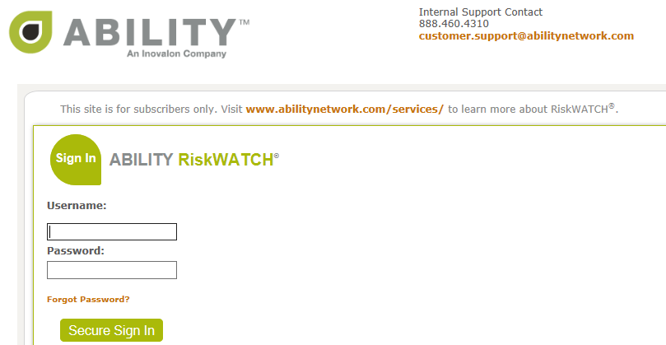
Login Page
Select RiskWatch on Nursing Links Page
ww1.ehealthdatasolutions.com

Slide 4
Occurrence Entry
In order to enter a report the name of your facility (not your unit) must always be noted in the white field at the top of the page
To change the date range, click on the calendar icon – set it to Last 90 Days

Slide 5
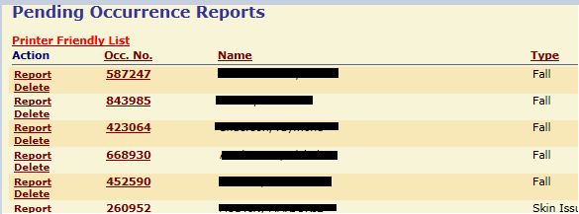
Pending Occurrences
List of “pending” (not submitted) occurrences after logging in

Slide 6
Report Entry
Enter new report by selecting Enter Report from Menu on left
Select the appropriate Location and Occurrence Type

Slide 7
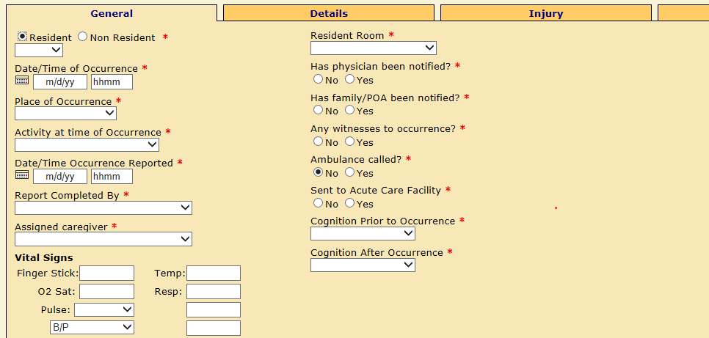
Report Entry Cont.
Complete information on each tab
Red asterisks indicate required fields
Data on each tab is saved when moving from tab to tab

Slide 8
General Tab
Basic information regarding occurrence
Highlight date field and enter as mm/dd/yy
Can use / for current day or \ for previous day
Military time must be used

Slide 9
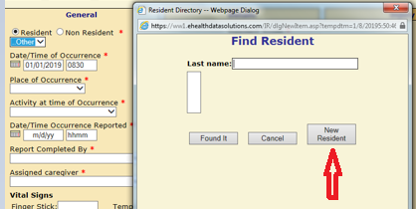
General Tab Cont.
Until MDS’ uploaded into CareWatch residents will have to be entered
Select Other in drop-down box then New Resident

Slide 10
General Tab Cont.
Add resident by entering the first & last name, gender, date of birth and room # (selecting from the drop-down list) and click Okay
Complete every question
Options drill down depending on answers provided
Assigned Caregiver is the person assigned primary care responsibility for the resident at the time of the occurrence (if not listed, click on Other to enter their info)

Slide 11
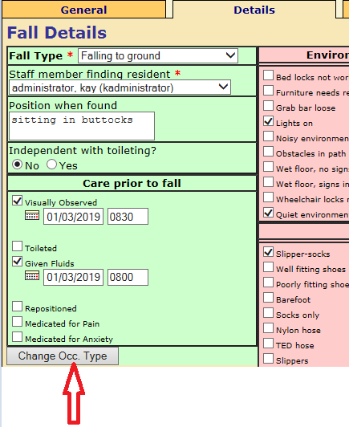
Details Tab Cont.
Next click on the Details tab to enter information specific to the type of Occurrence selected (option to change type if necessary)
Depending on answers additional information may be required

Slide 12
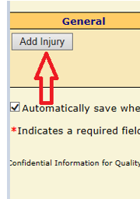
Injury Tab
Click on Injury tab and Add Injury to document injuries
Record the type and location of any injury suffered during the occurrence
Enter the type, location and description of the injury (description box available at the bottom of the page if needed)
If there are no injuries skip this tab

Slide 13
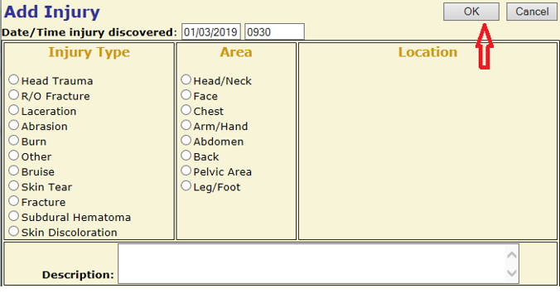
Injury Tab Cont.
Add as many injuries as necessary
When complete click OK

Slide 14
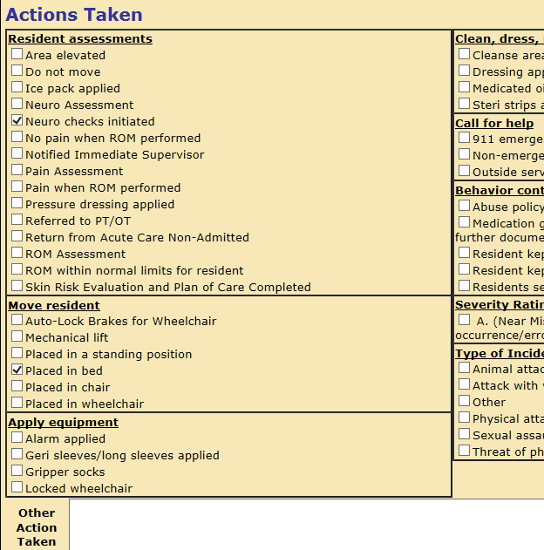
Actions Tab
Click on Actions tab to document immediate actions taken at the time of the occurrence
Select all that apply
Box at bottom of page to indicate other Action Taken

Slide 15
Statements Tab
Click on the Statements tab to document your statement of what happened as well as contributing factors
Add the Resident statement and any Witness statement

Slide 16
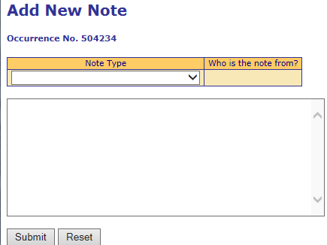
Final Steps
Once all tabs complete, you have the option to Submit, Add Note or Save (only managers upload files)
If you want to add an additional witness statement, click on Add Note, enter information and click Submit

Slide 17
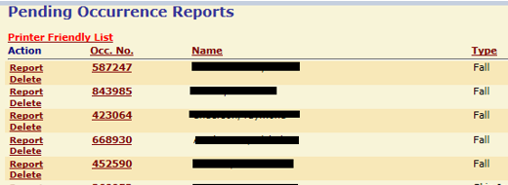
Final Steps Cont.
If report to be completed at another time, click on Save to save it in the Pending List
To resume a report, click on the Occ. No. in the list of Pending Occurrence Reports
The report will open to complete the submission process

Slide 18
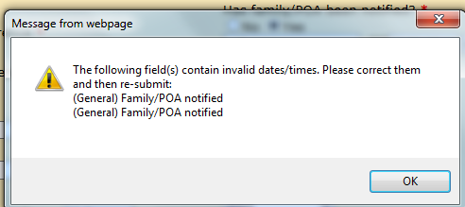
Submission of Report
Once complete click on Submit to submit the report for investigation
If required fields left blank a message will appear indicating unanswered required questions

Slide 19
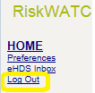
Submission of Report Cont.
Complete unanswered questions and click Submit
Confirmation of submission will appear
Click on Log Out in left column

Slide 20
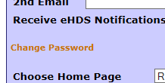
Changing Password
Click on Preferences in the menu bar on the right
Click on Change Password
Enter your old password and the new password and confirm it
Click Save

Slide 21
Questions?
Questions?
Questions?
Questions?

