Slide 1
Wound Management
February 2017

Slide 2
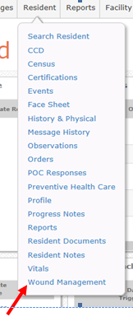
New Functionality
Beginning March 6th
Turned on in SNF Ohio Living Training Facility only at this time
On Resident Tab

Slide 3
Wound Management Page
Message with no wound
Add button on right side of page along with History button

Slide 4
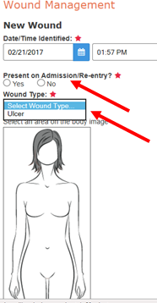
Adding New Wound
Like all Observations, date & time default
Select Yes or No for Present on Admission/Re-entry
Only “type” currently available is Ulcer

Slide 5
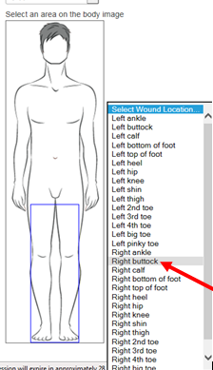
Adding New Wound cont.
Female or male based on resident gender
Options based on “area” selected

Slide 6
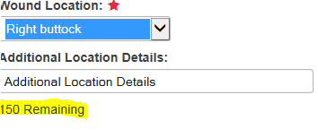
Adding New Wound cont.
Add location details after selecting area
Save & proceed

Slide 7
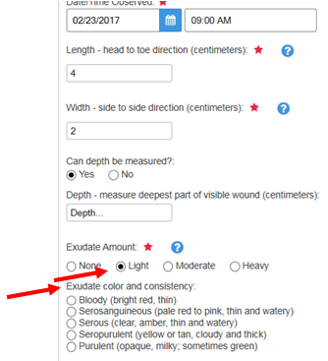
Skip Pattern Answers
Depending on answers additional questions appear
Required questions have asterisk

Slide 8
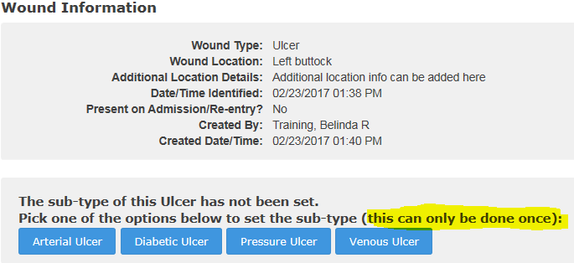
Sub-typing Ulcers
Only UMs & DONs can Stage wounds
Click on Update to add sub-type
This can only be done once

Slide 9
Sub-type
Once set type changes from “Ulcer” to specific type

Slide 10
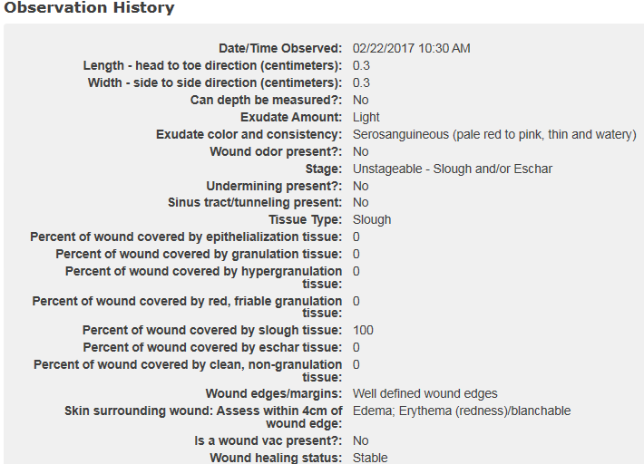
Viewing Wound

Slide 11
Updating Wound
When updating, history appears on right side

Slide 12
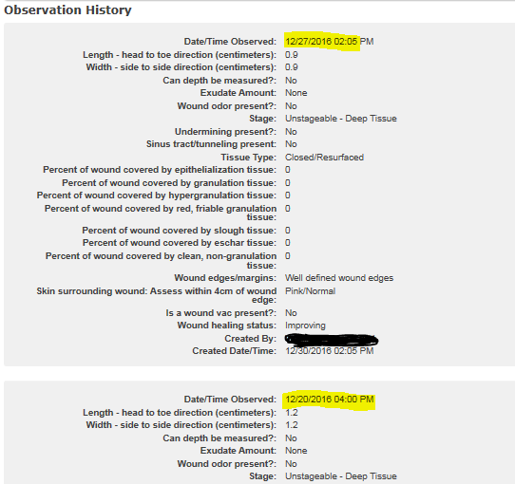
History
To view history, click on View under Actions or Wound History on right side next to Add

Slide 13
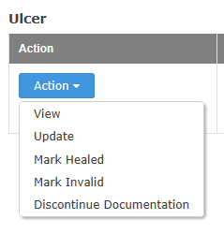
Action Options
View – view wound info/history
Update – add new info
Mark Healed – will appear in history
Mark Invalid – invalidate
Discontinue Documentation – use for discharged people

Slide 14
Pressure Wound PUSH Tool
PUSH Tool available for Pressure Wounds
Select from Action list (only available for pressure wounds) – 10 most recent, valid Observations are shown

Slide 15
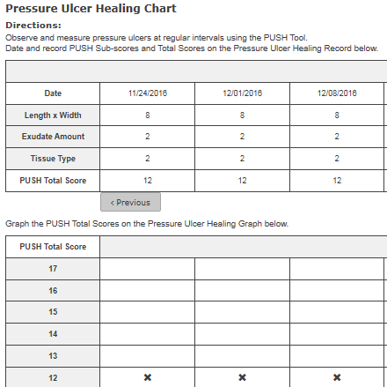
PUSH Chart

Slide 16
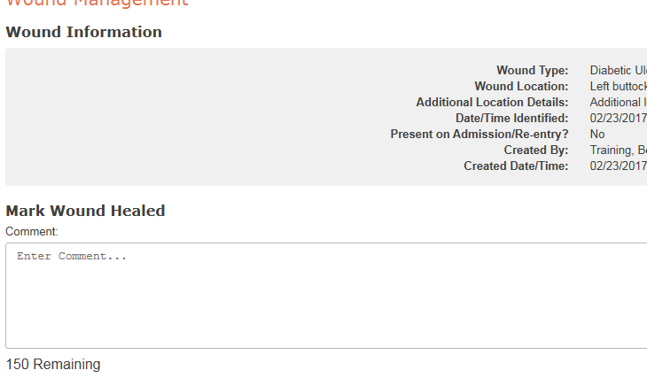
Healed Wounds
Select Action of Mark Healed for healed wounds
Character limit

Slide 17
Healed Wounds cont.
Only appear in Wound History

Slide 18
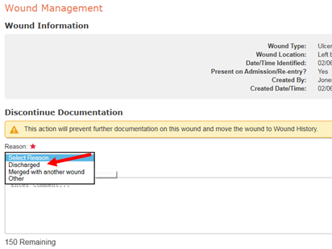
Discontinue Documentation
Use when a resident is discharged
Select Action of Discontinue Documentatio

Slide 19
Current Observations
Weekly Tracking of Pressure Wounds
Will be inactivated
Weekly Tracking of Non-Pressure Wounds
Adding note under type – “use wound management section for diabetic, arterial and venous ulcers”

Slide 20
Wound Company
Scan documentation in
Add/update Wound Management

Slide 21
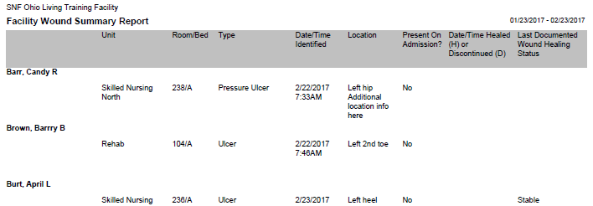
Reports
Facility Wound Summary Report
Facility tab under Wound Management
Track & trend wound healing in facility
Multiple parameter options

Slide 22
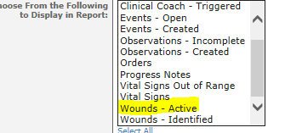
Reports cont.
Facility Activity Report
Include Active wounds

Slide 23
Enhancement Requests
Pressure Injury language
Tunneling and undermining need ranges and narrative option
Per cents should equal 100 – each one can be 100

Slide 24
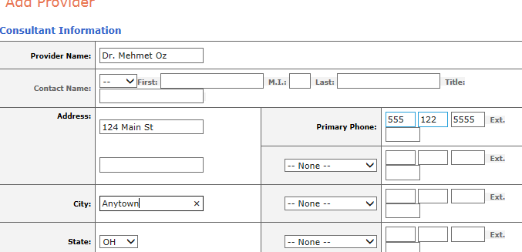
Miscellaneous Items
Adding provider (consultant) for info only

Slide 25
Miscellaneous cont.
Consultant in Provider List
Unable to log in, for facility info only

