Slide 1
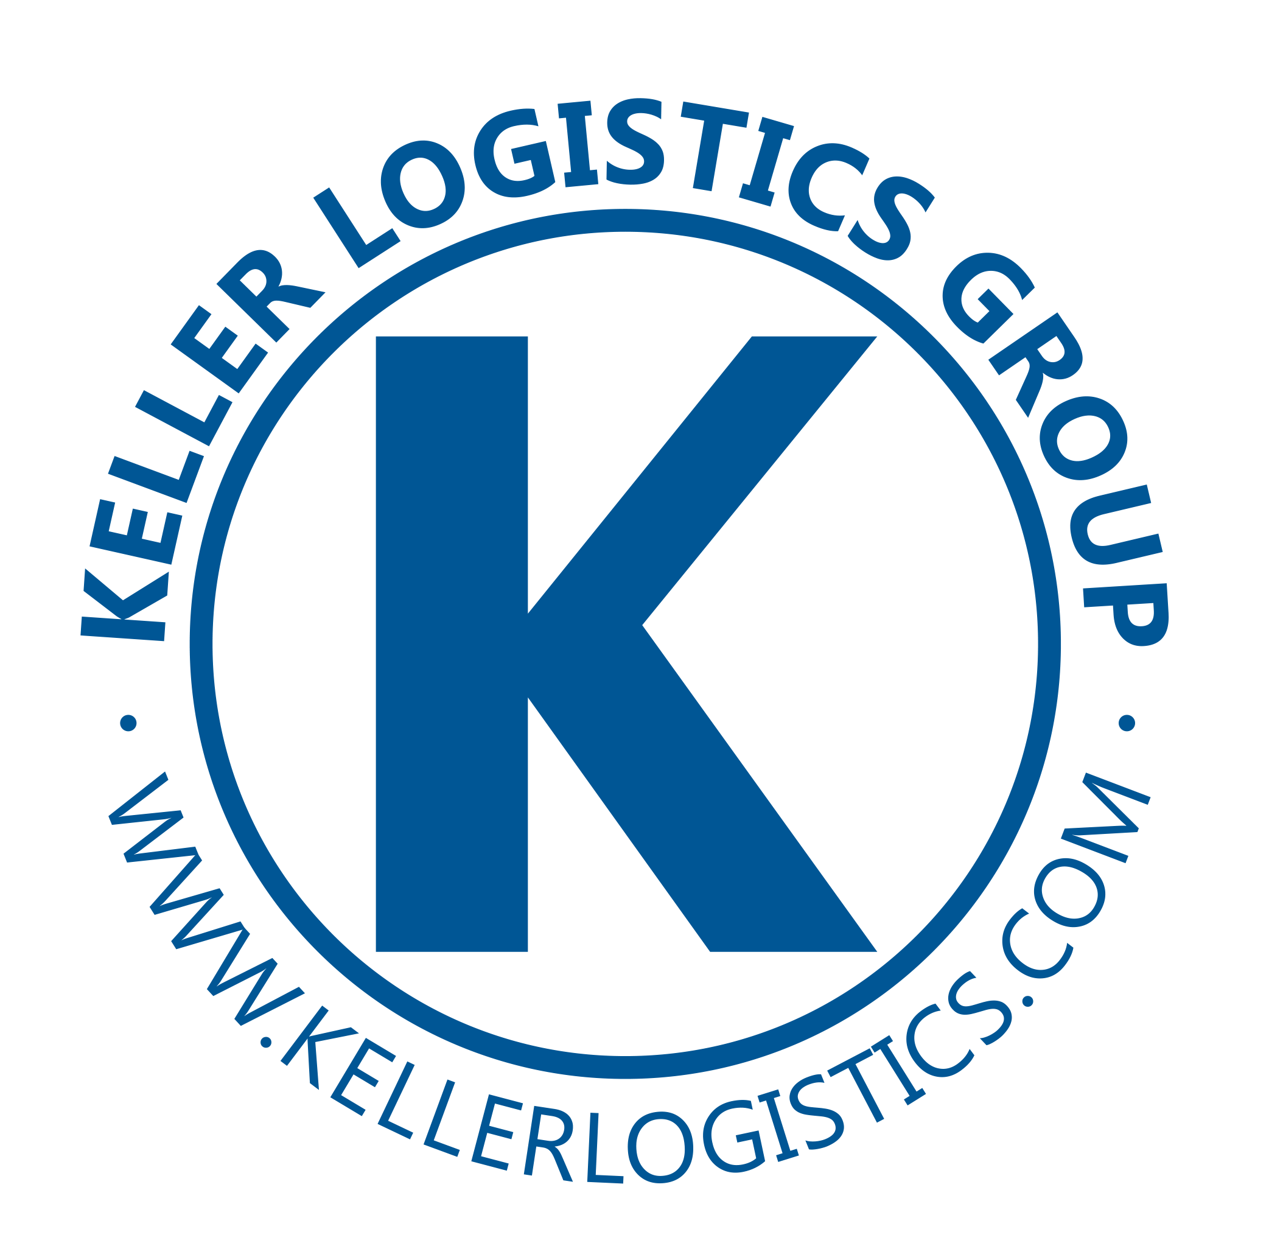
Trends to Expect and What The Future of Warehousing Holds in The Age of Automation
Darryl Logan
President Warehousing & Co-Packing

Slide 2
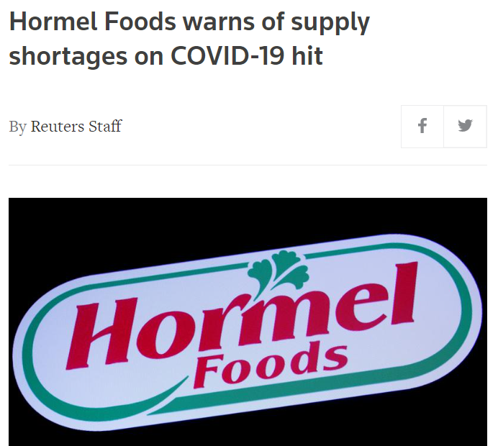
Macro Trends Outsourcing
Companies struggling to meet increased demand as a result of the virus and changes in consumer behavior
Tough decisions to make…
Will demand persist?
Ability to get the equipment in time?
Labor to get it done?
Notes:
OUTSOURCING The trend to OUTSOURCE to increase capacity is on the rise….
Companies continue to struggle to meet an increased demand as a result of the virus and changes in consumer behavior
For example General Mills and Hormel have been transparent with reports of their own efforts in the news lately to address this condition.
All companies in this situation are facing tough decisions as they consider how to respond….. struggling with the questions “Will demand persist?”….“Will they have the labor to get it done?”…….and “Can they acquire the equipment needed in time”
Both companies noted are taking on new vendor partnerships as well as tasking existing ones to add capacity.
This trend is creating tremendous opportunities for co manufacturing and co packaging. We have been invested in this future for sometime and have moved to expand our capacity with the recent acquisition of a new location in the Cincinnati area. I can also attest to the extended timeline on equipment purchases as we’re engaged in procuring machines for several locations currently and have seen timelines stretching out to 7-10 months for delivery.

Slide 3
Macro Trends On Shoring
A true “Black Swan Event” - Up to 95% of US companies had their supply chains disrupted by the virus
64% of companies are likely/extremely likely to bring sourcing/production back to the USA
An overall increase in business inventories in process
Before
After
HQ
Mfg
HQ
Domestic supply
Finished Goods Whse
Raw Whse
Notes:
Next ONSHORING…..
Some referred to the virus’s effect on the supply chain as a true “Black Swan Event” or a Highly improbable, impossible to predict event with a significant disruptive effect
For decades companies have worked hard to leverage the benefits of low cost manufacturing from global sources, combined with the concept of “Just in time” inventory positioning that created an environment for the virus to completely disrupt supply chains
As noted by CNBC, up to 95% of US companies had their supply chains disrupted by the virus and 64% of those at the time of the report were likely to extremely likely to bring sourcing and production back to the US.
The move to On Shore was already in motion as a result of changes in Trade Policy however when the virus hit it really accelerated that interest. While the move to OnShore will take sometime to execute, there are clear signs that businesses across all sectors are moving actively to increase inventories and stay ahead of demand.
The simple graphic at the bottom of the slide attempts to illustrate the potential for this to significantly increase the consumption of industrial real estate in the US. In the before example a company might have a single location for HQ and sales, wherein the After they might significantly expand their real estate footprint to include space for manufacturing and related warehousing as well as a potential expansion of real estate for any domestic supply vendors.

Slide 4
Macro Trends eCommerce
eCommerce sales up over 2019 by 44% through Q2 2020
Ecommerce Sales
2019
2020
44.4%
$138.96
$200.72
Notes:
Next eCommerce
As the graphic indicates spending through eCommerce is up $65 Billion dollars through the second quarter from 2019, with the busiest 2 quarters for spending yet to be reported
There is nothing more to be said about this that hasn’t been said today or in countless other research, news pieces or stories from our own lives. The meteoric rise of eCommerce is the principal manifestation of the noted change in consumer behavior in terms of how and where we acquire consumer goods.
The reason I do speak of it however… along with onshoring… and outsourcing is their collective effect on industrial real estate.

Slide 5
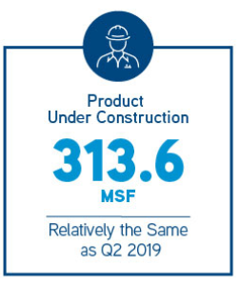
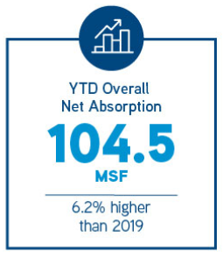
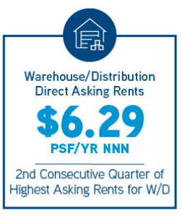
Macro Trends Real Estate
400-500MM SQF of New Demand for Industrial Real Estate
Vacancies are low averaging 5.5% across the US
Length of terms are extending
Cost per square foot on the rise
Notes:
So let’s talk about Real Estate
As noted here the combined effect on real estate from the previous trends discussed has resulted in an estimated additional 400-500 Million square feet of new demand.
Developers are hard at work meeting this demand. As noted in the left panel there are currently 313 Million square feet under construction and it’s being snatched up as quickly as it becomes available with an absorption rate of 104.5 million sqft as noted in the center panel
The net effect of all this is
Vacancies remain low at 5.5% across the US. In fact in some of the areas we are looking to take down space… that number plummets to less than 2%
Length of terms demanded by landlords are increasing making deals of 1-2yrs extremely difficult to secure
And finally costs per square foot are on the rise noted at $6.29 per square foot triple net currently.

Slide 6
Macro Trends Labor
All Roads Lead to LABOR…
We are focused on being the Employer of Choice
Higher wages (upwards of 30%+ increase in labor rates)
Incentives - based on efficiency
Culture, Culture, Culture - remote sites need to FEEL like family
Environment – clean, friendly, organized
COVID - preventative measures
Notes:
All roads lead to LABOR.
The demand for Labor is intense and the struggles are well known
Rising wages, Increased demand from OnShoring and eCommerce and the Virus effect are all hampering the ability to find and Retain quality talent
To make matters worse, with the impending cold and flu season upon us we’re concerned about it becoming even more difficult.
Material handlers and General Labor no longer a plentiful “replaceable resource”
That’s why were intensely focused on become the “employer of choice” by addressing the following:
Competitive wages… we keep a constant eye on data to ensure we remain competitive on pay and have in some areas increased wages by 30+%
Devising Incentives based on productivity, attendance and referrals – we’re keen to put the power for employees to earn more in their own hands
Culture – We take pride in our unique culture and work hard to foster that across the business, we currently have 14 sites in 7 states so its important that remote sites FEEL like family in spite of the geographic separation we face
Environment – we’re focused on providing clean, safe, friendly, and organized work environments for all of our employees, and as part of that we’ve been vigilant with COVID preventative measures in accordance with guidance from the CDC and local governments.

Slide 7
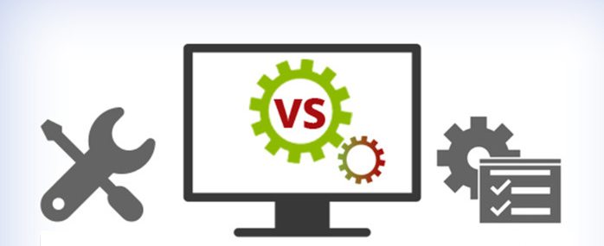
Age of Automation
Outsourcing – Make existing operations more efficient
Onshoring - Higher cost of manufacturing in the U.S.
E-Commerce – Incredibly higher volumes
Labor – Finding talent, Retaining talent, Rising costs
A perfect storm of opportunity for Automation
Notes:
Let’s move into Automation
All of the trends discussed thus far come together here to paint a picture of a rising interest in the use of automation each for it’s own specific reasons.
Out sourcing – in spite of pushing capacity to vendors these businesses are still turning their attention to driving efficiencies in their own processes as they struggle to adjust to new demand patterns
Onshoring - to mitigate the increased cost of labor when bringing manufacturing back to the US
eCommerce – to increase their capacities and lower labor cost to handle the incredible increase in volume.
Labor – as a general topic companies are struggling to find enough labor, and as labor costs rise, they are turning to automation for solutions.
Even the virus and the difficulty addressing social distancing is causing some companies to look in this direction

Slide 8
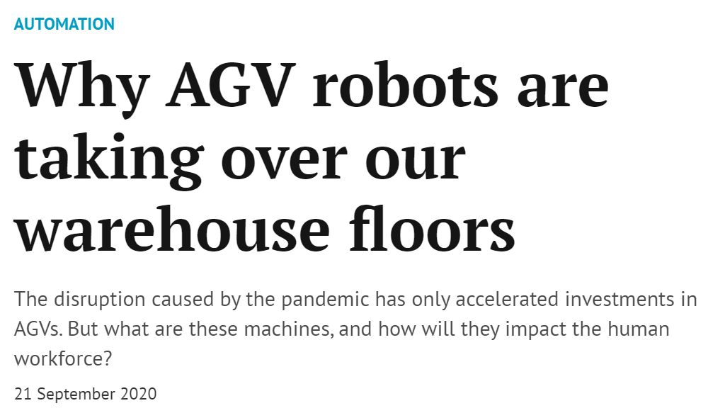
Age of Automation
TechHQ.com
The Global Warehouse Robotics Market was valued at USD 6.12 billion in 2019 and is expected to reach USD 25.8 billion by 2025, at a CAGR of 27% over the forecast period 2020-2025.
Notes:
Here are a few recent news clips that confirm the investment and movement to higher levels of automation happening in the logistics industry. This is clearly here to stay.

Slide 9
Age of Automation
How is Keller Warehousing and Co-Packing Moving in This Direction?
Automation in Co-Packing
Robotic Loading/Unloading and Palletization of Packaging machines to address
Safety - Repetitive motion
Facilitate speed and productivity
Robotic Process Automation
Eliminate tedious admin tasks freeing staff for more high value work
Notes:
How are we moving in this direction?
Automation in Co-Packing
Given the nature and characteristics of our business portfolio heretofore we’ve only kept a close eye on developments as each time we looked into it the ROI didn’t make sense. However we continue to look at it and have become more serious about moving on it due to the trends as noted in this presentation and the recent expansion of our Co-Packing operations.
Our focus would be to automate with robots the loading and unloading of the packaging machines both retrofitting existing equipment to some extent and ensuring all new equipment is specified with automation in mind.
Robotic Process Automation (RPA)
We’ve seen a great benefit on a few projects to implement RPA this year and this has become a strategic push for us in the 4th qtr and beyond to find other ways to leverage this technology.

Slide 10
Age of Automation
Embrace the Machines?
YES!
Automation is clearly on the rise to address the trends noted today
Industry, Academia, and Investment are pouring into this space
Finding the right technology to address
Safety, Productivity, Quality, Consistency, Speed
Notes:
Embrace the machines?? A resounding YES!
Automation is clearly on the rise to address the trends noted here today
Industry, Academia, and Investment are pouring into this space driving rapid development.
By embracing this technology, companies can see benefits ranging from speed, productivity, safety, quality, and consistency delivering significant value. But with the added cost that comes with automation, it's important to find the right fit for your company.
A lot of exciting things happening with Automation in logistics and it will be something to continue to watch going forward.

