Slide 1
ATREZZO PROVIDER PORTAL: OUTPATIENT CASE CREATION

Slide 2
ACCESSING ATREZZO PROVIDER PORTAL
Website Address: https://dmas.kepro.com
Select ‘’Atrezzo Login’’
To Register for Atrezzo Provider Portal:
Enter your 10 digit National Provider Identifier (NPI) number and Provider Registration Code. For additional assistance contact KEPRO Customer Service at 1-888-827-2884.
Registered Provider- Enter your unique username and password
**If you have multiple NPI numbers, you must register those NPI numbers under your administrative account in Atrezzo Connect.**

Slide 3
Outpatient Case Creation

Slide 4
ATREZZO PROVIDER PORTAL
Successful Completion of setup/Login, Takes you to the Home Page.
Hover over Request, click on Create New Request and click Search

Slide 5
Outpatient Case Creation
To search for member, hover over the Search Tab and click Member Search.

Slide 6
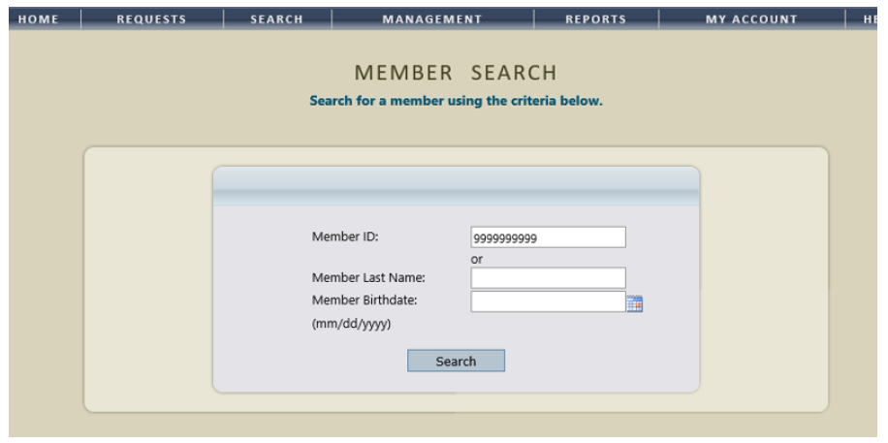
Outpatient Case Creation
A Member Search can be performed by either entering in the Members ID number or the Members Last Name and Date of Birth. (PLEASE NOTE: Entering information in all three search fields will NOT yield results. You must either search by the Members ID number or their demographic information.)

Slide 7
Outpatient Case Creation
Select the Member from the search results by clicking Select. (Ensure the accuracy of the members name and member ID before proceeding.)

Slide 8
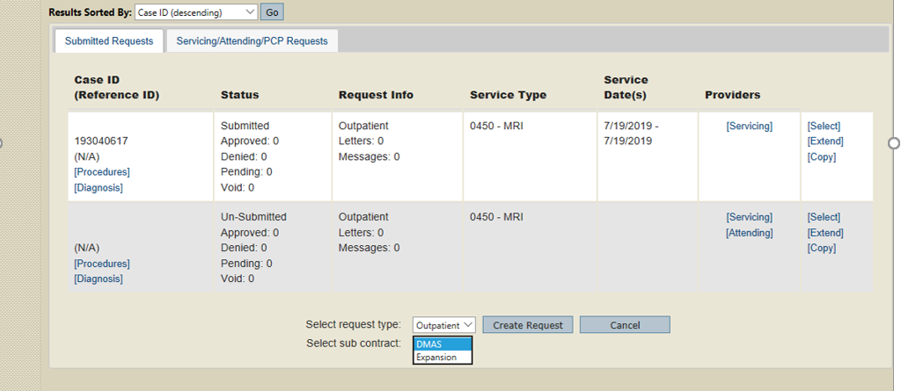
Outpatient Case Creation (cont’d)
Select Request Type as Outpatient, select the Sub Contract (either DMAS or Expansion), and then click Create Request.

Slide 9
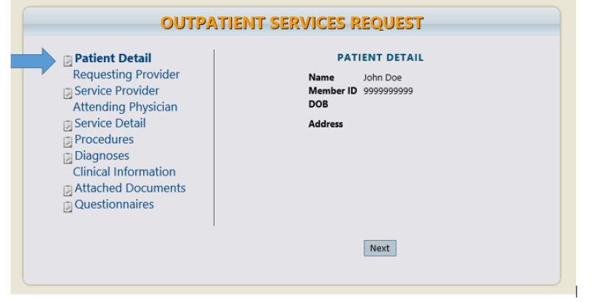
Outpatient Case Creation (cont’d)
The first section will be the Patient Detail. To continue click the NEXT button.

Slide 10
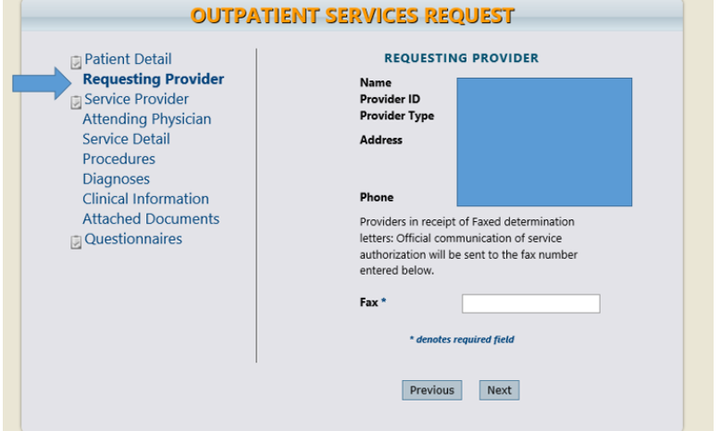
Outpatient Case Creation (cont’d)
The Requesting Provider section will populate the requesting provider listed in the change context Section. If requesting provider need to be changed, you must cancel request, make the selection from the change context section, then proceed with new case creation. Enter in the FAX number to where the correspondence pertaining to this request should be sent. (NOTE: The Requesting Provider can only be changed if there is more than one NPI number registered to the Atrezzo Provider Portal account.)

Slide 11
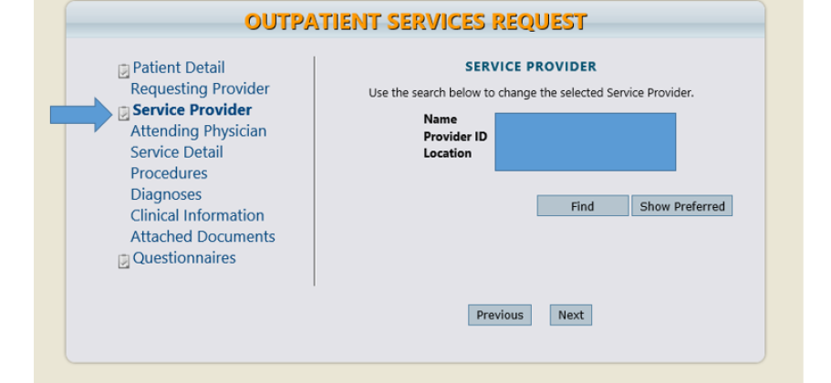
Outpatient Case Creation (cont’d)
The Service Provider section will display the populated provider from the requesting provider section. To change this information, click the Find button to perform a provider search.

Slide 12
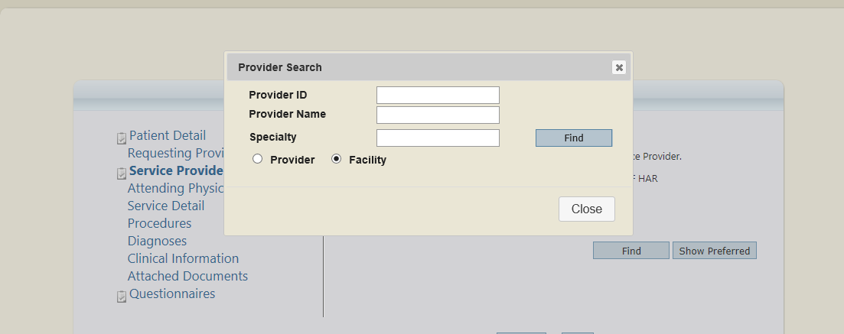
Outpatient Case Creation (cont’d)
Search for the provider by selecting Provider or Facility. Enter Provider ID (NPI number) or Provider Name and click Find.

Slide 13
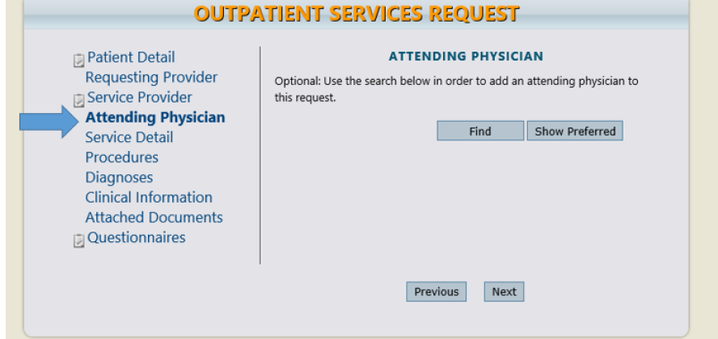
Outpatient Case Creation (cont’d)
The Attending Physician section is OPTIONAL. Use the Find button to search for the attending physician to be added.

Slide 14
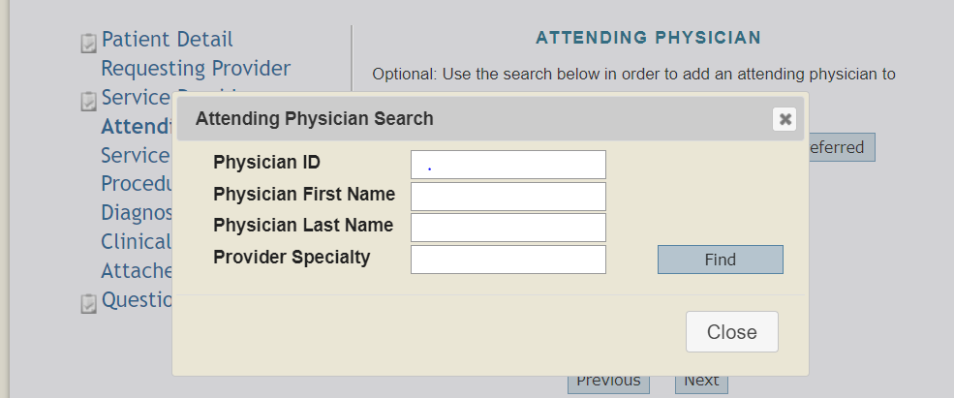
Outpatient Case Creation (cont’d)
You can search for the physician by entering either the Physician ID (NPI number), the Physicians First or Last Name, or the Provider Specialty, then click Find.

Slide 15
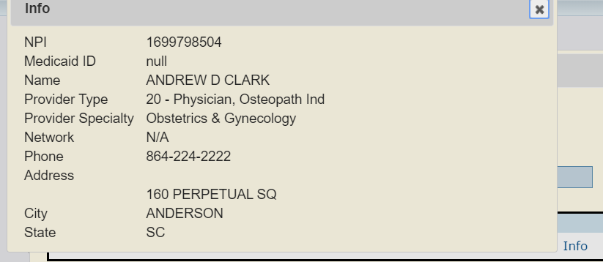
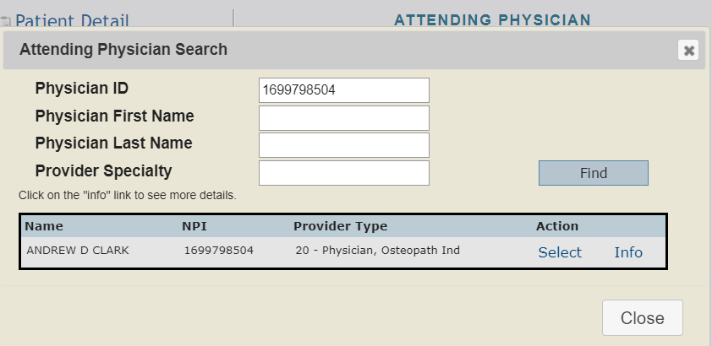
Outpatient Case Creation (cont’d)
The physicians information will then display. To see more detailed information about the physician click Info. To add the physician to the request click Select.

Slide 16
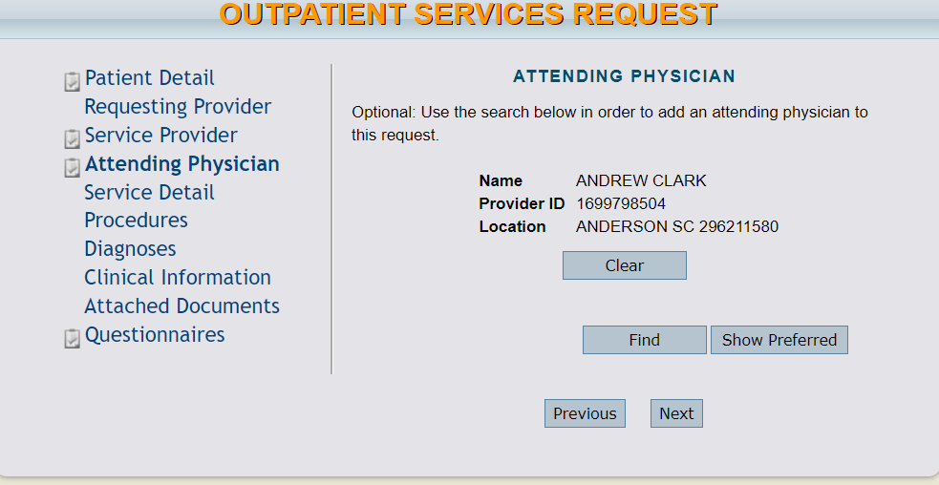
Outpatient Case Creation (cont’d)
The Attending Physician has now been added to the request. (To select a different physician, click Clear, and then Find to search for the physician)

Slide 17
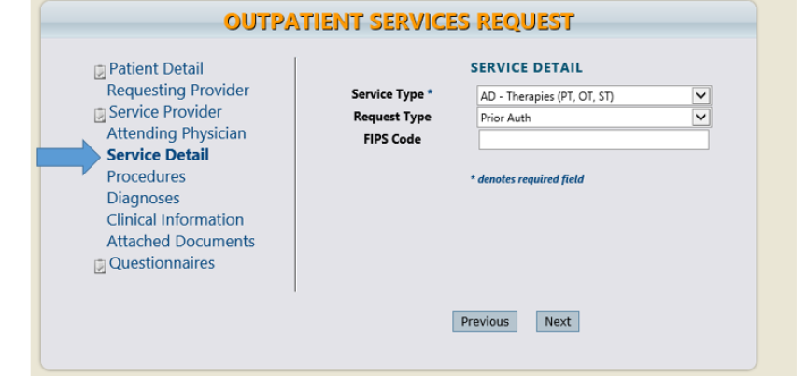
Outpatient Case Creation (cont’d)
In the Service Detail section, select the applicable Service Type and Request Type from the drop down menu. The FIPS Code is not applicable to your request and should be left blank.

Slide 18
Outpatient Case Creation (cont’d)
In the Procedures section, click Find button to search for procedure codes pertaining to this request. Enter the Code or Description of the procedure and click Find. Select the code from the list that displays. Continue to add codes, as needed.

Slide 19
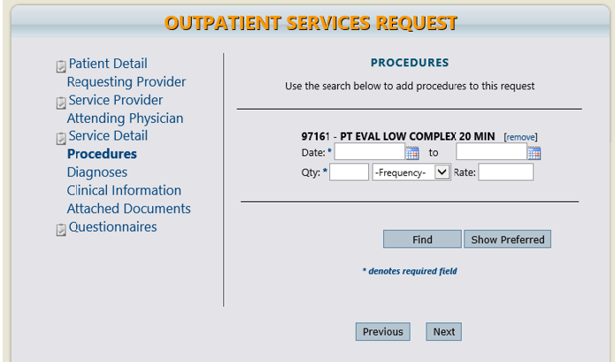
Outpatient Case Creation (cont’d)
After selecting the procedure code, enter in the requested Date span utilizing the calendar drop down menu. Then enter the Quantity (in units). The Frequency and Rate are left blank unless applicable for the requested service. Repeat this step for each procedure code.

Slide 20
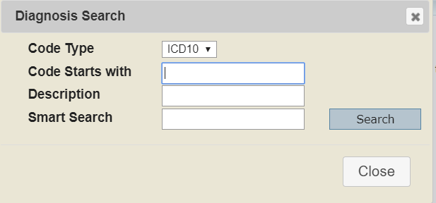
Outpatient Case Creation (cont’d)
In the Diagnosis section, click Find to select the diagnosis for this request. Enter the Code or the Description and click Search.

Slide 21
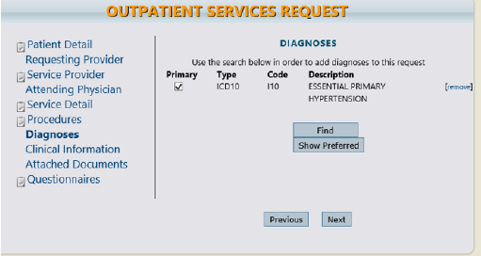
Outpatient Case Creation (cont’d)
A diagnosis code must be selected for the request. If there is multiple diagnosis codes, one must be selected as Primary. The codes cannot be changed once a case has been submitted.

Slide 22
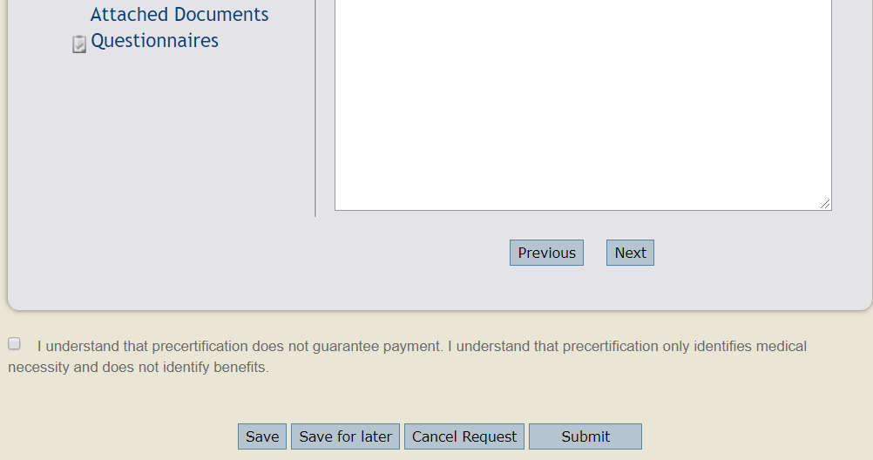
Outpatient Case Creation (cont’d)
In the Clinical Information section you can type or copy/paste clinical notes pertaining to the request. (PLEASE NOTE: Click the Save button before moving on to the next section).

Slide 23
Outpatient Case Creation (cont’d)
The Attached Documents section allows you to upload clinical documentation that has been saved to your computer. To attach documents, click on the Choose File button. Then select the document you want to upload and click Open.

Slide 24
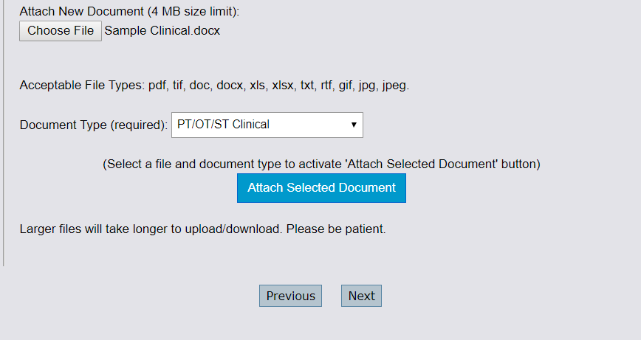
Outpatient Case Creation (cont’d)
The name of document that you uploaded will appear next to the Choose File button. You must then select a Document Type that describes the type of clinical information you attached. Once a document type is selected, the Attach Selected Document button will turn blue. Click the Attach Selected Document button to successfully attach the document.

Slide 25
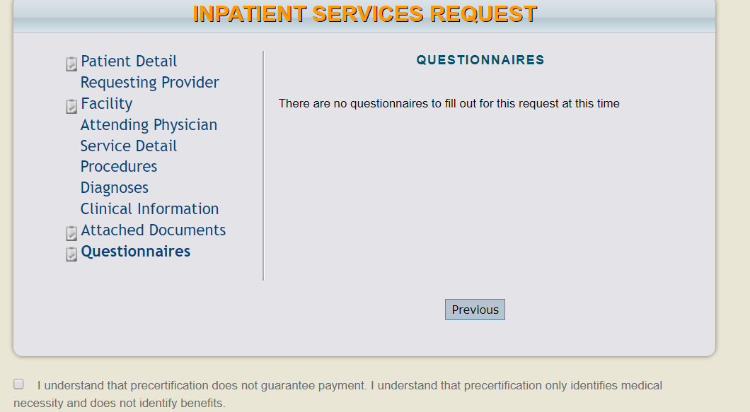
Outpatient Case Creation (cont’d)
All required questionnaire names will be displayed as a hyperlink. Click the on Questionnaires Name to open and complete.
See Atrezzo Provider Portal Questionnaire Training for additional details.

Slide 26
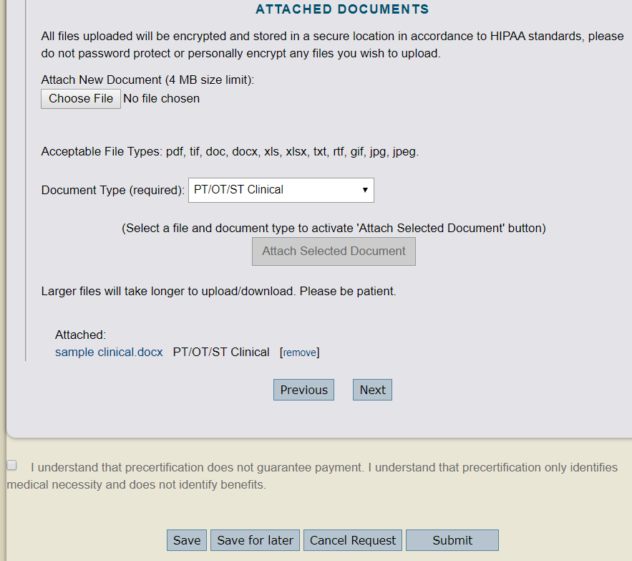
Outpatient Case Creation (cont’d)
Read and acknowledge the precertification statement, then Click Submit if you are ready to submit the request. Select the Save for Later button to save the request to submit at a later time (the request will display under the Saved But Not Submitted section on the Home page). The Cancel button will cancel the request.

Slide 27
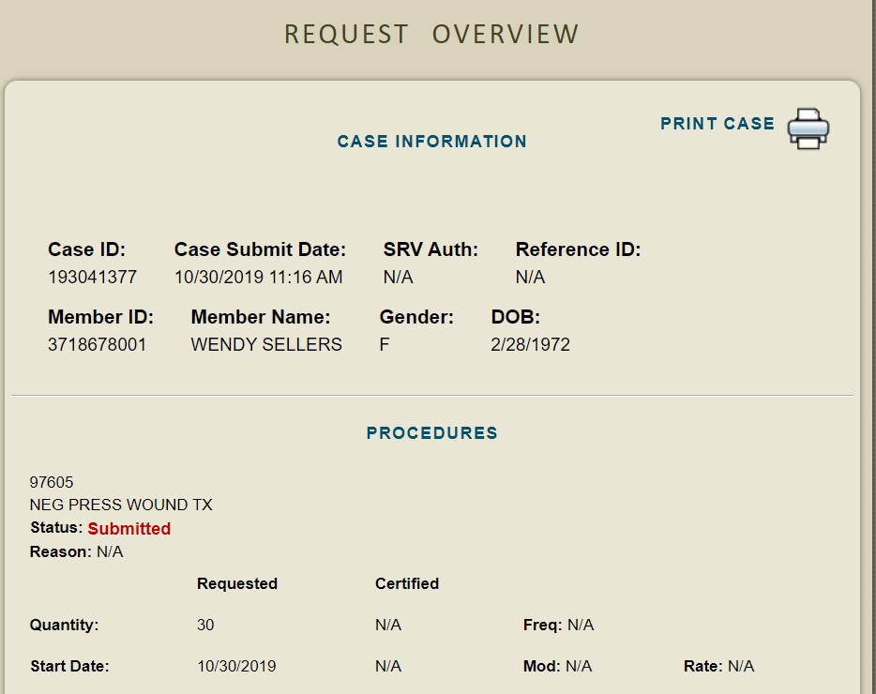
Outpatient Case Creation (cont’d)
Once the case has been submitted, the Request Overview page will display. (PLEASE NOTE: The case is not received by KEPRO until the Case ID is displayed under the Case Information section.) The request will also show the Status: Submitted under the procedures section.

Slide 28
For additional training documents, please refer to the Atrezzo Portal User Guide located under the HELP tab within your Atrezzo Provider Portal account.

