Slide 1
INTEGRATED CARE MANAGEMENT AND QUALITY IMPROVEMENT
Home Health Questionnaire
Presented To:
Home Health Providers
May 2015

Slide 2
Home Health Questionnaire
When initiating the Home Health questionnaire, you will see the question “Are you requesting an evaluation?” Answering “Yes” leads to the question “Is there a Physician’s order signed and dated by the Physician for the evaluation?”
The second question is “Are you requesting home health visits?” When you answer “Yes”, this will open up a series of questions requiring answers in order to complete the questionnaire. Examples follow in the next five slides.
All questions require completion for successful submission
2

Slide 3
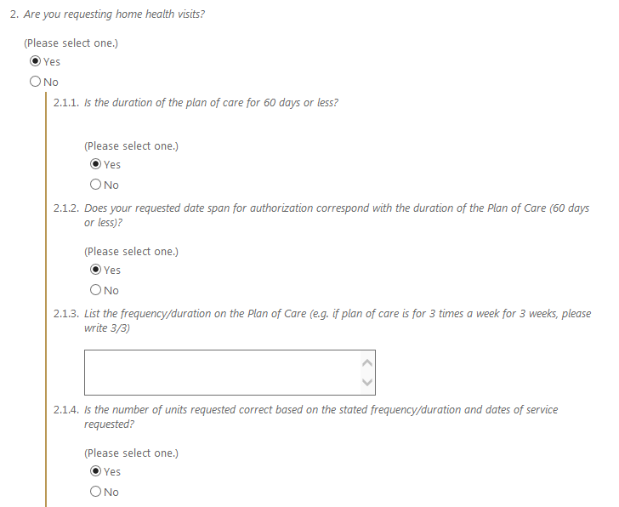
Question Samples
Drop Down Menus on select questions:

Slide 4
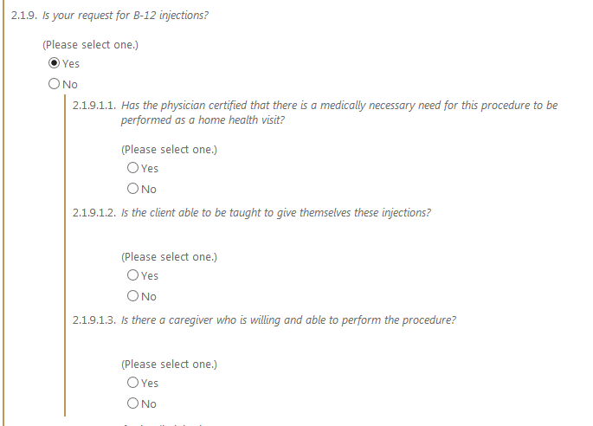
Question Samples
B-12 injections

Slide 5
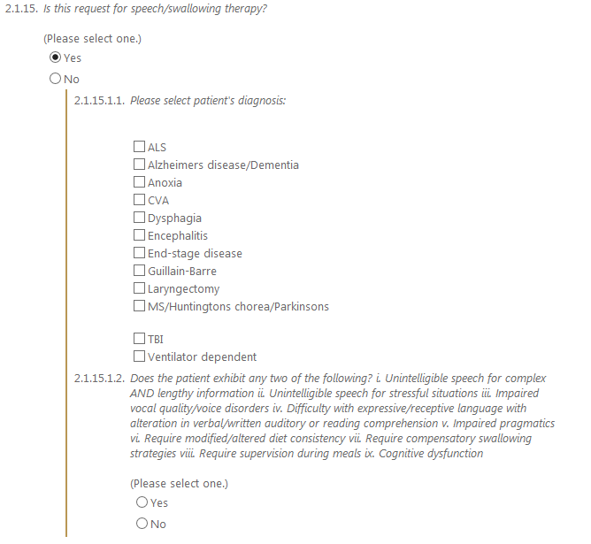
Question Samples
Speech/Swallowing Therapy:

Slide 6
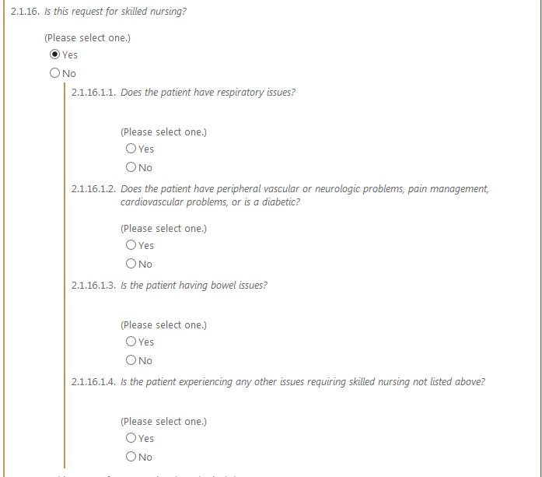
Question Samples
Skilled Nursing question:

Slide 7
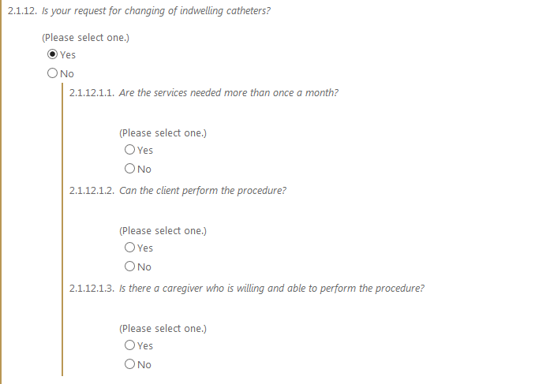
Question Samples
Indwelling catheters:

Slide 8
Home Health Questionnaires
If you have any questions or concerns regarding completion of the questionnaires ,please contact KEPRO at 1-888-827-2884

