Slide 1
Service Authorization for Specialized Care/Long Stay Hospital
(Service Type 1020)
Notes:
In this presentation, we will be discussing the service authorization process for specialized care and long stay hospital.
**In order to play the audio, click the speaker icon on the bottom left of each slide or the slide show icon at the bottom right of the screen to have the presentation play automatically**

Slide 2
New Health Coverage for Adults in Virginia
Beginning January 1, 2019, more adults living in Virginia will have access to quality, low-cost health insurance. The new coverage includes hospital stays, doctor visits, preventive care, prescription drugs and much more!
The rules have changed! So, if you applied for Medicaid in the past and were denied, you may soon be eligible. Eligibility is based on income, with a single adult making up to $16,754, or a family of three making up to $28,677, qualifying for coverage.
Interested in learning more?
Check out the below resources or visit www.coverva.org for more information and details on eligibility.
Coverage for Adults Brochure (PDF)
Coverage for Adults Flyer (PDF)
FAQs - New Adult Eligibility for Health Coverage (PDF)
Coverage for Adults Poster (PDF)
Notes:
Beginning January 1, 2019, more adults living in Virginia will have access to quality, low-cost health insurance. The new coverage includes hospital stays, doctor visits, preventive care, prescription drugs and much more!
The rules have changed! So, if you applied for Medicaid in the past and were denied, you may soon be eligible. Eligibility is based on income, with a single adult making up to $16,754, or a family of three making up to $28,677, qualifying for coverage.
Interested in learning more?
Check out the below resources or visit www.coverva.org for more information and details on eligibility.
Coverage for Adults Brochure (PDF)
Coverage for Adults Flyer (PDF)
FAQs - New Adult Eligibility for Health Coverage (PDF)
Coverage for Adults Poster (PDF)

Slide 3
GAP (GOVERNOR’S ACCESS PLAN)
As part of Medicaid Expansion, On January 1, 2019, Virginia Medicaid will offer new health coverage for adults. Most Governor’s Access Plan (GAP) members will be enrolled automatically in this new program.
If the member has any questions about the new health coverage for adults, or if they need to provide notification of a change in where they live, mailing address, phone number, change of income or health insurance coverage, please contact Cover Virginia GAP Processing Unit at 855-869-8190.
Notes:
As part of Medicaid Expansion, On January 1, 2019, Virginia Medicaid will offer new health coverage for adults. Most Governor’s Access Plan (GAP) members will be enrolled automatically in this new program.
If the member has any questions about the new health coverage for adults, or if they need to provide notification of a change in where they live, mailing address, phone number, change of income or health insurance coverage, please contact Cover Virginia GAP Processing Unit at 855-869-8190.

Slide 4
Methods of Submission Service Authorization Requests to KEPRO
Please note that for Specialized Care/Long Stay Hospital, all requests must be submitted via KEPRO’s Atrezzo Connect System
To access Atrezzo Connect on KEPRO’s website, go to http://dmas.kepro.com.
Provider registration is required to use Atrezzo Connect.
The registration process for providers happens immediately on-line
From http://dmas.kepro.com, providers not already registered with Atrezzo Connect may click on “Register” to be prompted through the registration process. Newly registering providers will need their 10-digit National Provider Identification (NPI) number and their most recent remittance advice date for YTD 1099 amount.
The Atrezzo Connect User Guide is available at http://dmas.kepro.com : Click on the Training tab, then the General tab.
Notes:
Please note that for Specialized Care/Long Stay Hospital, all requests must be submitted via KEPRO’s Atrezzo Connect System
To access Atrezzo Connect on KEPRO’s website, go to http://dmas.kepro.com.
Provider registration is required to use Atrezzo Connect.
The registration process for providers happens immediately on-line
From http://dmas.kepro.com, providers not already registered with Atrezzo Connect may click on “Register” to be prompted through the registration process. Newly registering providers will need their 10-digit National Provider Identification (NPI) number and their most recent remittance advice date for YTD 1099 amount.
The Atrezzo Connect User Guide is available at http://dmas.kepro.com : Click on the Training tab, then the General tab.

Slide 5
Service Authorization Requests: Contact Information for KEPRO/ DMAS Provider Information
Providers with questions about KEPRO’s Atrezzo Connect Provider Portal may contact KEPRO by email at atrezzoissues@kepro.com.
For service authorization questions, providers may contact KEPRO at providerissues@kepro.com.
KEPRO may also be reached by phone at 1-888-827-2884, or via fax at 1-877-OKBYFAX or 1-877-652-9329.
Notes:
Providers with questions about KEPRO’s Atrezzo Connect Provider Portal may contact KEPRO by email at atrezzoissues@kepro.com.
For service authorization questions, providers may contact KEPRO at providerissues@kepro.com.
KEPRO may also be reached by phone at 1-888-827-2884, or via fax at 1-877-OKBYFAX or 1-877-652-9329.

Slide 6
Service Authorization Information Specific to Specialized Care/Long Stay Hospital (SC/LSH)
Specialized Care - The Commonwealth of Virginia provides an increased reimbursement rate for nursing facility providers who enroll with the Department of Medical Assistance Services (DMAS) to provide a higher level of care to nursing facility residents. The residents have complex medical needs which are above the needs of typical nursing facility residents. This program applies to both adults and pediatric members.
Long Stay Hospital - DMAS also has an additional contract with two LSH providers to provide a higher level of care to members who would otherwise be in an acute care setting. Again, the residents have complex medical needs which are above the needs of typical nursing facility residents. This program also applies to both adults and pediatrics; however, the focus of the program is more pediatric in nature.
Notes:
Specialized Care - The Commonwealth of Virginia provides an increased reimbursement rate for nursing facility providers who enroll with the Department of Medical Assistance Services (DMAS) to provide a higher level of care to nursing facility residents. The residents have complex medical needs which are above the needs of typical nursing facility residents. This program applies to both adults and pediatric members.
Long Stay Hospital - DMAS also has an additional contract with two LSH providers to provide a higher level of care to members who would otherwise be in an acute care setting. Again, the residents have complex medical needs which are above the needs of typical nursing facility residents. This program also applies to both adults and pediatrics; however, the focus of the program is more pediatric in nature.

Slide 7
Service Authorization Information Specific to Specialized Care/Long Stay Hospital (SC/LSH)
Member Eligibility for SC/LSH Services:
Members must be Medicaid eligible at the time of the request otherwise the request will be rejected. Medicaid members eligible for SC/LSH services include:
Members enrolled in an MCO ARE eligible for this service
Members enrolled in FAMIS FFS, FAMIS Plus and FAMIS MCO ARE eligible for this service
*Members will automatically be disenrolled from the MCO once the level of care line is generated in VAMMIS.
Notes:
Member Eligibility for SC/LSH Services:
Members must be Medicaid eligible at the time of the request otherwise the request will be rejected. Medicaid members eligible for SC/LSH services include:
Members enrolled in an MCO ARE eligible for this service
Members enrolled in FAMIS FFS, FAMIS Plus and FAMIS MCO ARE eligible for this service
*Members will automatically be disenrolled from the MCO once the level of care line is generated in VAMMIS.

Slide 8
Service Authorization Information Specific to Specialized Care/Long Stay Hospital (SC/LSH)
Timeliness of Submission:
Provider request for services must be submitted as follows:
Within three business days prior to the date of admission to the SC/LSH facility
Within three business days after the date of admission to the SC/LSH facility
Timeliness is waiver and requests are considered retrospective reviews if the:
Member’s Medicaid covers is retro eligible
Member has exhausted Medicare A Benefits and Medicaid is not primary
Member has exhausted Private Insurance and Medicaid is now primary
If the request is not retrospective review and is not submitted within the required timeframe, the request is authorized effective the date of receipt by KEPRO and the earlier dates of service are denied for untimely submission.
Notes:
Timeliness of Submission:
Provider request for services must be submitted as follows:
Within three business days prior to the date of admission to the SC/LSH facility
Within three business days after the date of admission to the SC/LSH facility
Timeliness is waiver and requests are considered retrospective reviews if the:
Member’s Medicaid covers is retro eligible
Member has exhausted Medicare A Benefits and Medicaid is not primary
Member has exhausted Private Insurance and Medicaid is now primary
If the request is not retrospective review and is not submitted within the required timeframe, the request is authorized effective the date of receipt by KEPRO and the earlier dates of service are denied for untimely submission.

Slide 9
Service Authorization Information Specific to Specialized Care/Long Stay Hospital (SC/LSH)
Process for Requests Submitted Three Days Prior to the Date of Admission:
For requests that are submitted three business days prior to the date of admission to the SC/LSH facility, the level of care line cannot be pre-dated. KEPRO will automatically pend the request for the provider to respond within the required timeframe the member has been admitted to the facility. KEPRO will then process the case once the member has been admitted.
If the provider does not respond within the required timeframe then the case will be denied. The provider may either appeal the denial with the correct admission date or submit a new request with the correct admission date if the member has been admitted to the facility.
Notes:
Process for Requests Submitted Three Days Prior to the Date of Admission:
For requests that are submitted three business days prior to the date of admission to the SC/LSH facility, the level of care line cannot be pre-dated. KEPRO will automatically pend the request for the provider to respond within the required timeframe the member has been admitted to the facility. KEPRO will then process the case once the member has been admitted.
If the provider does not respond within the required timeframe then the case will be denied. The provider may either appeal the denial with the correct admission date or submit a new request with the correct admission date if the member has been admitted to the facility.

Slide 10
Service Authorization Information Specific to Specialized Care/Long Stay Hospital (SC/LSH)
Required Forms in Addition to Clinical Information: SPEC 100
SPEC 100 – For any request submitted to the Contractor, providers must complete and submit this form. Under no circumstances are SC/LSH requests approved without the required form. Clinical information must also be submitted with all requests in order to establish and meet clinical criteria.
Please note that an updated SPEC 100 form can be found on KEPRO’s website at dmas.kepro.com.
On the 3rd section of this form be sure to only pick one selection or the request will be pended back to the provider for clarification
Notes:
Required Forms in Addition to Clinical Information: SPEC 100
SPEC 100 – For any request submitted to the Contractor, providers must complete and submit this form. Under no circumstances are SC/LSH requests approved without the required form. Clinical information must also be submitted with all requests in order to establish and meet clinical criteria.
Please note that an updated SPEC 100 form can be found on KEPRO’s website at dmas.kepro.com.
On the 3rd section of this form be sure to only pick one selection or the request will be pended back to the provider for clarification

Slide 11
Service Authorization Information Specific to Specialized Care/Long Stay Hospital (SC/LSH)
Required Forms in Addition to Clinical Information: SPEC 100 & Questionnaire:
SC/LSH Questionnaire and SPEC 100 – Providers must complete and submit these two forms for the scenarios listed below. Under no circumstances are SC/LSH requests approved without the required forms. Clinical information must also be submitted with all requests in order to establish and meet clinical criteria.
New Admissions: All new admissions to SC/LSH facilities. This includes the member being discharged from one SC/LSH and being admitted into another SC/LSH within the same state. *This also applies to The Hospital for Sick Children in DC admissions.
Notes:
Required Forms in Addition to Clinical Information: SPEC 100 & Questionnaire:
SC/LSH Questionnaire and SPEC 100 – Providers must complete and submit these two forms for the scenarios listed below. Under no circumstances are SC/LSH requests approved without the required forms. Clinical information must also be submitted with all requests in order to establish and meet clinical criteria.
New Admissions: All new admissions to SC/LSH facilities. This includes the member being discharged from one SC/LSH and being admitted into another SC/LSH within the same state. *This also applies to The Hospital for Sick Children in DC admissions.

Slide 12
Service Authorization Information Specific to Specialized Care/Long Stay Hospital (SC/LSH)
Required Forms in Addition to Clinical Information: SPEC 100 & Questionnaire (continued):
Breaks in Service: Anytime there has been a break in service which is 30 days or greater, the request for specialized care/long stay hospital services are to be treated as a new admission. Anytime there has been a break in service which does not exceed 30 days, the request for specialized care/long stay hospital services are to be treated as a readmission to the program.
A Break in Service could include a discharge out of the facility to services under the EDCD or Tech waivers, hospitalization, or discharge to the community with no continuation of any long term care services (such as waiver services).
Notes:
Required Forms in Addition to Clinical Information: SPEC 100 & Questionnaire (continued):
Breaks in Service: Anytime there has been a break in service which is 30 days or greater, the request for specialized care/long stay hospital services are to be treated as a new admission. Anytime there has been a break in service which does not exceed 30 days, the request for specialized care/long stay hospital services are to be treated as a readmission to the program.
A Break in Service could include a discharge out of the facility to services under the EDCD or Tech waivers, hospitalization, or discharge to the community with no continuation of any long term care services (such as waiver services).

Slide 13
Service Authorization Information Specific to Specialized Care/Long Stay Hospital (SC/LSH)
Required Forms in Addition to Clinical Information: SPEC 100 & Questionnaire (continued):
Medicare A or Private Exhaust: When a member has exhausted Medicare A benefits or Private Pay Insurance and Medicaid is now primary. There is a section on the SPEC 100 form for providers to complete if the member’s Medicare or private insurance has exhausted and the date of exhaustion.
Out of State Admissions: If a member is transferring directly to a SC/LSH from out of state, it is the responsibility of the admitting SC/LSH to ensure the member meets nursing facility criteria and the SC/LSH criteria.
**NOTE** The Questionnaire can be found in Atrezzo Connect. In addition to the questionnaire, providers should also key in via direct data entry, any additional clinical in the free-space box when submitting prior authorization request via Atrezzo Connect.
**If additional information is needed from the provider, the case is pended for 5 business days to allow the provider time to submit additional clinical.
Notes:
Required Forms in Addition to Clinical Information: SPEC 100 & Questionnaire (continued):
Medicare A or Private Exhaust: When a member has exhausted Medicare A benefits or Private Pay Insurance and Medicaid is now primary. There is a section on the SPEC 100 form for providers to complete if the member’s Medicare or private insurance has exhausted and the date of exhaustion.
Out of State Admissions: If a member is transferring directly to a SC/LSH from out of state, it is the responsibility of the admitting SC/LSH to ensure the member meets nursing facility criteria and the SC/LSH criteria.
**NOTE** The Questionnaire can be found in Atrezzo Connect. In addition to the questionnaire, providers should also key in via direct data entry, any additional clinical in the free-space box when submitting prior authorization request via Atrezzo Connect.
**If additional information is needed from the provider, the case is pended for 5 business days to allow the provider time to submit additional clinical.

Slide 14
Service Authorization Information Specific to Specialized Care/Long Stay Hospital (SC/LSH)
Criteria:
SPEC 100
The provider must complete the DMAS Admission Authorization - Specialized Care Cover Sheet (SPEC-100), which must include the physician’s signature certifying the need for SC/LSH and the admission date. The certification must be completed by the attending physician for the resident or by the Medical Director for the NF/LSH. Discharge documentation does not require the physician’s signature or completion of a SPEC 100.
Nursing Facility Criteria
In order to receive services under the SC/LSH program, the member must meet the established criteria for nursing facility placement. The questionnaire will determine whether nursing facility criteria has been met. The Nursing Facility Criteria Worksheet is a tool used to determine if the criteria has been met.
Clinical Criteria to Meet Specialized Care/Long Stay Hospital LOC
Specialized Care and Long Stay Hospital facilities provide a higher level of care to nursing facility members. Therefore, members must meet the established criteria to determine complex medical care needs. Specialized Care and Long Stay Hospital criteria must be met in addition to Nursing Facility Criteria.
Notes:
Criteria:
SPEC 100
The provider must complete the DMAS Admission Authorization - Specialized Care Cover Sheet (SPEC-100), which must include the physician’s signature certifying the need for SC/LSH and the admission date. The certification must be completed by the attending physician for the resident or by the Medical Director for the NF/LSH. Discharge documentation does not require the physician’s signature or completion of a SPEC 100.
Nursing Facility Criteria
In order to receive services under the SC/LSH program, the member must meet the established criteria for nursing facility placement. The questionnaire will determine whether nursing facility criteria has been met. The Nursing Facility Criteria Worksheet is a tool used to determine if the criteria has been met.
Clinical Criteria to Meet Specialized Care/Long Stay Hospital LOC
Specialized Care and Long Stay Hospital facilities provide a higher level of care to nursing facility members. Therefore, members must meet the established criteria to determine complex medical care needs. Specialized Care and Long Stay Hospital criteria must be met in addition to Nursing Facility Criteria.

Slide 15
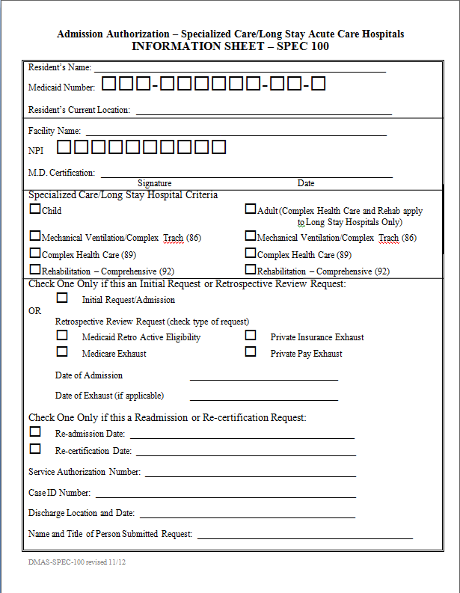
Service Authorization Information Specific to Specialized Care/Long Stay Hospital (SC/LSH)
Only pick 1 for this section
This is new and needs to be filled out or case could potentially be denied for untimely submission
NEW!!!!
Notes:
On this slide, is an example of the SPEC 100.

Slide 16
SC/LSH Questionnaire
Notes:
On the next 4 slides are examples of the SC/LSH questionnaire.

Slide 17
SC/LSH Questionnaire
Notes:
This is a continuation of the SC/LSH questionnaire example.

Slide 18
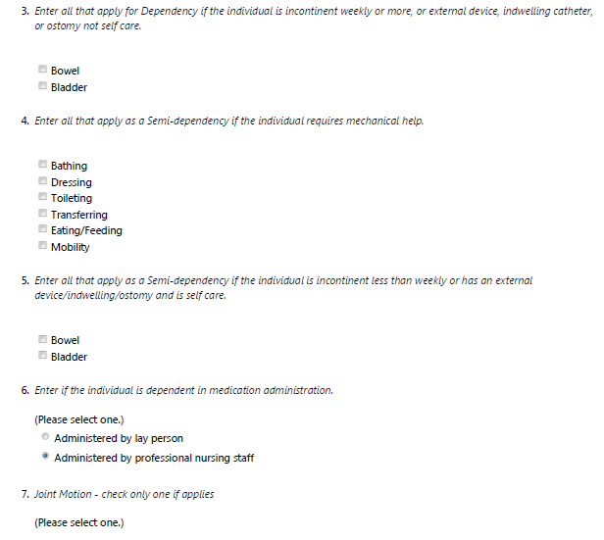
SC/LSH Questionnaire
Notes:
This is a continuation of the SC/LSH questionnaire example.

Slide 19
SC/LSH Questionnaire
Notes:
This is a continuation of the SC/LSH questionnaire example.

Slide 20
Service Authorization Information Specific to Specialized Care/Long Stay Hospital (SC/LSH)
For Specialized Care and Long Stay Hospital requests:
Providers must request the service(s) under Service Type 1020
Maximum duration for service authorizations are up to 365 days, 1 unit per day frequency
For readmissions, the duration for service authorization can be authorized using the readmission date up to 365 days, 1 unit per day
For Medicare Exhaust and Private Pay Exhausts, the date of service will begin with the date of exhaust on the Level of Care and Srv Auth file.
Notes:
For Specialized Care and Long Stay Hospital requests:
Providers must request the service(s) under Service Type 1020
Maximum duration for service authorizations are up to 365 days, 1 unit per day frequency
For readmissions, the duration for service authorization can be authorized using the readmission date up to 365 days, 1 unit per day
For Medicare Exhaust and Private Pay Exhausts, the date of service will begin with the date of exhaust on the Level of Care and Srv Auth file.

Slide 21
Memo –Manual – CFR -VAC
Notes:
On this slide, is a list of the memos and manuals available.

Slide 22
General Information for All Service Authorization Submissions
KEPRO’s website has information related to the service authorization processes for all DMAS programs they review. Questionnaires and much more are on KEPRO’s website. Providers may access this information by going to http://dmas.kepro.com.
KEPRO will approve, deny, or pend requests. If there is insufficient medical necessity information to make a final determination, KEPRO will pend the request back to the provider requesting additional information. Do not send responses to pends piecemeal since the information will be reviewed and processed upon initial receipt. If the information is not received within the time frame requested by KEPRO, the request will automatically be sent to a physician for a final determination. In the absence of clinical information, the request will be submitted to the supervisor for an administrative review and final determination. Providers and members are issued appeal rights through the MMIS letter generation process for any adverse determination. Instruction on how to file an appeal is included in the MMIS generated letter.
Notes:
KEPRO’s website has information related to the service authorization processes for all DMAS programs they review. Questionnaires and much more are on KEPRO’s website. Providers may access this information by going to http://dmas.kepro.com.
KEPRO will approve, deny, or pend requests. If there is insufficient medical necessity information to make a final determination, KEPRO will pend the request back to the provider requesting additional information. Do not send responses to pends piecemeal since the information will be reviewed and processed upon initial receipt. If the information is not received within the time frame requested by KEPRO, the request will automatically be sent to a physician for a final determination. In the absence of clinical information, the request will be submitted to the supervisor for an administrative review and final determination. Providers and members are issued appeal rights through the MMIS letter generation process for any adverse determination. Instruction on how to file an appeal is included in the MMIS generated letter.

Slide 23
General Information for All Service Authorization Submissions
**NOTE** There are no automatic renewals of service authorizations. Providers must submit requests for continuation of care needs, with supporting documentation, prior to the expiration of the current authorization.
Providers must verify member eligibility prior to submitting the request.
Authorizations will not be granted for periods of member or provider ineligibility.
Requests will be rejected if required demographic information is absent.
Providers should take advantage of KEPRO’s web based checklists/information sheets for the services(s) being requested. These sheets provide helpful information to enable providers to submit information relevant to the services being requested.
Providers must submit a service authorization request under the appropriate service type. Service authorization requests cannot be bundled under one service type if the service types are different.
Notes:
**NOTE: There are no automatic renewals of service authorizations. Providers must submit requests for continuation of care needs, with supporting documentation, prior to the expiration of the current authorization.**
Providers must verify member eligibility prior to submitting the request.
Authorizations will not be granted for periods of member or provider ineligibility.
Requests will be rejected if required demographic information is absent.
Providers should take advantage of KEPRO’s web based checklists/information sheets for the services(s) being requested. These sheets provide helpful information to enable providers to submit information relevant to the services being requested.
Providers must submit a service authorization request under the appropriate service type. Service authorization requests cannot be bundled under one service type if the service types are different.

Slide 24
VIRGINIA MEDICAID WEB PORTAL
DMAS offers a web-based Internet option to access information regarding Medicaid or FAMIS member eligibility, claims status, check status, service limits, service authorizations, and electronic copies of remittance advices.
Providers must register through the Virginia Medicaid Web Portal in order to access this information. The Virginia Medicaid Web Portal can be accessed by going to: www.virginiamedicaid.dmas.virginia.gov.
Notes:
DMAS offers a web-based Internet option to access information regarding Medicaid or FAMIS member eligibility, claims status, check status, service limits, service authorizations, and electronic copies of remittance advices.
Providers must register through the Virginia Medicaid Web Portal in order to access this information. The Virginia Medicaid Web Portal can be accessed by going to: www.virginiamedicaid.dmas.virginia.gov.

Slide 25
DMAS Helpline Information AND/OR RESOURCES
The “HELPLINE” is available to answer questions Monday through Friday from 8:00 a.m. to 5:00 p.m., except on holidays.
KEPRO Website https://dmas.KEPRO.com.
DMAS web portal https://www.virginiamedicaid.dmas.virginia.gov.
For any questions regarding the submission of Service Authorization requests, please contact KEPRO at 888-827-2884 or 804-622-8900.
For claims or general provider questions, please contact the DMAS Provider Helpline @ 800-552-8627 or 804-786-6273.
Notes:
The “HELPLINE” is available to answer questions Monday through Friday from 8:00 a.m. to 5:00 p.m., except on holidays.
KEPRO Website https://dmas.KEPRO.com.
DMAS web portal https://www.virginiamedicaid.dmas.virginia.gov.
For any questions regarding the submission of Service Authorization requests, please contact KEPRO at 888-827-2884 or 804-622-8900.
For claims or general provider questions, please contact the DMAS Provider Helpline @ 800-552-8627 or 804-786-6273.

Slide 26
THANK YOU
THANK YOU!
Notes:
Thank you for reviewing this presentation.

