Slide 1
LIVE workshop:
The NEW Workforce
Engagement & Communication

Slide 2
WFH / hybrid workforce
Notes:
Going into Open enrollment.. The world is a different place

Slide 3
Notes:
Our webinars are changing from educational conversations to live workshops

Slide 4
Engagement
Notes:
Everyone has a phone.. It’s the remote control of today

Slide 5
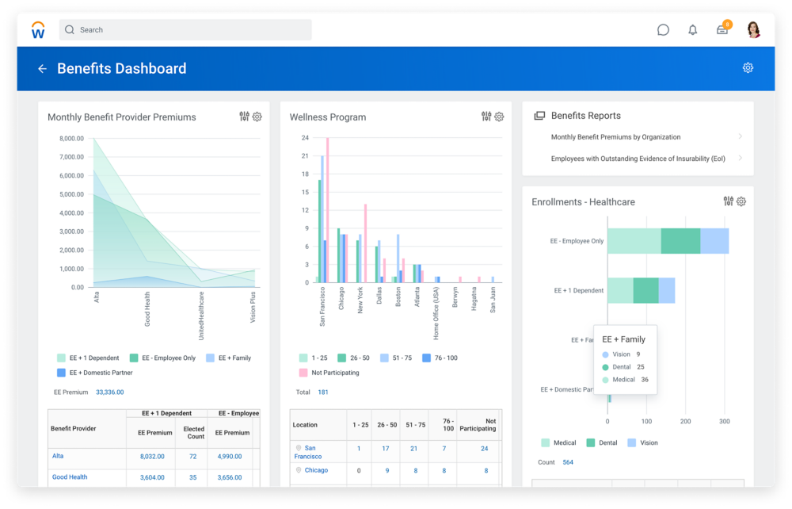
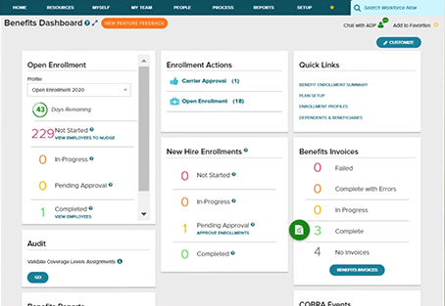
Reports:
What Can You Learn
Notes:
Going into OE, you clients have so much info that can help the strategy

Slide 6
LIVE workshop:
3 strategies that can help impact your new WFH workforce
ELIMINATE THE EXCUSES
CHANGE THE STORY
IMPROVE THE QUALITY

Slide 7
Today’s Journey
Webinar is being RECORDED
Questions:
Q&A section
Value Creation – CALL TO ACTION
Wait to the end… it will be WORTH IT
SAVE THE DATE
10/28 = Employer Facing Webinar
LIVE WORKSHOP: The NEW Workforce with Engagement & Communication
7

Slide 8
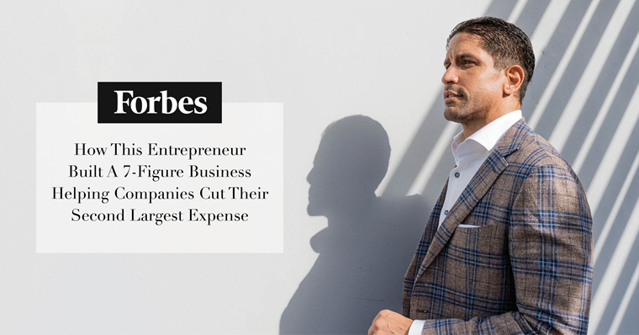
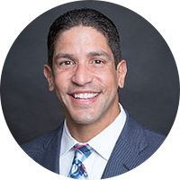
TRANSPARENT HEALTH BENEFITS
19-year employee benefits professional
12 years at large consulting house
$3.5M+ personal production
Chief Growth Officer for $350M+ practice
Self-funding and health management expert
Creator of THB and disruptor of the status quo
LESTER J MORALES
Founder & CEO, Next Impact
Creator of Transparent Health Benefits
lester.morales@nextimpactllc.com
(813) 784-1519
LIVE WORKSHOP: The NEW Workforce with Engagement & Communication
8

Slide 9
OUR TOPICS
Increase WHF/hybrid workforce
Utilize technology platforms
Engage employees and their families
LIVE WORKSHOP: The NEW Workforce with Engagement & Communication
9

Slide 10
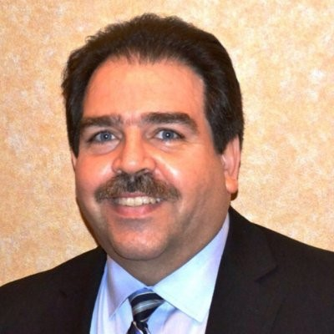
OUR SPEAKERS
Frank Mengert
Founder & CEO
Eric Silverman
Founder
Julian Lago
President Co-Founder
LIVE WORKSHOP: The NEW Workforce with Engagement & Communication
10

Slide 11
TECHNOLOGY

Slide 12
How are you engaging employees at Open Enrollment and beyond?
55%
of employees wish they were more informed about their benefits so they could get more value from them
“Employees have varying levels of understanding when it comes to benefits.
From the recent college graduate who is on their own health plan for the first time - to the expecting parents shopping for life insurance, not all employees have the same benefits education needs.”
Notes:
enrollment strategy, education, communication & engagement

Slide 13
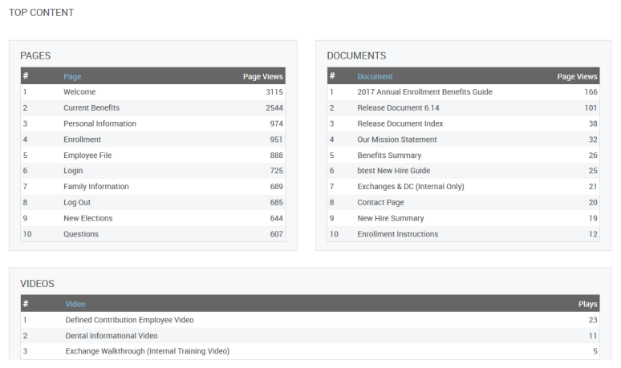
Is the message being received?
EMPLOYEES’ PREFERRED CHANNELS FOR BENEFITS EDUCATION
Online Portal
Mobile App
Email
Phone Call
50%
18%
41%
17%
Source: MetLife’s 19th Annual U.S. Employee Benefit Trends Study 2021
Notes:
Balanced approach to benefits education & communication across multiple channels (diff employees want to learn about benefits in different ways)
What devices are employees using to enroll? Short-form content vs. long-form content (cater communications & messaging)

Slide 14
Say hello to Better BenAdmin®
(and goodbye to technology regret)
Frank B. Mengert
Founder & CEO
ebm
203-985-1714
frank@getebm.com
www.getebm.com
© 2021 ebenefit Marketplace, LLC

Slide 15
COMMUNICATION EDUCATION

Slide 16
ENGAGEMENT

Slide 19
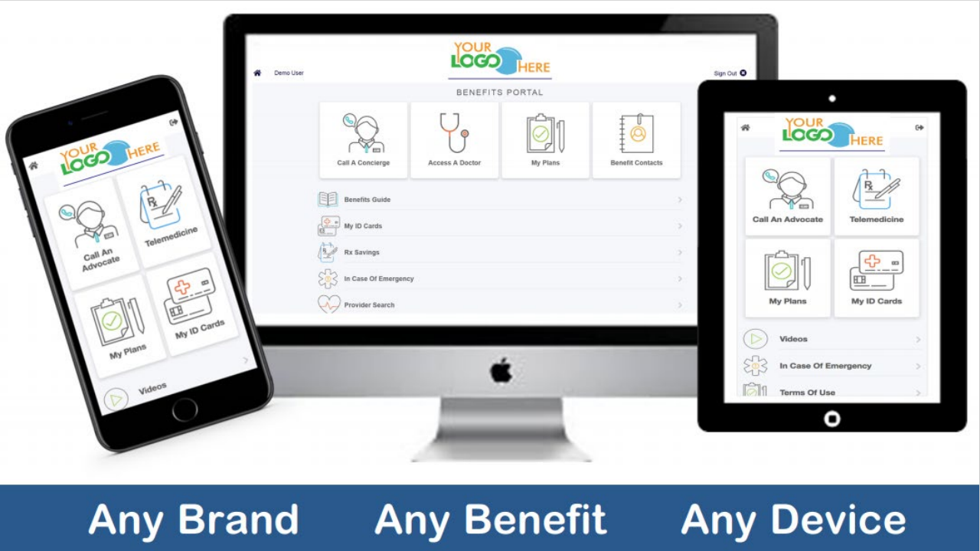

Slide 22
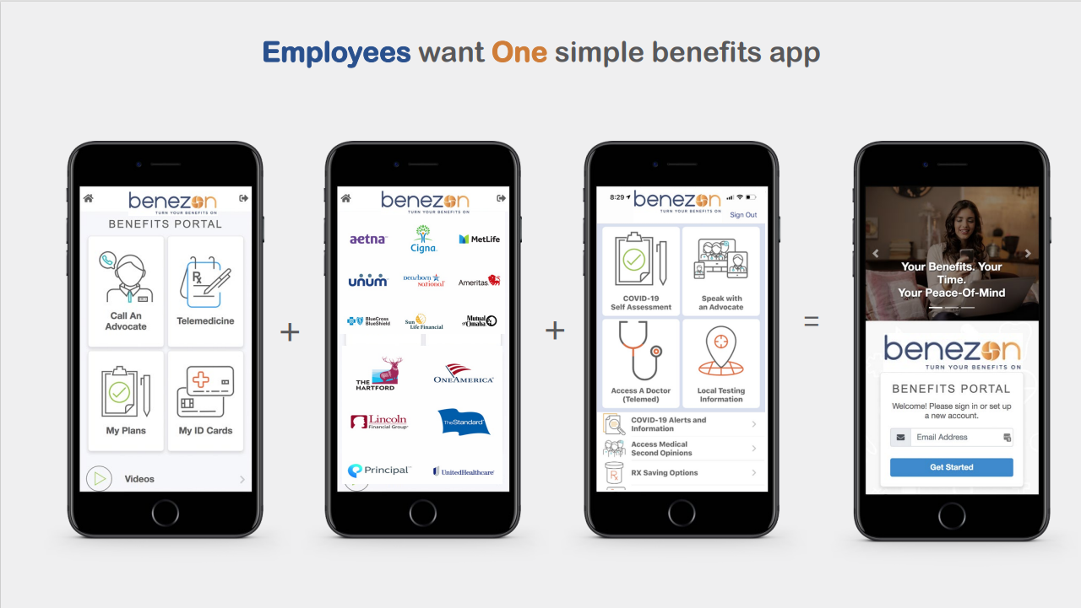

Slide 24
QUESTIONS?
MY MOM SAYS THE ONLY STUPID QUESTION IS THE ONE NEVER ASKED

Slide 25
PARTING SHOTS
If you only do 1 thing…

Slide 26
(855) 702-8300
Frank Mengert – Founder & CEO
(203) 645 -8458
frank@getebm.com

Slide 27
Eric Silverman - Founder
(443) 676 – 0340
eric@voluntarydisruption.com

Slide 28
Julian Lago – President & Co-Founder
(800) 943 – 1801 ext. 201 | (561) 262 – 4499
julian@benezon.com

Slide 29
TRANSPARENT HEALTH BENEFITS
LESTER J MORALES
Founder & CEO, Next Impact
Creator of Transparent Health Benefits
lester.morales@nextimpactllc.com
(813) 784-1519
SAVE THE DATE
10/28 = Next Employer Facing Webinar
Immediate Impact: 3 strategies that can make raising a deductible a GOOD THING for an employee or their family member
LIVE WORKSHOP: The NEW Workforce with Engagement & Communication
29

Slide 30
Thank You
CHANGE STARTS WITH YOU

