Slide 1
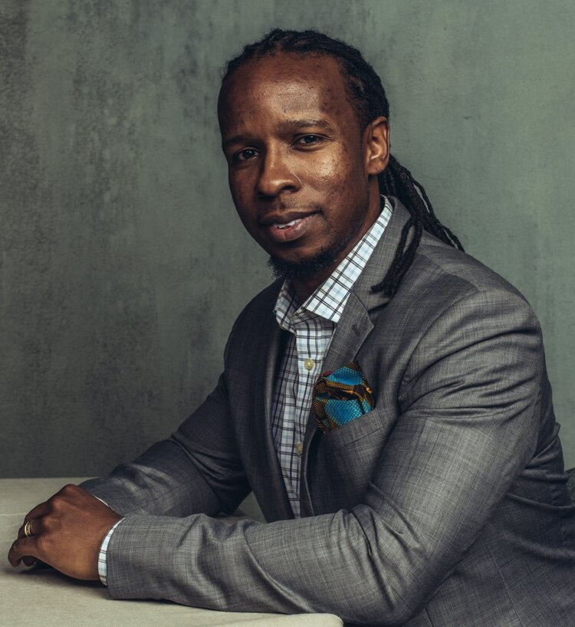
Our School is Participating
SPECIAL PROGRAM FOR AISNE MEMBER SCHOOLS
Wednesday, March 3, 2021
Go Beyond an Awareness of Racism
Contribute to the Formation of a Truly Just and Equitable Society
A Webinar Talk by #1 New York Times Best-Selling Author
Ibram X. Kendi
Followed by Member-Facilitated AISNE Community Conversations
Register Here: http://bit.ly/AISNEDrKendi
This event and registration are for adult community members of AISNE member schools who have purchased a community access package for this event.
Faculty | Staff | Administrators | Board Members / Trustees | Current Parents/Guardians

