Slide 1
SHARE911 REFERENCE GUIDE

Slide 2
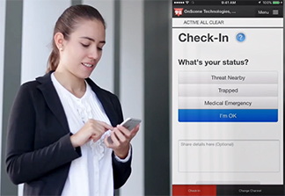
What is Share911
Share911 is the first platform purpose-built to privately and securely connect everyone involved in any kind of emergency; employees, administrators and public safety personnel, to share information needed to make better decisions and respond faster.
From the everyday to the unimaginable, whether people are being threatened or people are trapped due to a fire, Share911 can help.

Slide 3
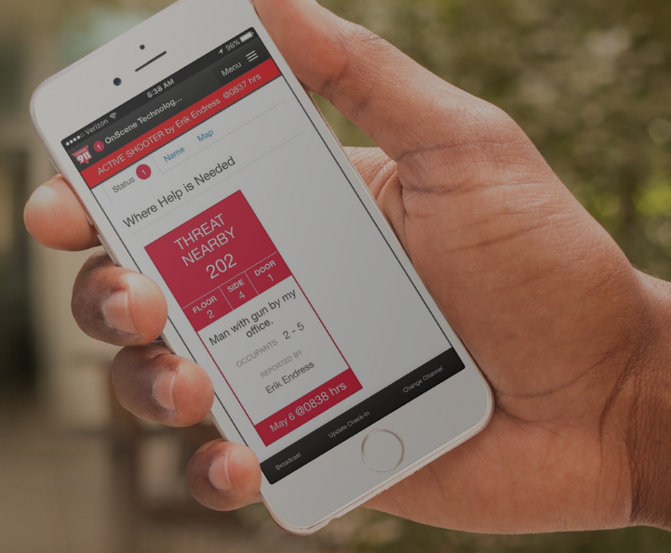
Share911 alerts everyone at the same time
When an emergency is happening, Share911 allows building staff to simultaneously alert employees, administrators and public safety personnel, from wherever they are, right from their mobile device or computer, letting everyone know that an emergency is happening and what they should do in response.

Slide 4
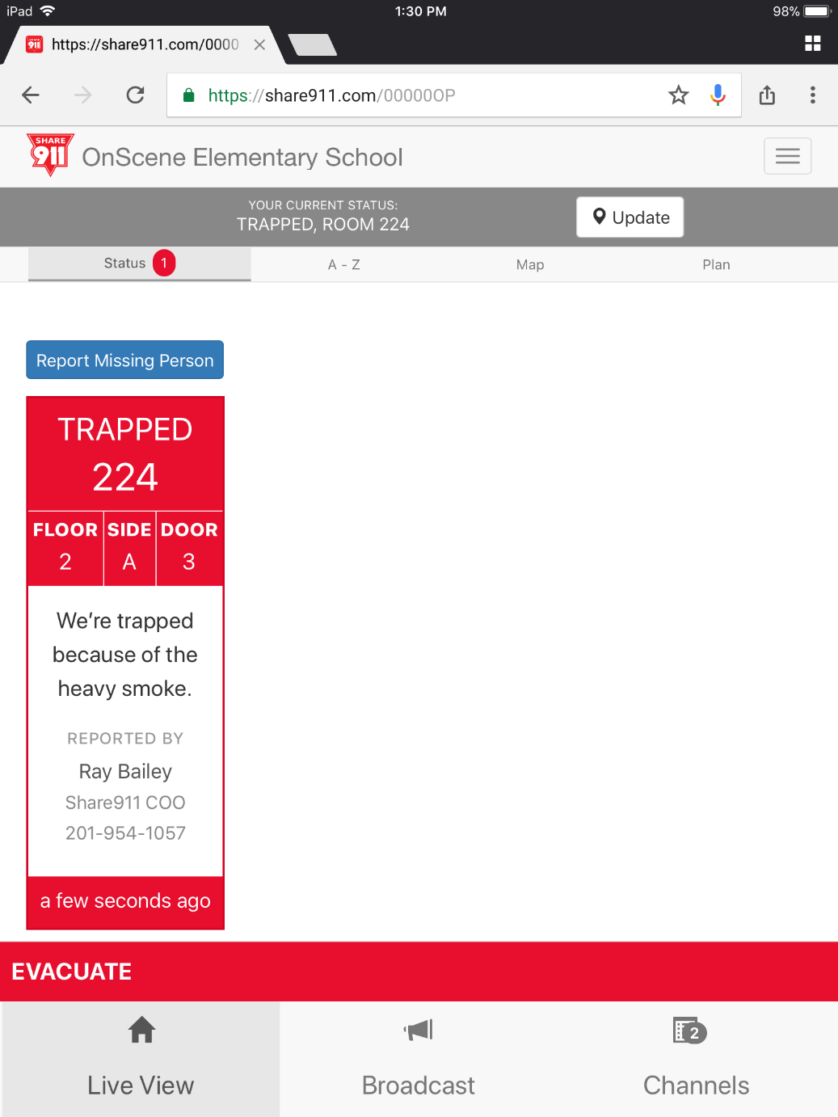
Everyone sees the information they need
Share911 makes it easy for everyone to see the information they need - where help is needed, what’s happening around them and who is unaccounted for. Whether you’re a police officer looking for a threat or you’re a firefighter trying to rescue people trapped under a pile of debris, Share911 puts the information needed at your fingertips.
Share911 enables first responders, administrators and incident commanders to stay informed of what's happening during an emergency. All in real-time and on one platform.

Slide 5
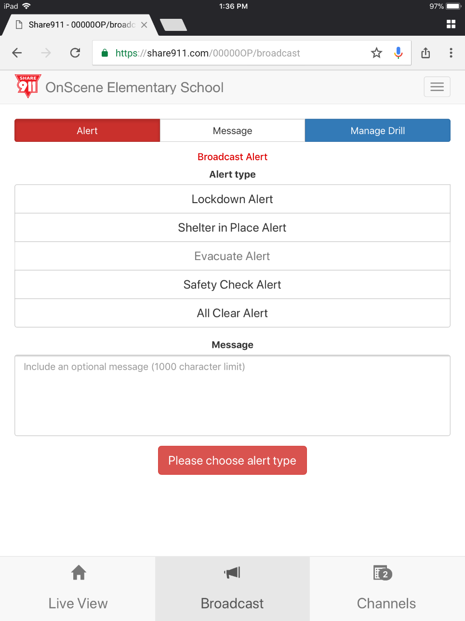
Share911 Permissions
Everything on the Share911 is permission based.
Because Share911 is so powerful, permissions are based on employees roles and responsibilities.
All employees can access Share911, receive alerts, check-in with their status and receive updates.
The ability to Broadcast Alerts, Messages and Manage Drills may be restricted to supervisors and administrators. You’ll know if you have that permission if you see any of the buttons here.

Slide 6
Joining Your Share911 Channel
You’ll receive an email invite from Share911 with an “Activate Now” link.
After you click the activation link you can complete your profile.

Slide 7
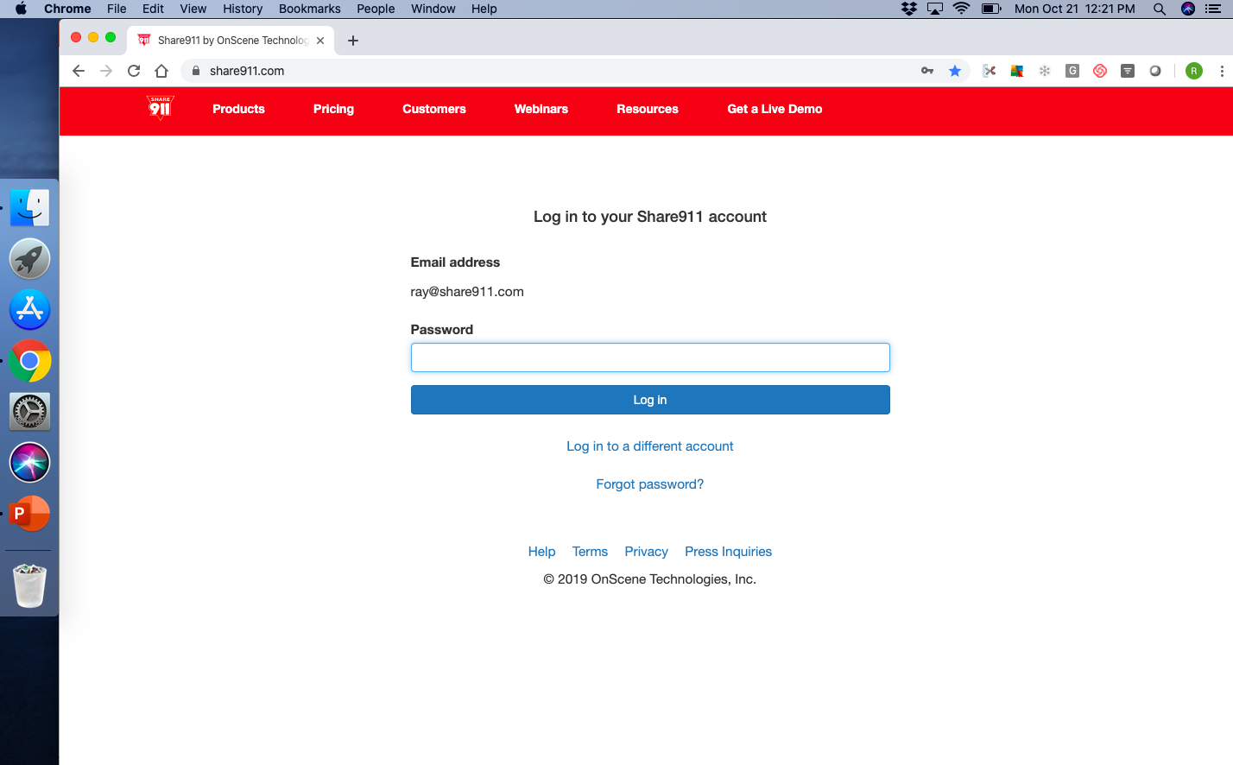
Accessing Share911
Share911 was originally built as a web-application. This means that you do not have to use a cell-phone to access Share911 – You just need something that connects to the internet; laptop, computer or tablet.
However, if you wish to use your mobile device you can download the mobile app from Apple ‘s App Store or Google Play.
To sign-in from all devices, simply go to your web browser and type in www.share911.com in the URL box. If you’re using the mobile app just click the icon on your device.
Steps to sign in:
Type www.share911.com into your browser
Enter your email address
Enter the password that you created when you set up your account.

Slide 8
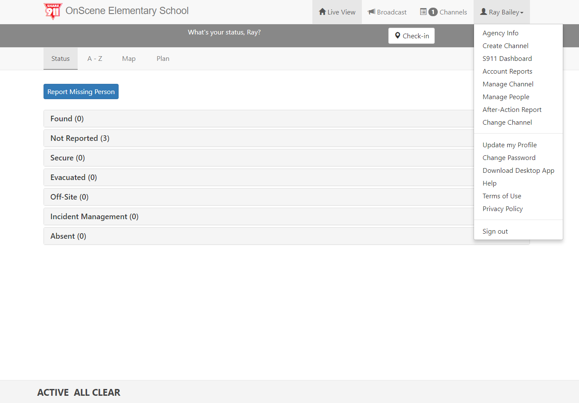
Updating Your Profile and Password
You should update your profile anytime that you change:
Your Name
Email address
Position
Mobile number
To Update your profile select your name or menu.
Select Update my Profile. After updating your profile remember to click “save” when done.

Slide 9
Desktop Notifications
You can chose to receive Desktop Alerts by downloading the desktop application*
You can easily do that by clicking on your name in the right corner, then Download Desktop App. From there, just follow the prompts.
The desktop app will keep you logged in and will run in the background. Anytime there’s an emergency you’ll receive an alert!
*Please check with your IT department to make sure that you have permission to download applications

Slide 10
Share911 Alerts on Mobile Devices
Share911 has two methods of sending alerts to mobile devices:
Text Alerts. You must enter your mobile number in your profile to receive text alerts.
Push notifications. You must download the mobile app and accept push notifications.
During an emergency you can click on the blue link in the text message or on the push notification banner. This will allow to quickly check-in during an emergency.

Slide 11
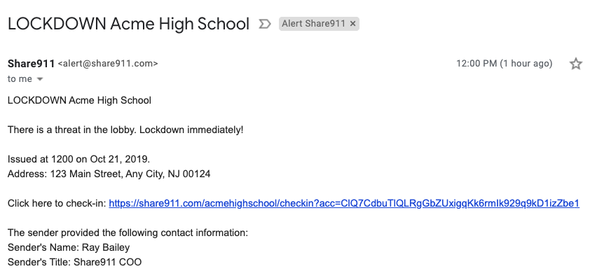
Alert Emails from Share911
While emails were never intended for emergency communications we will still send you an email as another method of notification. You should consider the mobile and desk top alerts as your primary method of being alerted.
Nick Camera

Slide 12
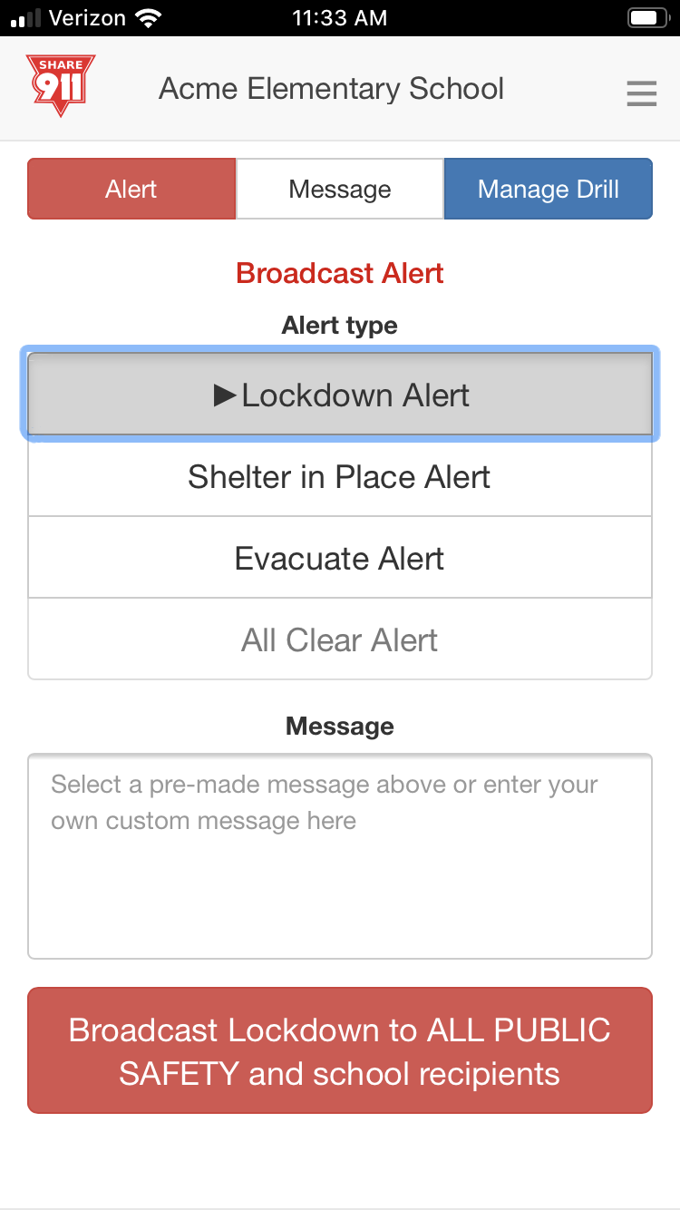
Broadcast an Alert
When you Broadcast an Alert, everyone on that Channel can recieve the Alert as a text, push notification, email and desktop pop-up.
Select Broadcast and Alert
Select an Alert Type
Type a message (optional)
Click this button to Broadcast an Alert

Slide 13
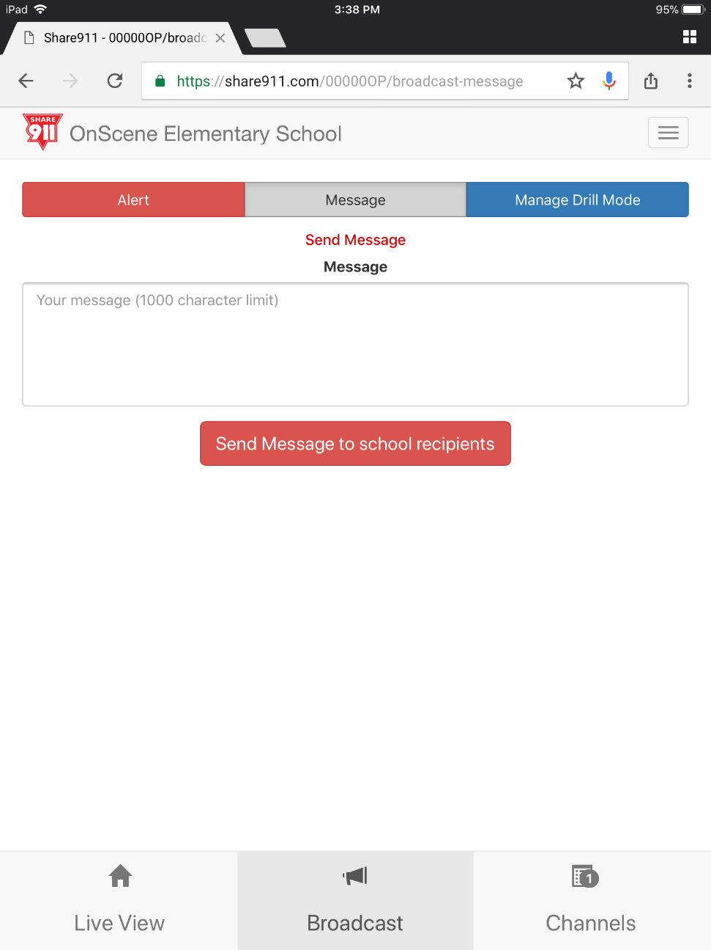
Send a Message
The Send a Message feature is a powerful way to connect very quickly to everyone on your channel or just to specific groups. Note: This feature is permission based and assigned by your system administrator.
Select Message on the Broadcast page
Type your message
Click Send Message

Slide 14
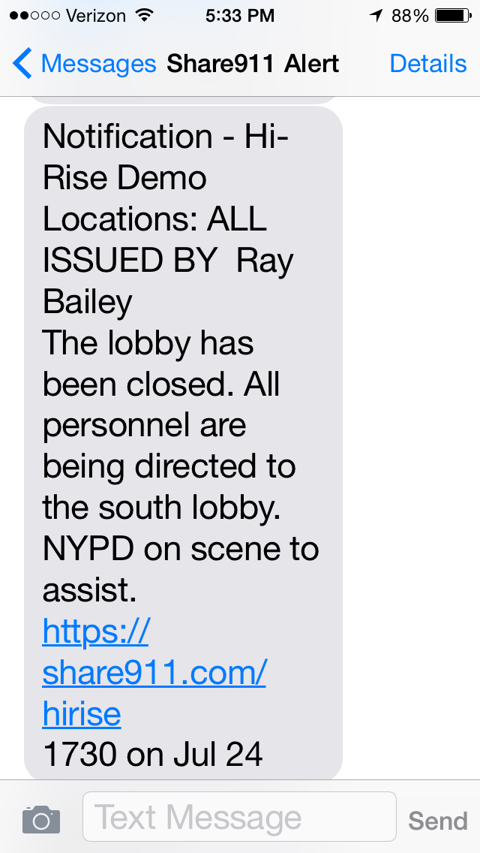
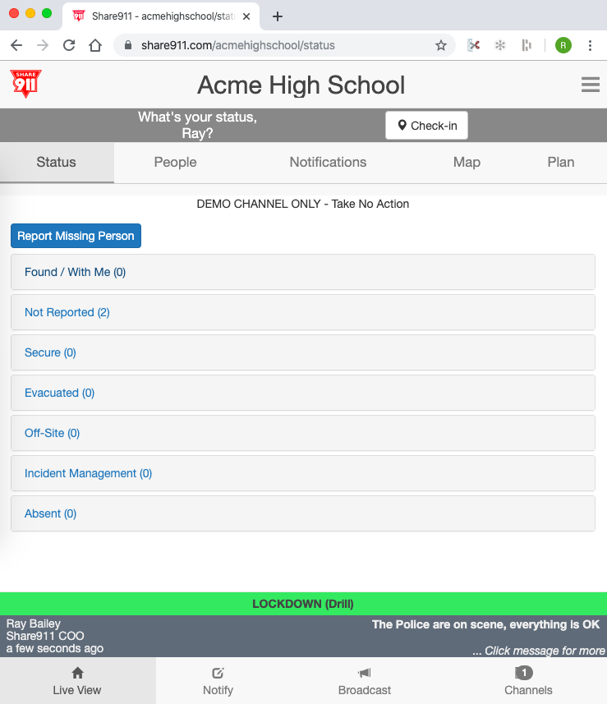
Messages are received via text message and can be viewed in the status bar.
Message are received as a text message.
Message listed in status bar.
Click on the message in the status bar to see the all messages in this incident.

Slide 15
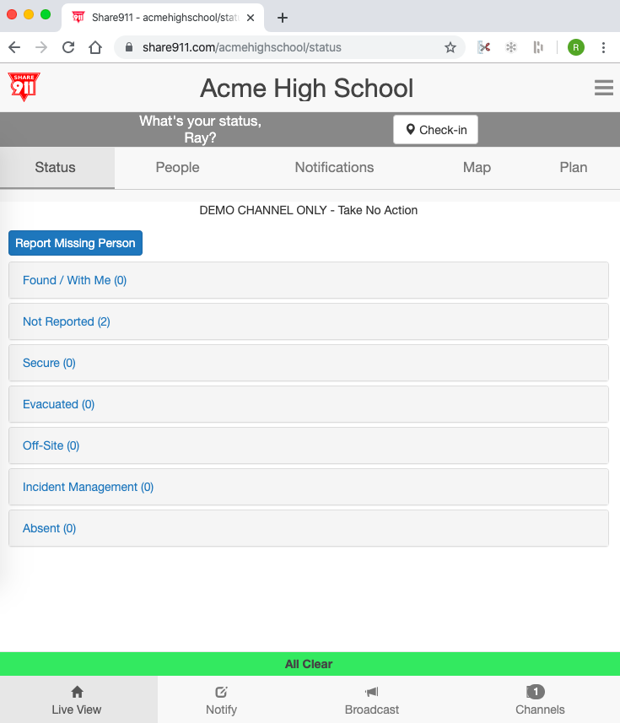
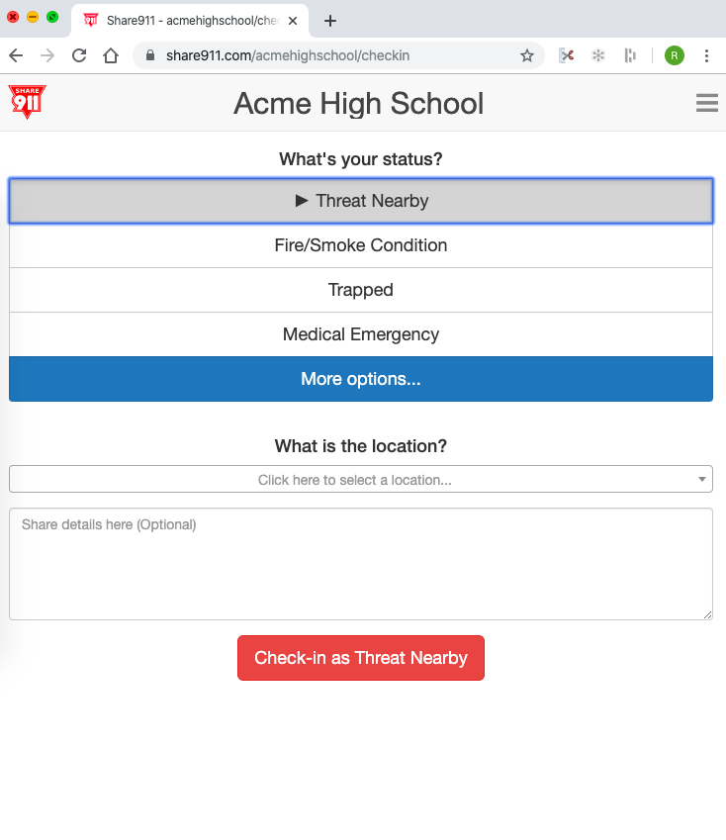
Check-In
Once an alert has been received you must take the action in the Alert and get safe!
Once it is safe to do so, Check-in and share your status.
Share your status by checking in
Select your status
Select your location
Enter any details that will those responding to your emergency
Submit your Check-in
When you check in a high priority status, like Threat-Nearby, an emergency notification is sent to users that have Emergency Check-in Notifications permission turned on.

Slide 16
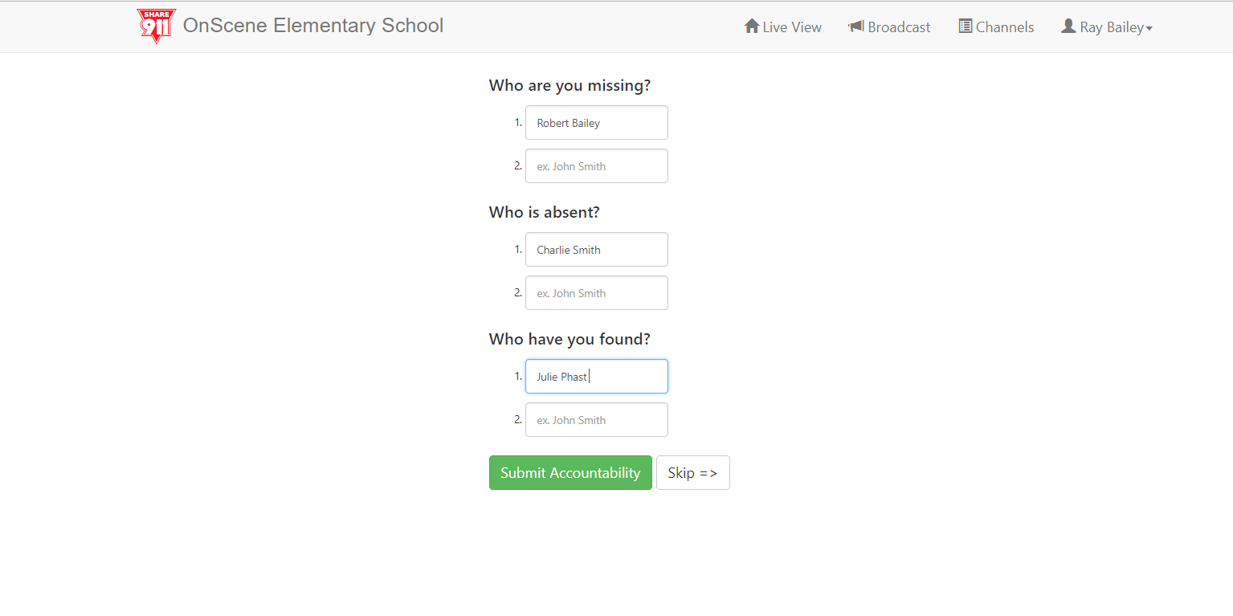
Report Accountability Accounting for Missing and Found Students
After you check-in, you’ll account for students here on Report accountability.
Enter one student at a time and include the student’s first and last name.
If you took a student with you as you left the building, or pulled a student into your classroom, you have “found” that student.
If you don’t have students missing or you haven’t found a student click “Skip”

Slide 17
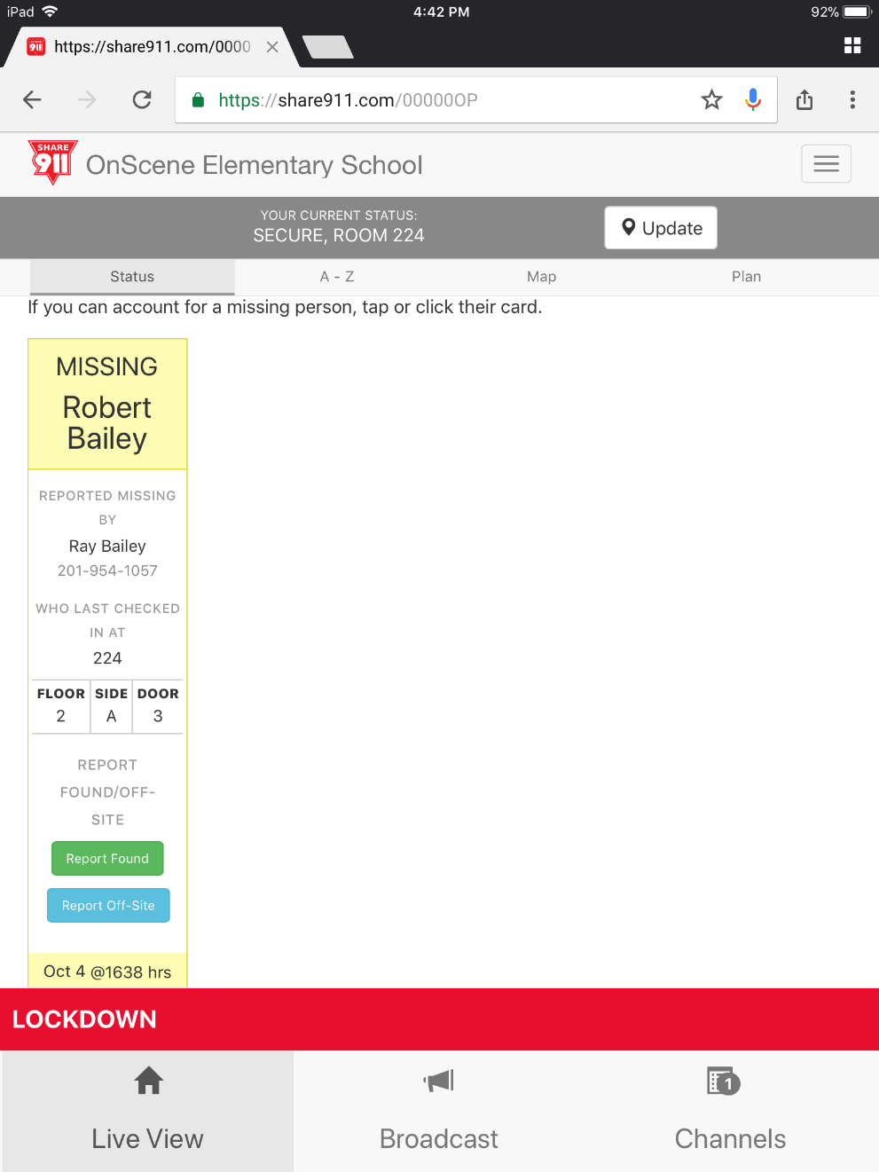
Report Accountability Accounting for Missing and Found Students
Students that have been reported missing, absent or found appear on Live View.
Missing students appear at the top of Live View.
If you have a missing student with you, you can tap or click the card and select Report Found. The card will update in real time and move to the “Found” category.

Slide 18
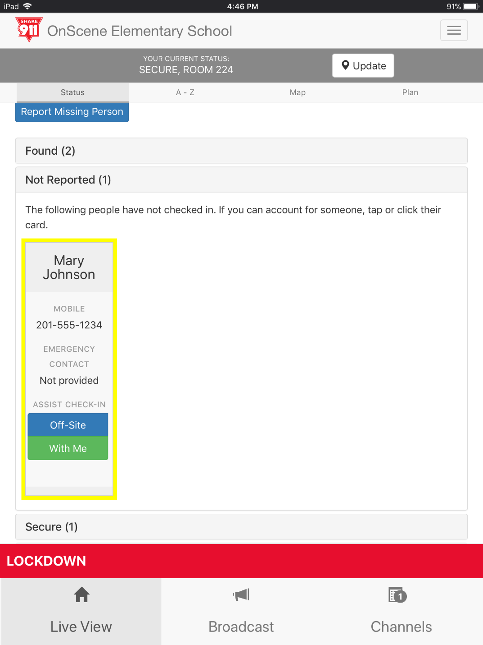
Accounting for Staff that have “Not Reported”
After accounting for students, you should help account for other staff members by clicking “Not Reported”
If a staff member is confirmed not in the building, indicate that they are off site.
If the staff member is with you, indicate that they are with you. Their status will be the same as you. If you’re secure they will also appear as secure.

Slide 19
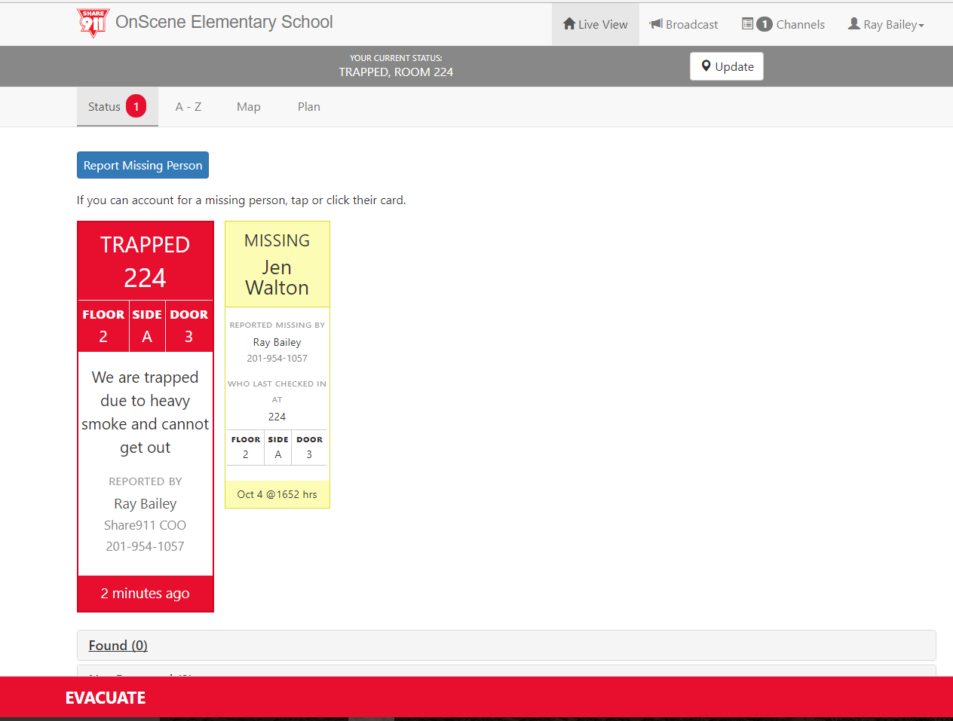
Live View
Live View is a real-time dashboard that provides critical situational awareness for people responding to emergencies.
Live View Shows you:
The type of emergency.
Where help is needed.
Specific information from the people in need of help.
Who needs help.
Contact information. If you have permission and see the mobile number you can press and hold the number for options.
Shows how many people have Checked-In that need assistance.

Slide 20
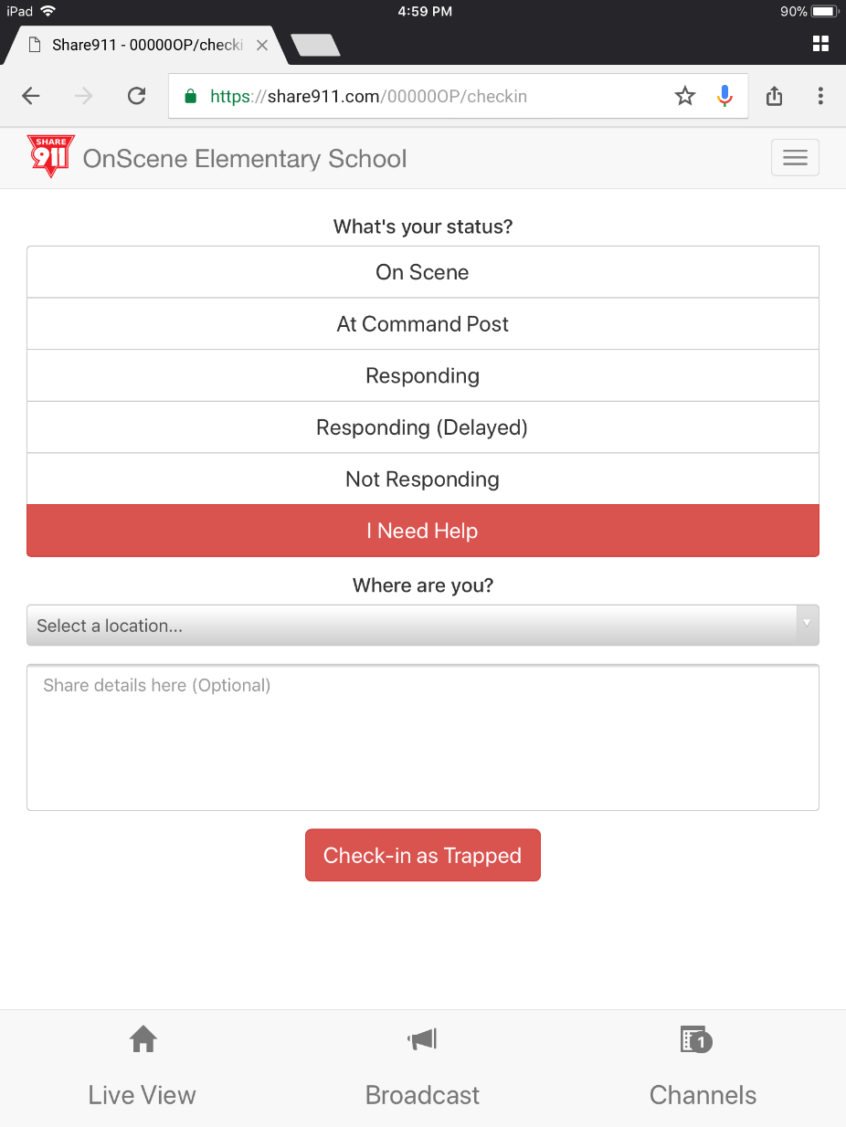
Critical Operations Staff
If you are assigned as a member of the Critical Operations Staff, you have a special role during an emergency.
When you submit your check‐in status, everyone involved will know your status. It is advisable to supply a message if you are away from the scene or need help.
Your submission will be visible to all on the “Live View” page under “Incident Management”
Select your status
If you need help, click here
Select your location
Write a message
Submit your Check-In

Slide 21
After-Action Report
After-Action Reports (AAR’s) provide a report of everything that happened during your incident. To access the AAR, click on you name or menu and select After-Action Report. You’ll be prompted to select a date.
To print the AAR, use you browsers print feature.
Like most features on Share911, AAR’s are only visible if you have permission to generate and view the report.

Slide 22
Conclusion
Share911 is a simple, yet powerful web based platform that can provide real‐time information to those who need it during an emergency.
Through the use of Share911, staff can react quicker to an emergency, critical operations staff can make informed decisions much faster, and first responders can identify information to save lives.
IMPORTANT: Although your Share911 channel says Drill – You will send alerts if you hit any of the alerts or check-in options. Please wait until an official drill before hitting any buttons.
Need additional assistance? Click here: Share911 Support
Stay Safe,
Share911

